Slide 1

Blended Intensive Programmes
Good Practices & Challenges

Slide 2
agenda
Set the stage
Identify common challenges
How would you do it?
How AUTh has dealt with them?
Key take-aways

Slide 3


Do you have any BIP experience?

Slide 4
Bip Description
At least 3 HEIs from 3 programme countries
Minimum 10 learners
Award of at least 3 ECTS (in case of learners being BA or MA students)

Slide 5

Challenges

Slide 6
challenges
Centralization vs De-centralization
Funding of short-term mobilities
Management of organizational support grant in case of a BIP coordination
Timeline for joining/organizing a BIP

Slide 7
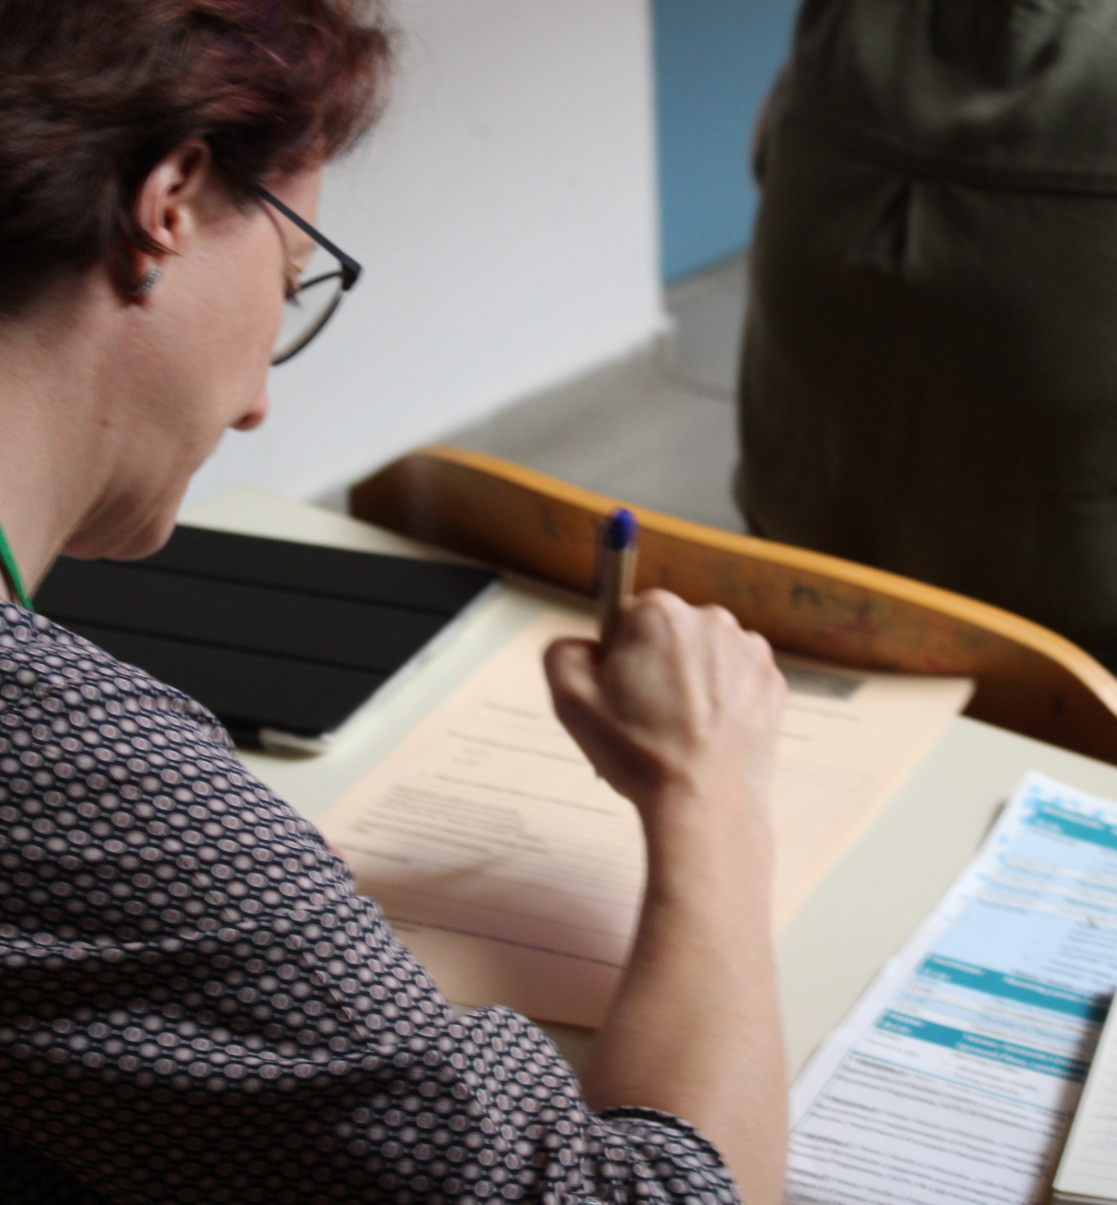
How would you do it?
Scenario: 1 Erasmus Office, 4 Faculties, 11 Schools
3 challenges
  Procedures
  Funding
  Dissemination and engagement

Slide 8
solutions
Decentralization of the academic and logistics part of the participation/organization (BIP coordinator)
Centralization of financial issues (funding of mobilities/management of OS grant)
Introduction of a maximum number per BIP and case-by-case approval of additional mobilities

Slide 9
solutions
Submission of budget proposal from BIP coordinator
Introduction of milestone dates, being flexible in requests for participation

Slide 10
Key takeaways

Slide 11
Thank you
Nikos Liolios,
Erasmus Officer,
Department of European Educational Programs
lioliosn@auth.gr
&
Theodora Zygouri,
Erasmus Officer,
Department of European Educational Programs
tzygouri@auth.gr

