Slide 1
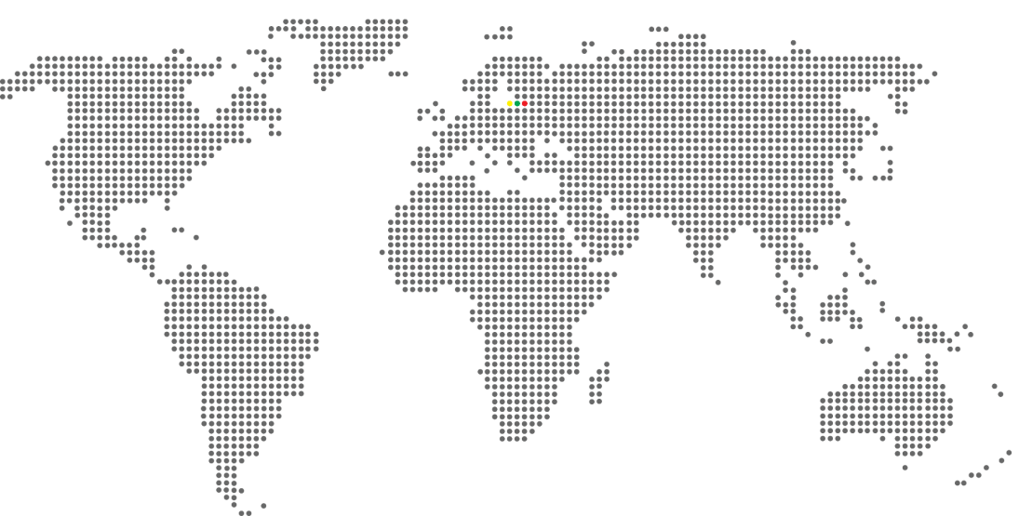
HIGHER EDUCATION IN LITHUANIA: Academic and Cultural Excellence at VMU

Slide 2
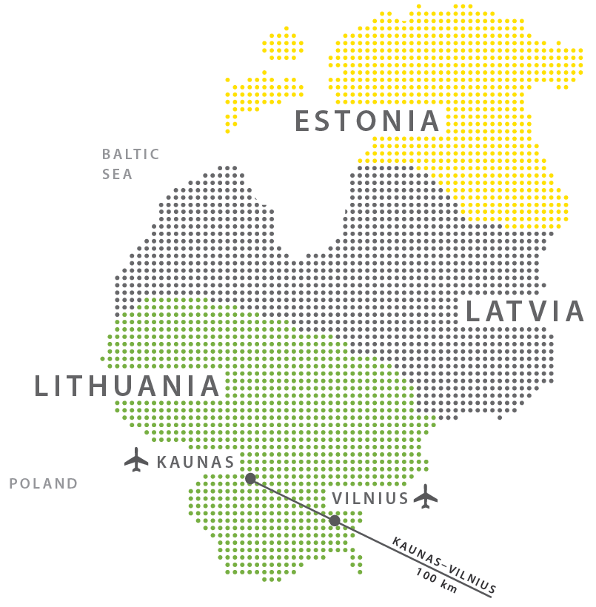
LT: Location
Located in Northern Europe
Is 1 of 3 Baltic states
On the southeastern shore of the Baltic Sea
A MEMBER OF:

Slide 3
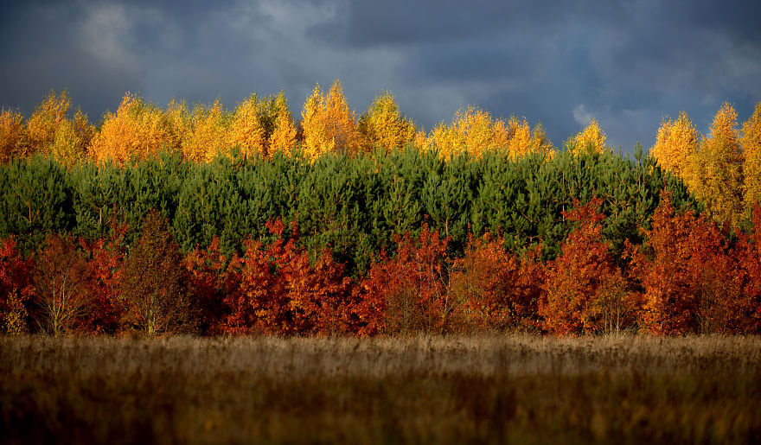
LT: General Facts
Republic of Lithuania
Vilnius
~3 mln. (83 % Lithuanians)
Lithuanian
Euro (€)
Roman Catholic
Vilnius, Kaunas, Klaipėda,
Šiauliai
OFFICIAL NAME
CAPITAL
POPULATION
LANGUAGE
CURRENCY
RELIGION
THE LARGEST CITIES
EEST
GMT + 2
GMT + 3 Daylight Saving Time

Slide 4
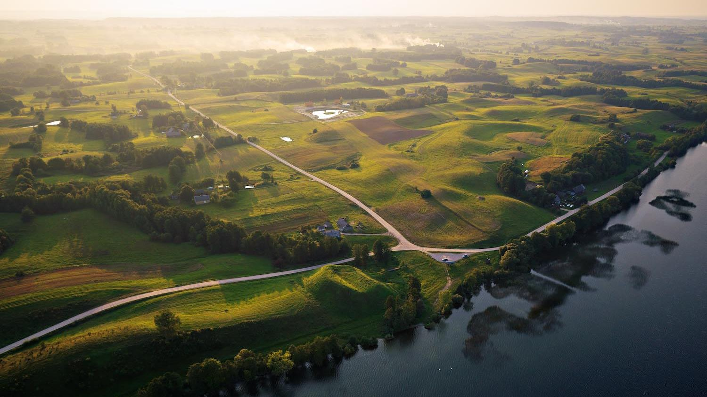
Notes:
Is a member of NATO, European Union,

Slide 5
LT: Interesting Facts
Fastest public
Wi-Fi in the world
(15,4 Mbps)
The highest number of hot air balloons per person in the world
It’s the oldest living
Indo-European language
in the world
Boredpanda.com was launched and is maintained by Lithuanians
Basketball here is as a second religion
Anthony Kiedis
is ¼ Lithuanian

Slide 6
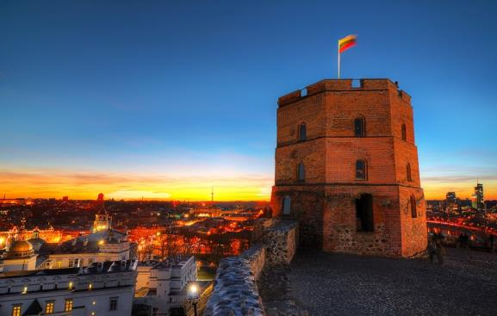
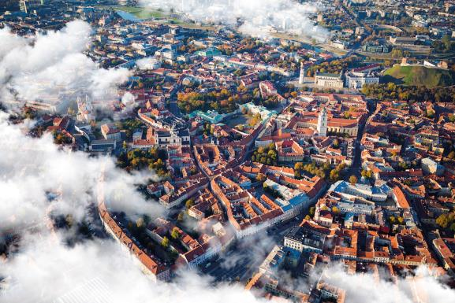
LT: Vilnius
Capital and the biggest city
~523 K inhabitants
Old town protected by UNESCO since 1992
3rd Lonely Planet destination for 2015
Multicultural city (~58 % Lithuanians)

Slide 7
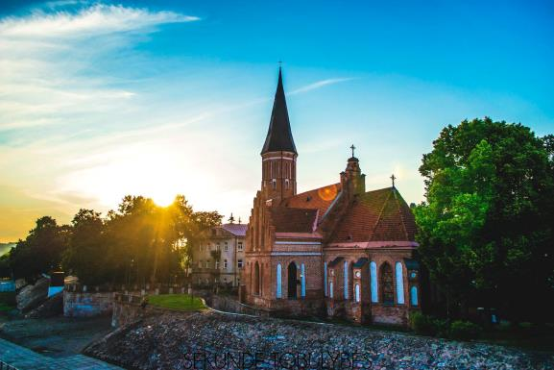
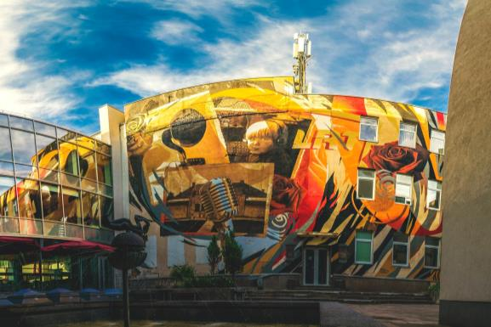
LT: Kaunas
Temporary capital of Lithuania
~301 K inhabitants
Highly appreciated interwar architecture
City of students (~50 K students each year)
Has longest pedestrian street in Eastern Europe
Located at the confluence of the rivers Neris and Nemunas

Slide 8
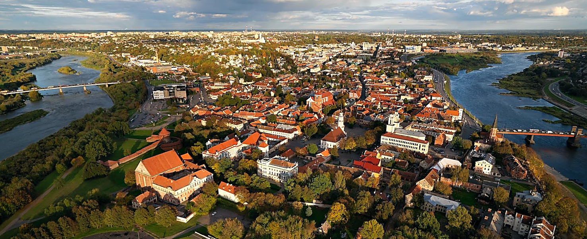
LT: Kaunas
Notes:
Video: www.youtube.com/watch?v=8NHD6UEtUhY

Slide 9
LT: Higher Education
Degree studies in EN
Academic roots reach XVI century
Use of ECTS system
Part of European Bologna process
Various mobility programmes
Various scholarships
So WHY
study in
Lithuania?
Notes:
Video: www.youtube.com/watch?v=j3VVGQ3Cg-c

Slide 10
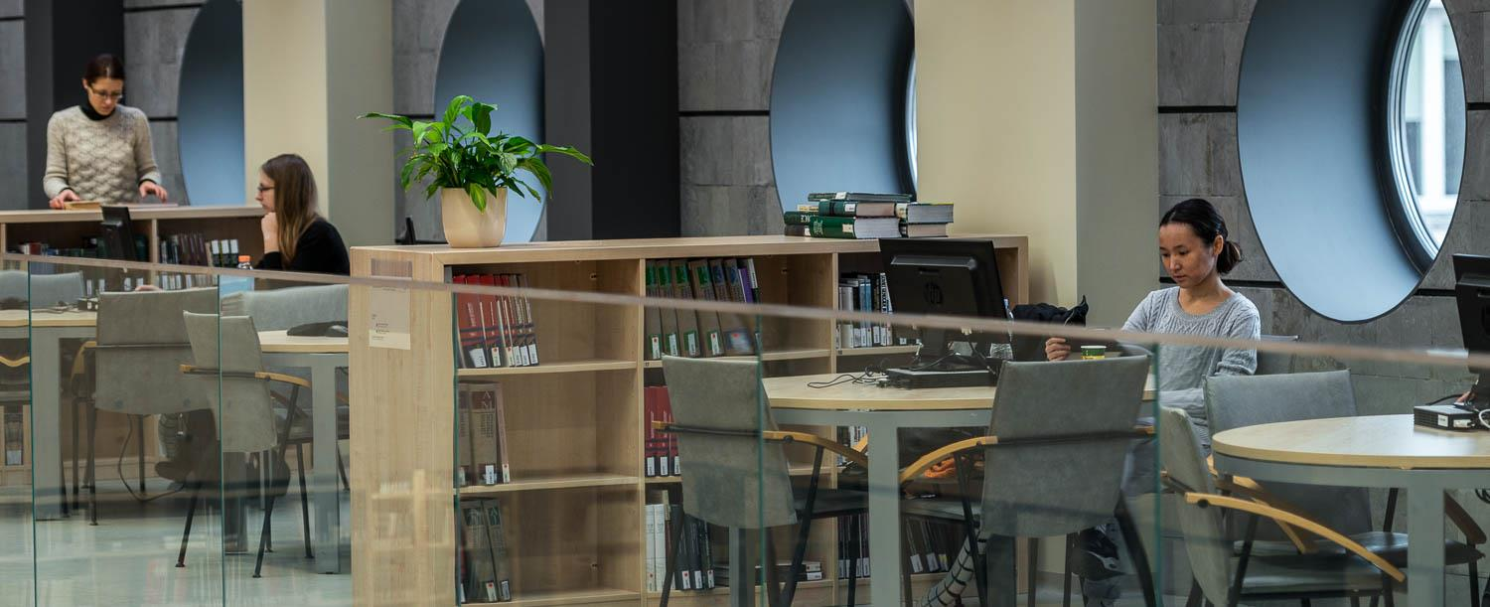
VMU: Vytautas Magnus University
Notes:
Video: www.youtube.com/watch?v=ST3Kv_7R3d4

Slide 11
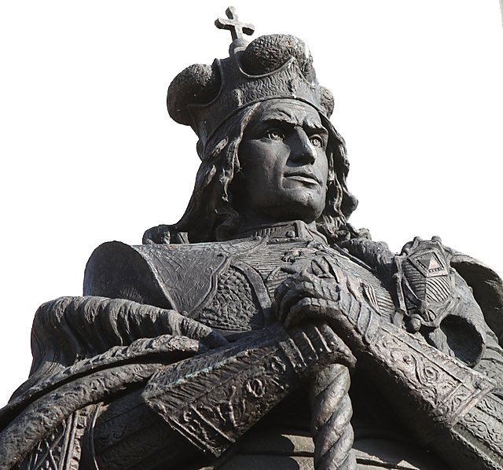
VMU: Vytautas the Great
Grand Duke of Lithuania
Ruled from 1392 to 1430
Brought the greatest military and political prosperity to the country
In 1410 won the Battle of Grünwald (Tannenberg) against Teutonic Order
During his reign the push eastward by the German Order was broken
Extended the state border all the way to the shores of the Black Sea
Notes:
11
Video: www.youtube.com/watch?v=Llqkhq2EQrY&t=2s

Slide 12
VMU: Timeline
1950
1989
1930
University was closed due to the historical reasons.
VMU was
re-established.
University of Lithuania was renamed to Vytautas Magnus University, commemorating 500 years of death of Vytautas Magnus.
1922
After reorganization of courses of Higher Learning, the University of Lithuania was established.
1920
Course of Higher Learning were established as a temporary substitute for a university.

Slide 13
VMU: In Numbers
Notes:
13

Slide 14
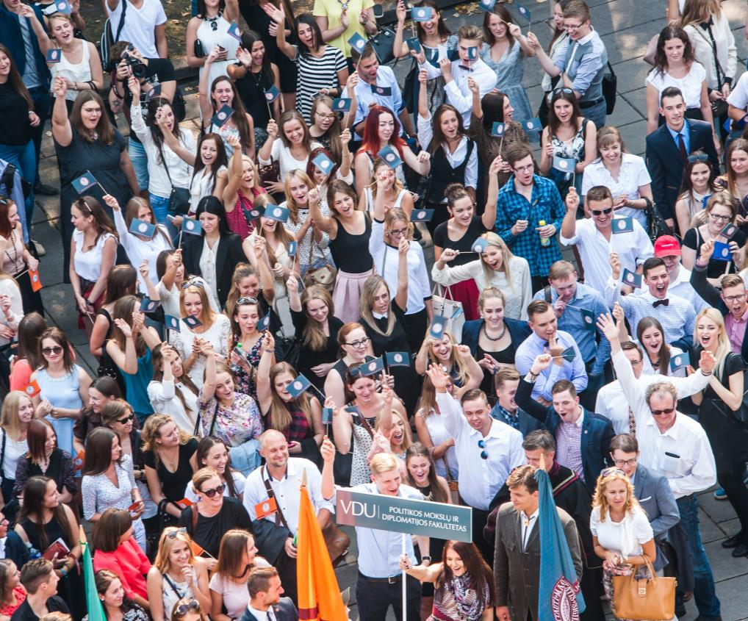
2
cities
10
faculties of:
Arts
Catholic Theology
Economics and Management
Humanities
Informatics
Law
Music Academy
Natural Sciences
Political Science and Diplomacy
Social Sciences with Institute of Social Welfare
Notes:
14

Slide 15
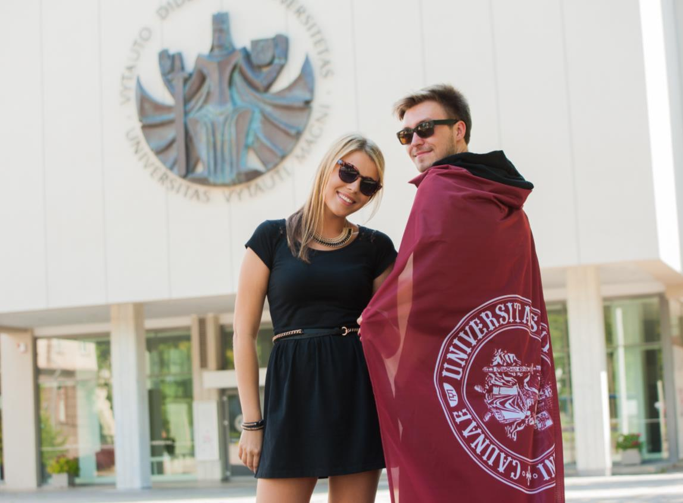
44
BA
49
MA
35%
programmes
in EN
Notes:
15

Slide 16
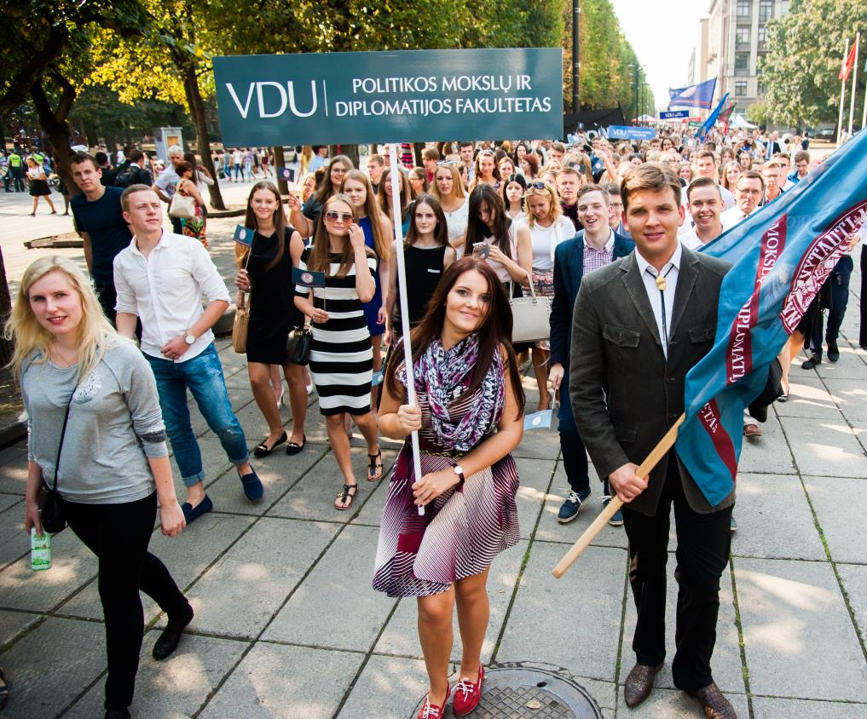
> 6 500
BA and MA
students
> 35 000
graduates
(since’89)
> 200
PhD students
Notes:
16

Slide 17
500+
courses
30
languages
18
PhD fields
Notes:
17

Slide 18
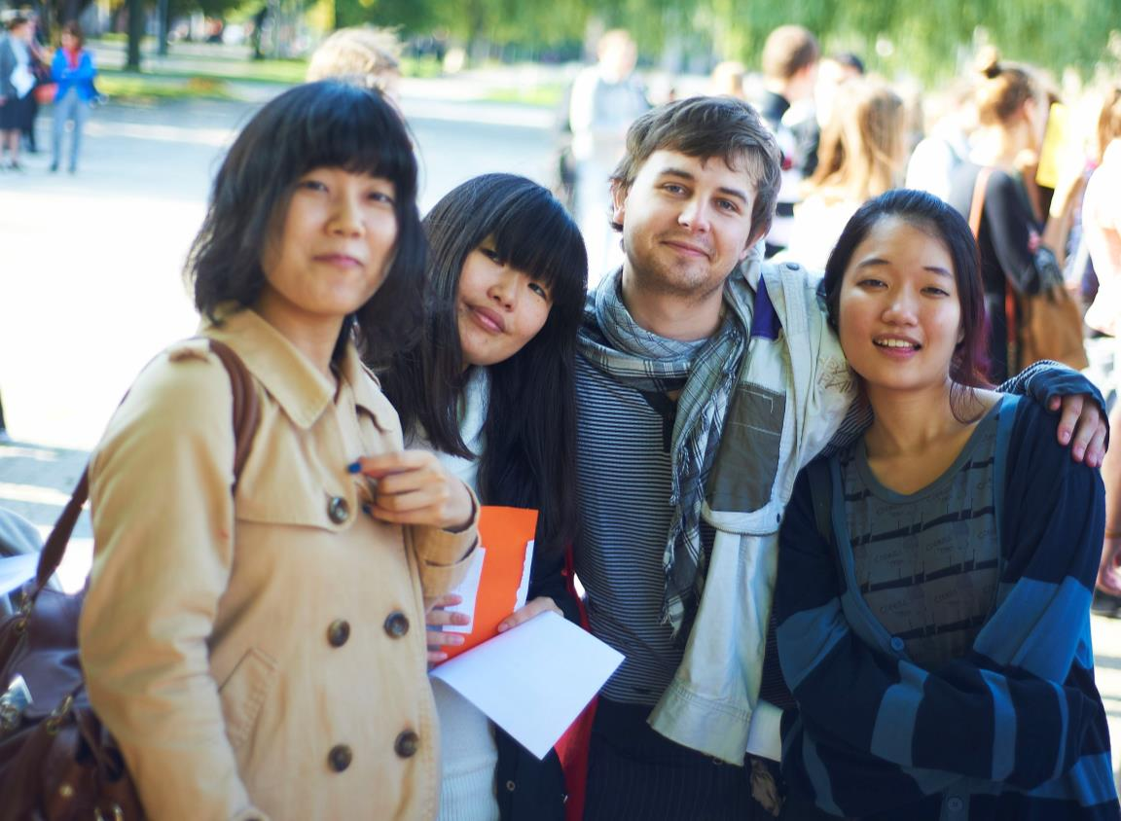
>700
int. students
each year
>290
Erasmus+ partners
>180
Bilateral
partners
Notes:
18

Slide 19
VMU: Study Programmes (Bachelor degree)
FACULTY OF POLITICAL SCIENCE AND DIPLOMACY
International Politics and Development Studies
World Politics and Economy
FACULTY OF ECONOMICS AND MANAGEMENT
European Economy and Finance
FACULTY OF INFORMATICS
Informatics Systems
FACULTY OF HUMANITIES
English Philology
FACULTY OF NATURAL SCIENCES
Biology
Biotechnology
Environmental Science and Ecology
FACULTY OF SOCIAL SCIENCES
Social Work
Society, Culture and Communication
FACULTY OF ARTS
Music Production

Slide 20
VMU: Study Programmes (Master degree)
FACULTY OF POLITICAL SCIENCE AND DIPLOMACY
Social and Political Critique
Diplomacy and International Relations
Diplomacy
Journalism and Media Industries
MIREES: Interdisciplinary Research and Studies on Eastern Europe (Joint Degree)
FACULTY OF ECONOMICS AND MANAGEMENT
International Economics (Double Diploma)
Marketing and International Commerce (Double Diploma)
Finance (Double Diploma)
FACULTY OF INFORMATICS
Applied Informatics
MUSIC ACADEMY
Performing Arts
FACULTY OF LAW
International Business Law
FACULTY OF NATURAL SCIENCES
Molecular Biology and Biotechnology
Applied Biotechnology
Environmental Management
FACULTY OF HUMANITIES
Sociolinguistics and Multilingualism (Joint Degree)
East Asia Region Studies
Migration Policy and History of Diasporas
FACULTY OF SOCIAL SCIENCES
Applied Sociology
Social Work
Educational Management
Social Anthropology

Slide 21
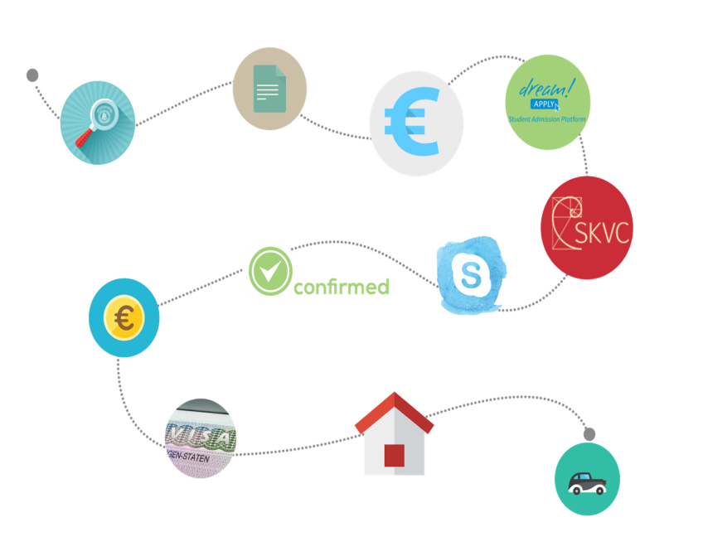
VMU: HOW TO Dream Apply?
STEP 1 – Choose study programme at VMU
STEP 2 – Pay the application fee
STEP 3 – Apply on-line
STEP 4 – Assess your education documents
STEP 5 – Get ready for an interview
STEP 6 – Get confirmation of admission
STEP 7 – Sign the study contract
STEP 8 – Pay the tuition fee
STEP 9 – Check information for visa
STEP 10 – Get original documents
STEP 11 – Make an appointment at Lithuanian Embassy
STEP 12 – Book VMU dormitory
STEP 13 – Arrange your arrival

Slide 22
VMU&LT: Scholarships
full-time Master degree studies
short-term Lithuanian (Baltic) studies
Lithuanian diaspora
Lithuanian language and culture summer course
GET TO
KNOW
MORE: www.smpf.lt/en
degree studies
exchange studies
Lithuanian diaspora
Ukrainian citizens
Lithuanian language and culture summer course
GET TO
KNOW
MORE:
www.vdu.lt/en

Slide 23
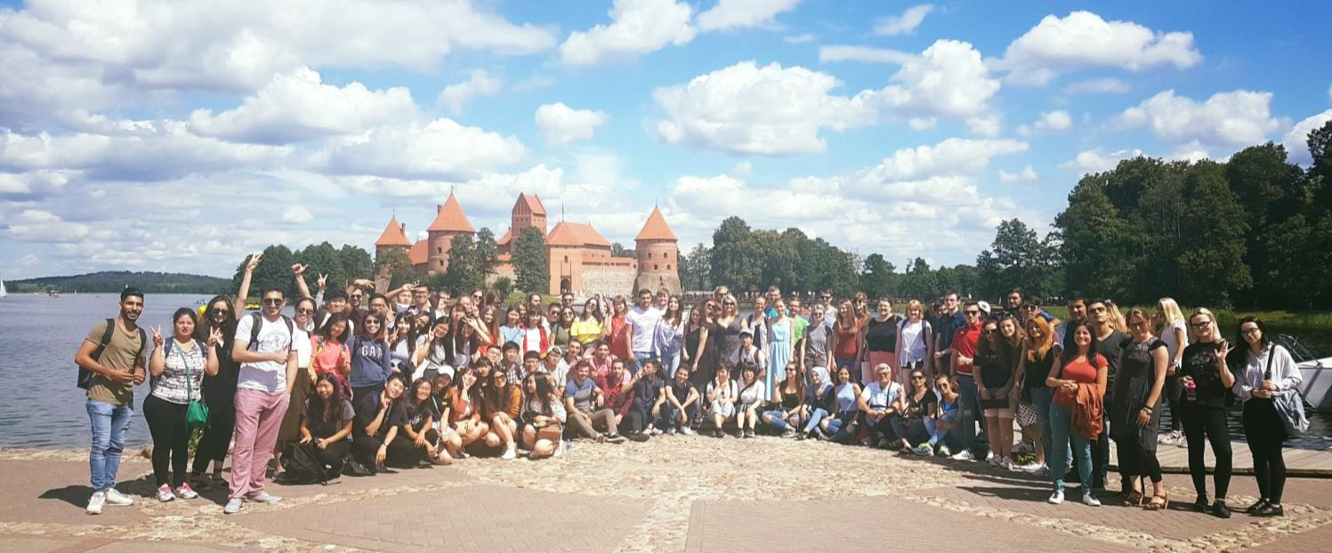
VMU: Baltic Summer University
Notes:
23

Slide 24
>25 academic organizations & clubs | Students’ Council |
Sport Centre | Theatre

Slide 25
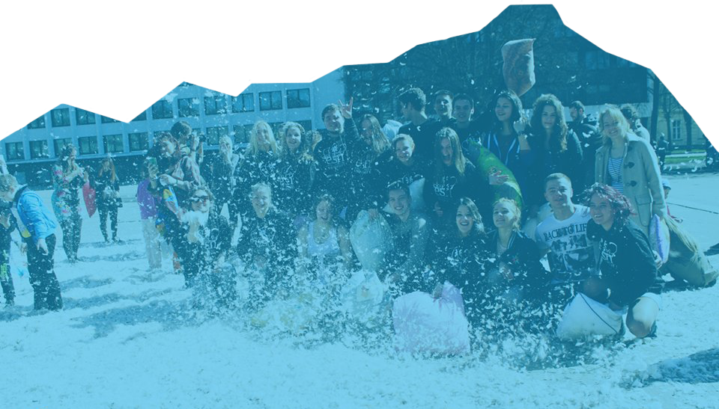
ESN VMU and VMU Mentors
Think different, think ESN VMU!
guiding I caring I entertaining I enriching
Notes:
A mentor is a student of Vytautas Magnus University who has international and intercultural experience and will be there to help foreign students in all aspects.
A mentor:
Meets foreign student in the airport or bus/train station and accompany him/her to the living place;
Assists foreign student in orientating both at University and in Kaunas;
Helps foreign student in everyday matters & making new friends.

Slide 26
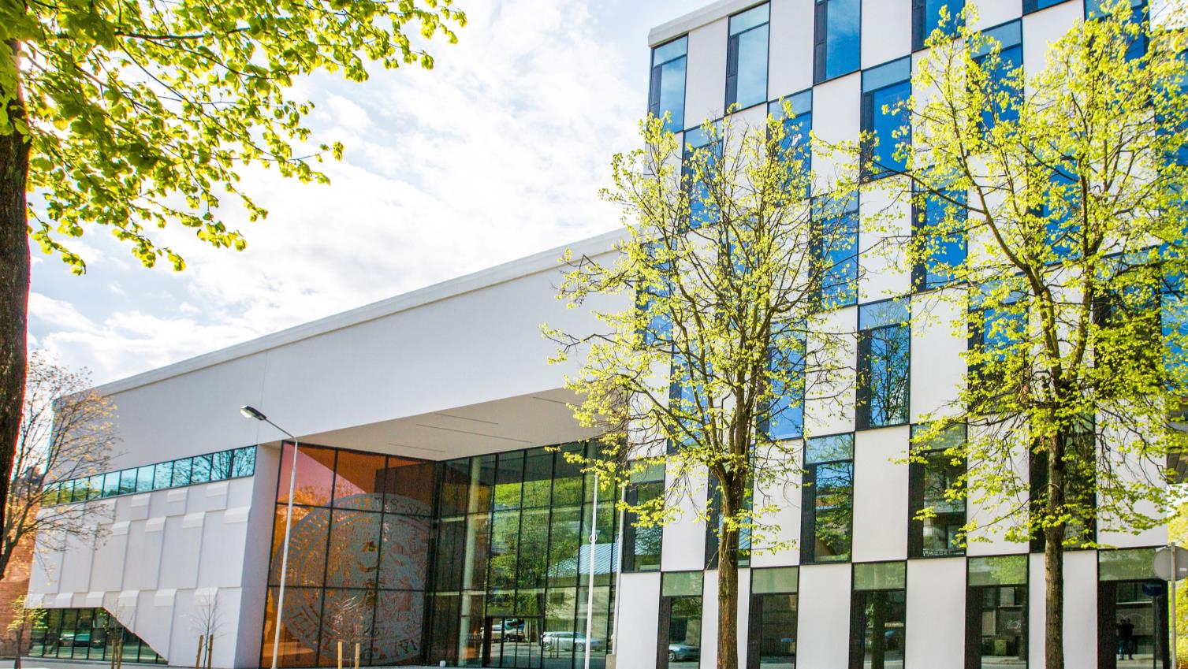
International Cooperation Department
Visiting address: V. Putvinskio g. 23, room 207-215
Phone: + 370 37 327 986
Email: international@vdu.lt
Website: www.vdu.lt/en
Facebook: VMU International

Slide 27
THANK YOU! ☺
Notes:
27

