Slide 1
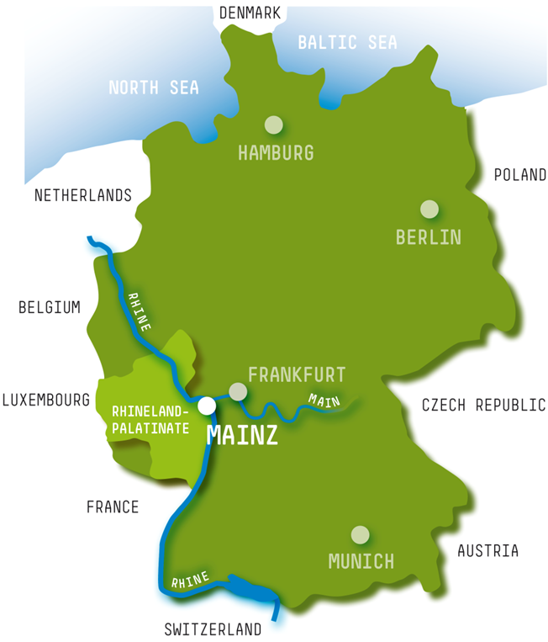
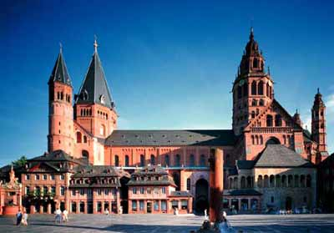
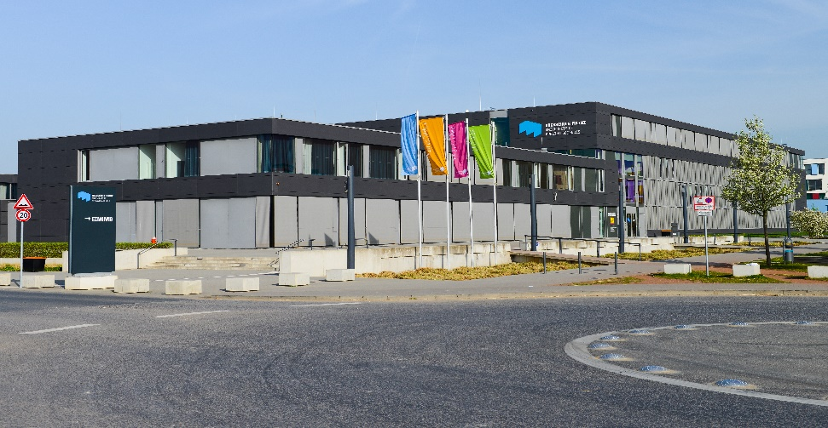
Welcome to Mainz University of Applied Sciences www.hs-mainz.de

Slide 2
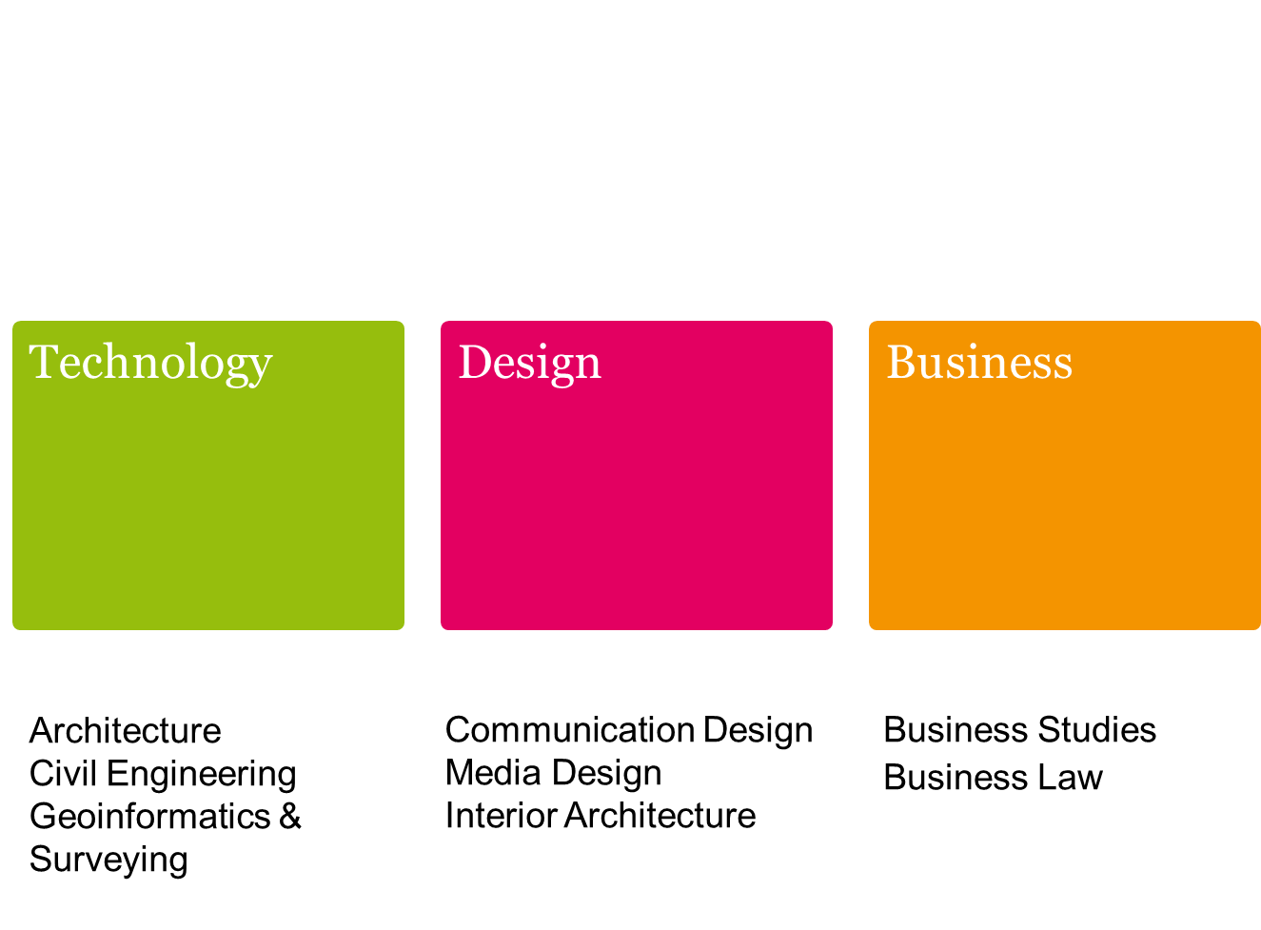
Hochschule Mainz – University of Applied Sciences
5,500 students at Hochschule Mainz
~ 3000 students
~ 60 professors,
~ 115 part time lecturers ~ 280 foreign students ~50 partner universities ~50-70 incoming/semester ~80-100 outgoing/semester
Information Systems

Slide 3
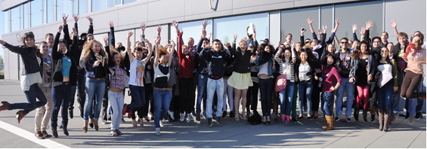
Study programme for Incoming Students
Induction Week
Handbook for International Students
Exchange students may choose their individual programme out of all listed courses (German and English)
We offer modules in English worth approx. 50 ECTS credit points ( 1st and 2nd cycle)
German Language and Culture (5 levels)
International Master Programmes

