Slide 1



EU actions for supporting Scholars @ Risk
The InspirEurope Project
Prof. Dr. Alexandros Triantafyllidis
Aristotle University of Thessaloniki
Chair of SAR Greece Section
“13th Erasmus Staff Training week ”, 15 October 2024

Slide 2
The SAR Network and the Inspireurope+ project
SAR Greece section formation
Supporting Researchers at Risk
Funding Opportunities

Slide 3




SCHOLARS AT RISK
An Introduction to the Network

Slide 4
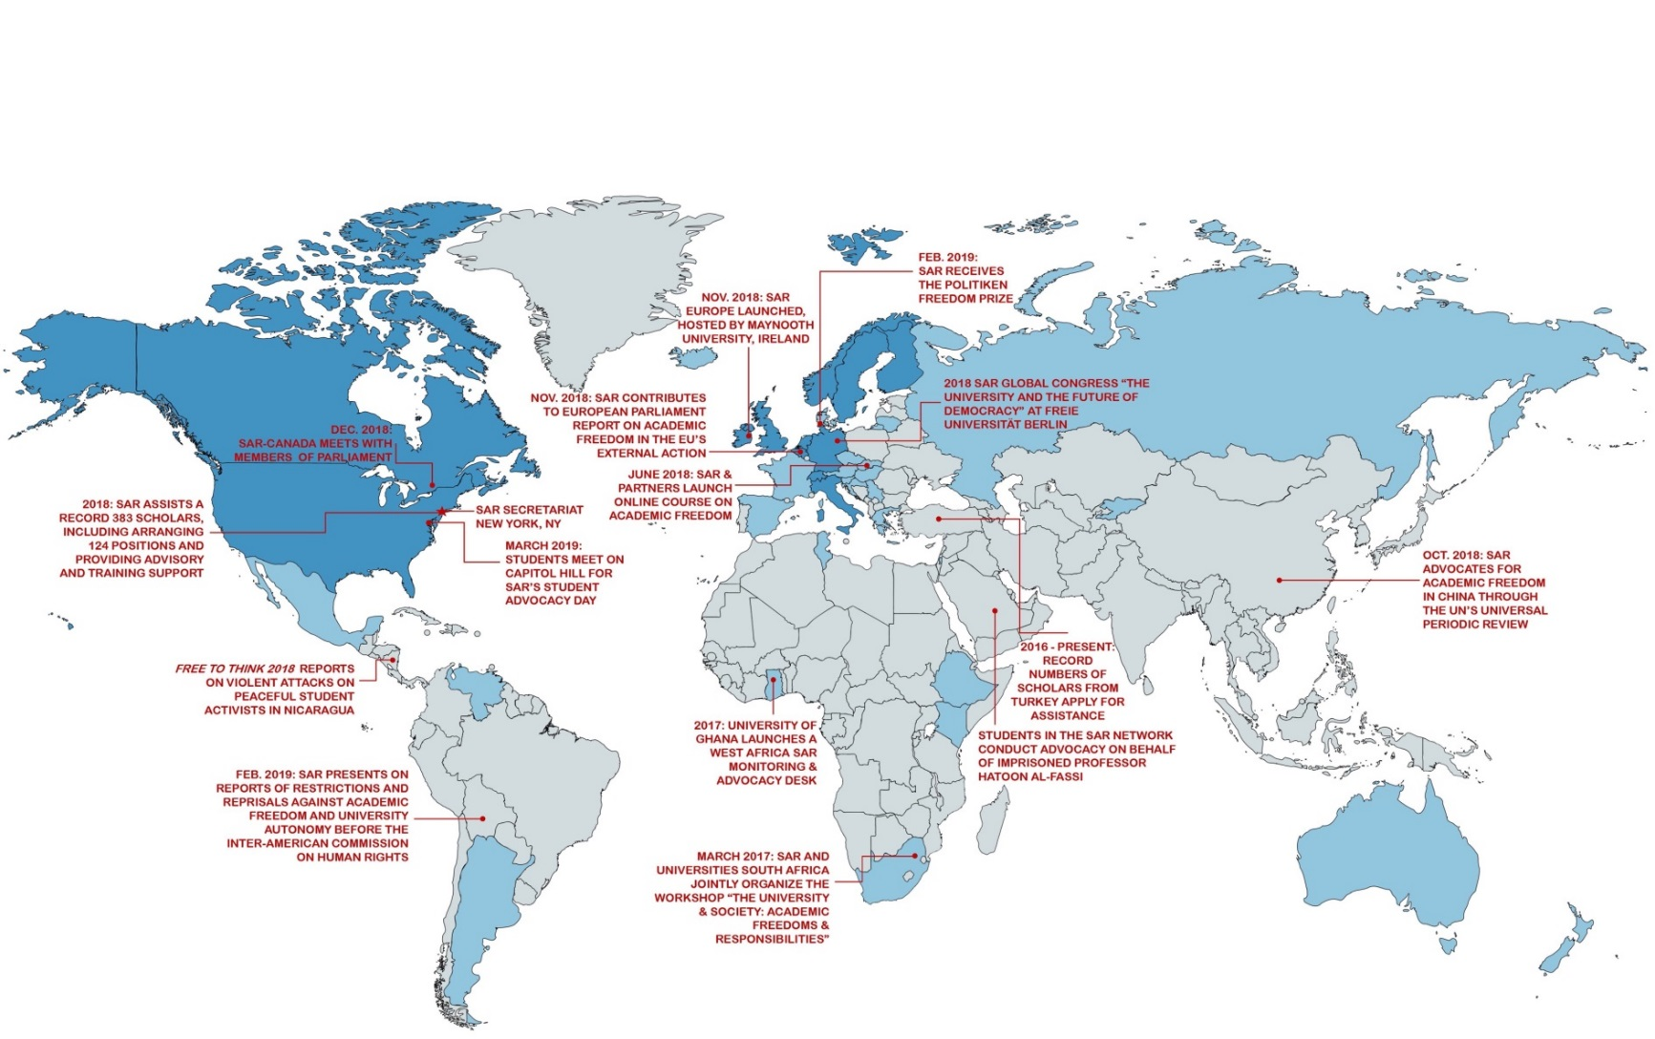
THE SAR NETWORK
Over 600 institutions in 42 countries, with 15 national sections in the U.S., Canada, Australia, Ireland, Netherlands & Belgium, Norway, Sweden, Switzerland, the UK, Italy, Denmark, Germany, Greece, Finland, and Slovakia.

Slide 5
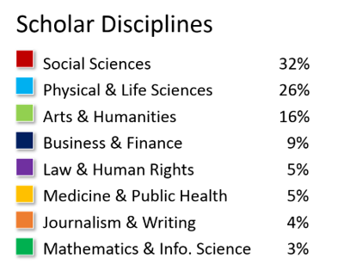



Why are researchers at risk?
Scholars assisted by SAR in 2019 by discipline
risk due to the content of a scholar’s work, research, or teaching
risk because of the individual’s status as academics/researchers
risk as a result of their peaceful exercise of basic human rights
risk as a result of conflict, situational violence, and natural disasters
risk because of the individual’s gender, sexual orientation, religion, or ethnicity
LEARNING
PROTECTION
ADVOCACY

Slide 6
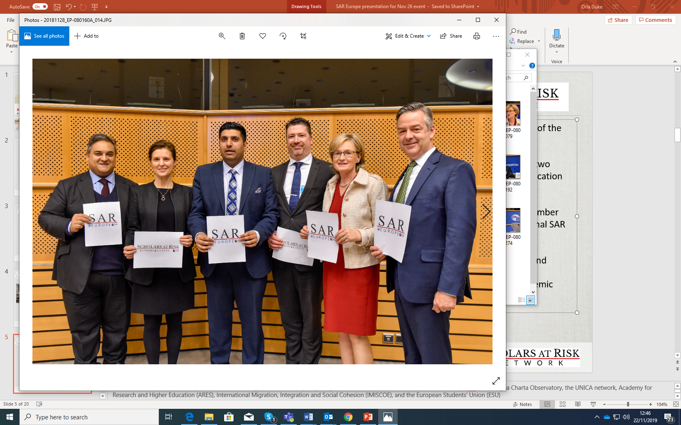
SAR NATIONAL SECTIONS IN EUROPE
National networks of higher education institutions dedicated to supporting threatened scholars and promoting academic freedom.
CARA-SAR UK Universities Network with CARA (2006)
SAR-UAF Netherlands Network (2009)
SAR-Ireland section with Universities Ireland (2009)
SAR- Norway section (2011)
SAR-Switzerland section (2014)
SAR-Sweden section (2016)
SAR-Germany section with Alexander von Humboldt Foundation (2016)
SAR-Finland section with UNIFI Universities Finland (2017)
SAR Italy section (2019)
SAR Denmark section (2019)
SAR Slovakia section with Bratislava Policy Institute (2019)
SAR Greece section (2021)
SAR Flanders (2021)
Launch of SAR Europe, European Parliament, Brussels, November 2018

Slide 7











INSPIREUROPE+ FACTS
Title: Initiative to Support, Promote and Integrate Researchers at Risk in Europe PLUS
Duration: September 2022 to August 2025
Coordinator: SAR Europe at Maynooth University, Ireland
Consortium: 7 project partners, 3 associated partners, 9 advisory board members
Funder: European Union’s Marie Skłodowska-Curie Actions (MSCA), Horizon Europe

Slide 8
Develop a long-term sustainable cross-sectoral European support structure
Improve career development opportunities for researchers at risk
Contribute to informed policymaking across Europe to strengthen support
Prepares the work environment in academic and non-academic sectors
Bridge the gaps between national and European support mechanisms
Grow the network of actors supporting researchers at risk with an emphasis on CESEE

Slide 9
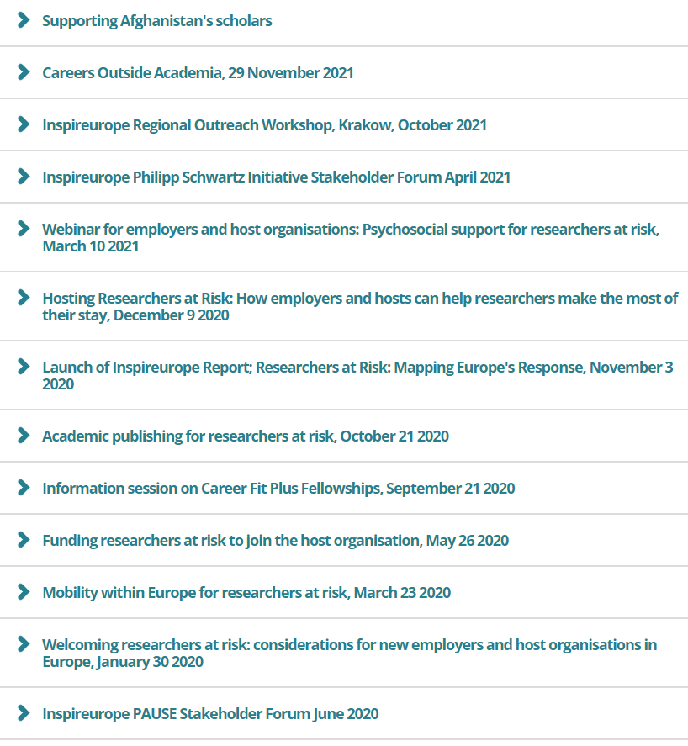
Inspireurope training support for scholars as well as employers

Slide 10

National-level Actions in Europe
There is no one-size fits all approach to organising a national-level initiative in support of researchers at risk.
National-level support for at-risk scholars serves to publicly highlight the crucial role of scholars, free inquiry, and free expression in democratic societies. Public attention to these issues is needed now more than ever.
https://www.maynoothuniversity.ie/sar-europe/inspireurope/publications
Notes:
High level engagement at EU & National Level; European Commission Vice President Margaritis Schinas (speaking at Outreach workshop in Greece) with Gregory Dimitriadis, Secretary General for International Economic Affairs, Anne-Sophie Barthez; Director General for Higher Education and Employability at the French Ministry of Higher Education speaking at the Stakeholder Forum, June. Initial engagement with DG GROW, DG HOME, Enterprise Europe, CEDEFOP
A total of 1,452 people attended Inspireurope events in the reporting period; Sept 19 – Nov 20; WP2 (webinar report launch = 214), WP3 (Stakeholder Forum Plenary 297), WP4 (362; 3 webinars = 192 + 1 Training = 162 +coaching =12), WP5 (366; 2 Webinars = 124 + 2 workshops = 242), WP6 (221; Poland = 50, Greece =171)
390 views of recorded Inspireurope webinars – 680 views in total (incl other events)
- A total of 815 people currently subscribed to Mailing List

Slide 11


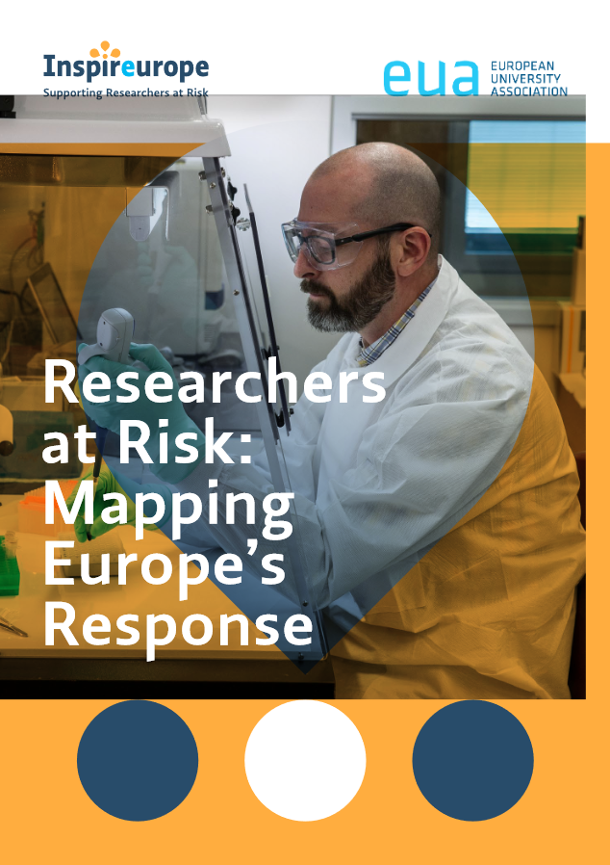
Researchers at Risk: Expanding Opportunities in Europe
Inspireurope Recommendations
Key outputs from Inspireurope project (2019-2022) delivered by EUA
  Researchers at risk: Mapping Europe's Response (2020)
  Inspireurope recommendations report (2022)
Recommendations for
EU policy level
National policy levels
Higher education institutions
Other
Compendium of resources
Relevant policy links
Resources, reports, webinars, etc
Notes:
HS

Slide 12
Researchers at Risk: Expanding Opportunities in Europe
Inspireurope Recommendations
Inspireurope recommendations
Acknowledge and support researchers at risk in higher education and research, including as a matter of defending academic freedom, and as a contribution to diversity, equity, and inclusion
Establish a dedicated European fellowship scheme
Create national support programmes for researchers at risk
Facilitate access of researchers at risk to existing European funding programmes
Build capacity to enhance long-term prospects for researchers at risk
Expand opportunities beyond academia for researchers at risk
Consider intersectionality in the support for researchers at risk
Enhance visa pathways for researchers at risk
Notes:
HS
Overview, plus 1 sentence each to describe
Highlight in detail R 1, 2, 4

Slide 13
Inspireurope in the numbers
Guidance, training, coaching for over 350 researchers at risk
Guidance, training for over 400 current and future employers
2 high-level stakeholder fora, 6 mutual learning opportunities, bringing European and national-level policymakers into the discussions
Invitations to over 75 business networks and companies, leading to meaningful engagement with 15 business networks, companies/SMEs across Europe, leading to 11 collaborations with private sector company representatives.
Dissemination: Invitations to consultation processes, events, webinars, publications( mapping report, national-level report) have reached over 71,000 people in 153 countries, including over 1,800 in Central, Eastern & Southern Europe.
This project has received funding from the European Union’s Horizon 2020 research and innovation programme under grant agreement No 857742

Slide 15
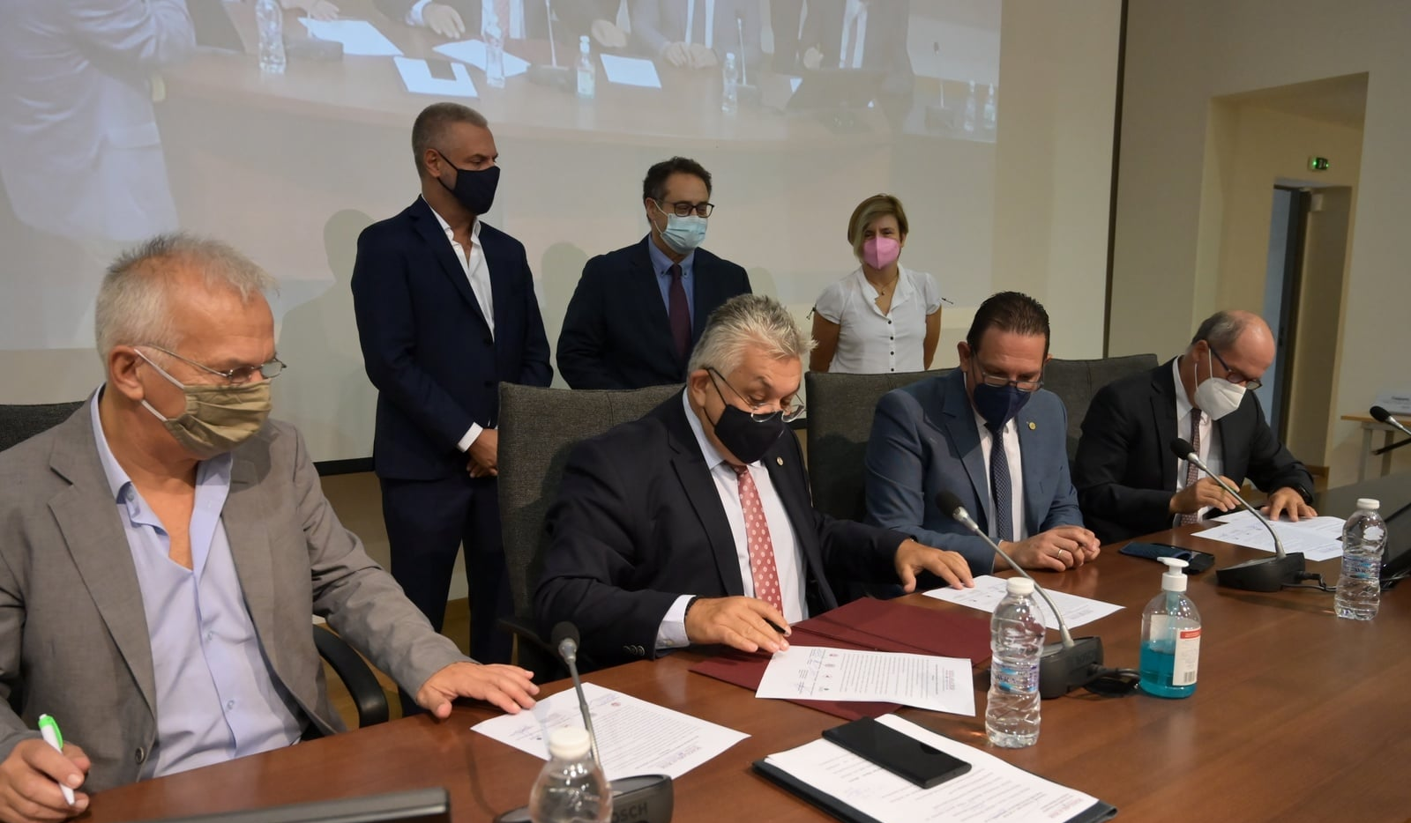

SAR Greece Section formation history
2018: AUTh joined SAR
Oct. 2018: AUTh hosted the first meeting for Greek universities and national agencies to discuss forming a SAR Greece section.
Oct. 2020: SAR Europe and AUTh co-hosted a meeting for Greek universities to continue work towards a SAR Greece Section.
Dec 2020: Ionian University joined the SAR network
Jan 2021: University of the Aegean joined the SAR network
Jun 2021: Univ of Thessaly joined the SAR network
Oct 2021: Launch of SAR Greece Section!
Dec 2021: Panteion Univ joined the SAR network
2022
University of Crete joined the network
University of Western Macedonia joined the network
Ongoing discussions with another 9 Greek Universities

Slide 16
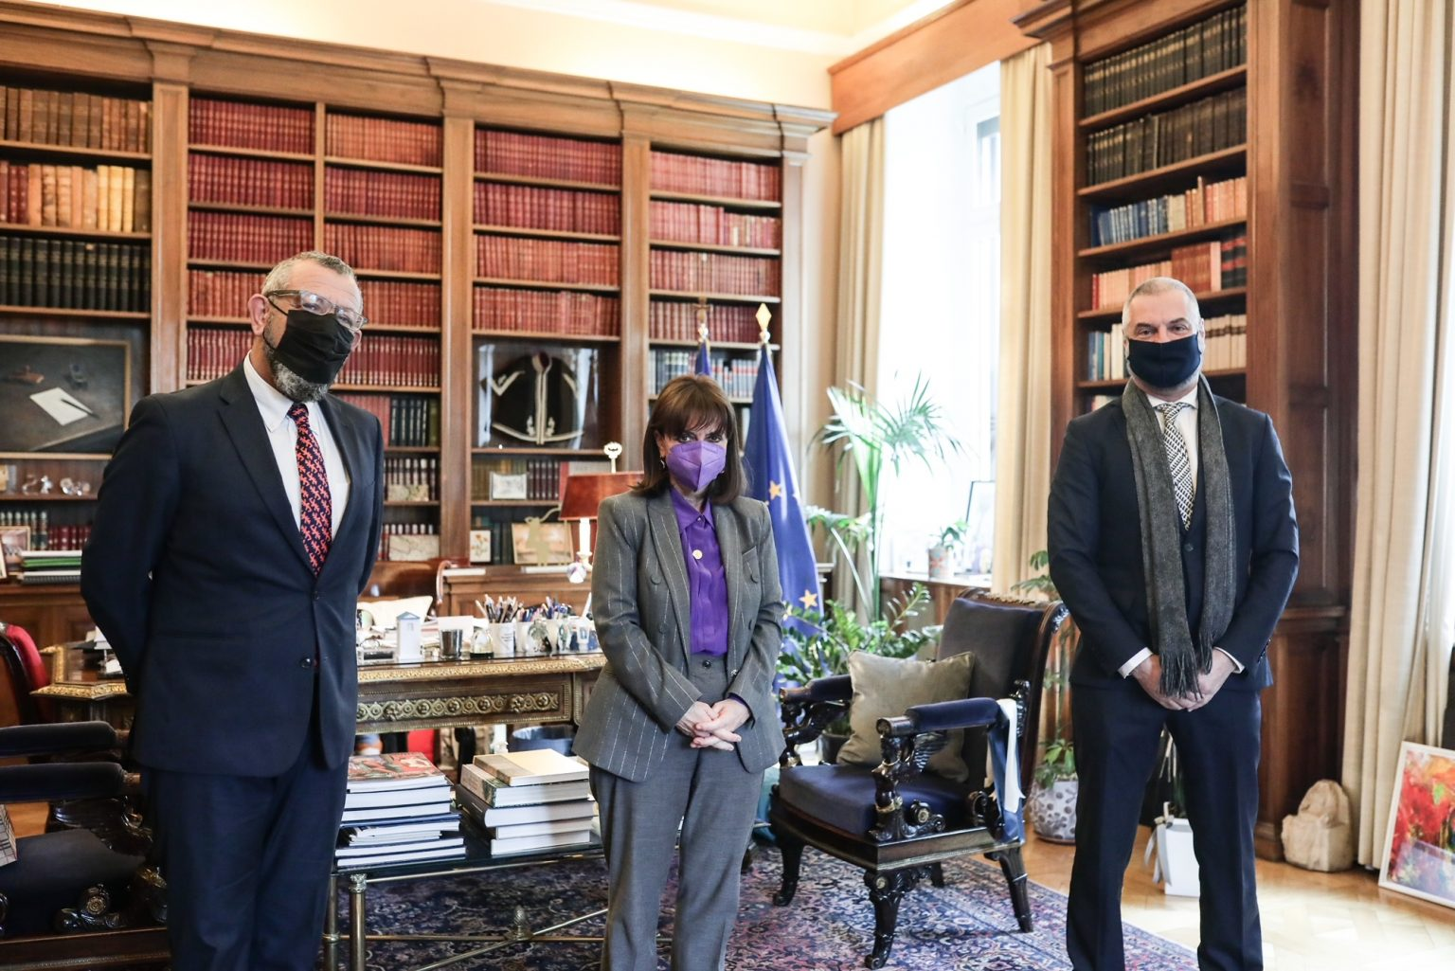
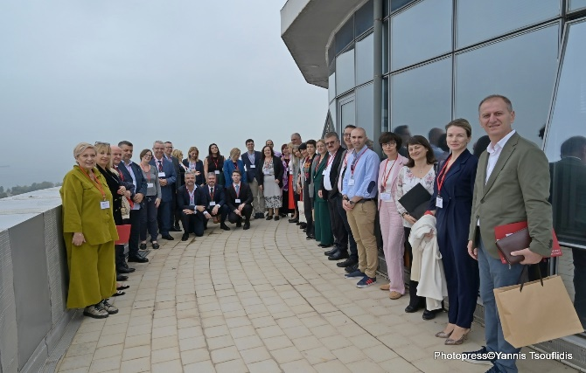
SAR Greece actions
Informing HE the President of the Hellenic Republic on SAR Greece and the Inspireurope project (March 14, 2022)
Ensuring support at the highest University level (Rectors of the joining Universities)
Presentation/raising awareness at the highest possible level (Rectors’ Synod – April 2021, July 2022, April 2023, June 2024)
Presentation/collaboration with the Vice-Minister of Education – May 2021, June 2022, August 2022, March 2023) to promote specific measures for the support of researchers at risk
Frequent Contact with National Scholarship Agency
Personal communications with academics and HEIs’ administration at all levels (not just one time but with follow-ups) to develop/expand the network
Seeking external sources of funding (from National, European and private bodies)
Dedicated website at Ionian Univ. https://scholarsatrisk.ionio.gr
Dissemination of SAR Greece's work through participation in European events (EPICUR forum, Utrecht Network Task Force, PSI forum etc.) and through relevant publications (SAR network newsletters, Inspireurope project etc.)
Helping others – Inspireurope+ University Leaders Roundtable (Thessaloniki, 23/10/23) with representation from 30 Rectors/Vice Rectors/ Higher Level Officials from 12 countries mostly from SE Eeurope from 22 HEIs

Slide 17


Recent Actions in AUTh
https://www.maynoothuniversity.ie/sar-europe/events/inspireurope-outreach-workshop-thessaloniki-greece-september-30th-2020
Signing of Memorandum of Understanding with Ministry of Migration Policy (special regulatory decision to enable Greek HEIs to offer temporary positions for S@Rs beyond the regular procedures for academic posts/ work visa acceptance)
Supporting Scholar at Risk
1^{η} Scholarship in AUTh through self funding
Creation of a Welcome Guide
For hosting S@Rs in AUTH https://inspireurope.auth.gr/welcomeguide/
Submission to the MSCA4Ukraine Call …
Push for Creation of A National Scheme for S@R (the National Agency is willing to fund a limited symbolic number of scholarships to warmly encourage Greek HEIs to independently establish temporary positions for Rs@R with partial funding from the HEI’s Research Committee and co-funding from the National Agency)
AUTh is Associate Partner of Consortium for Preparatory Action-European Fellowship Scheme for Researchers at Risk (SAFE project)
Funding
LEARNING

Slide 18

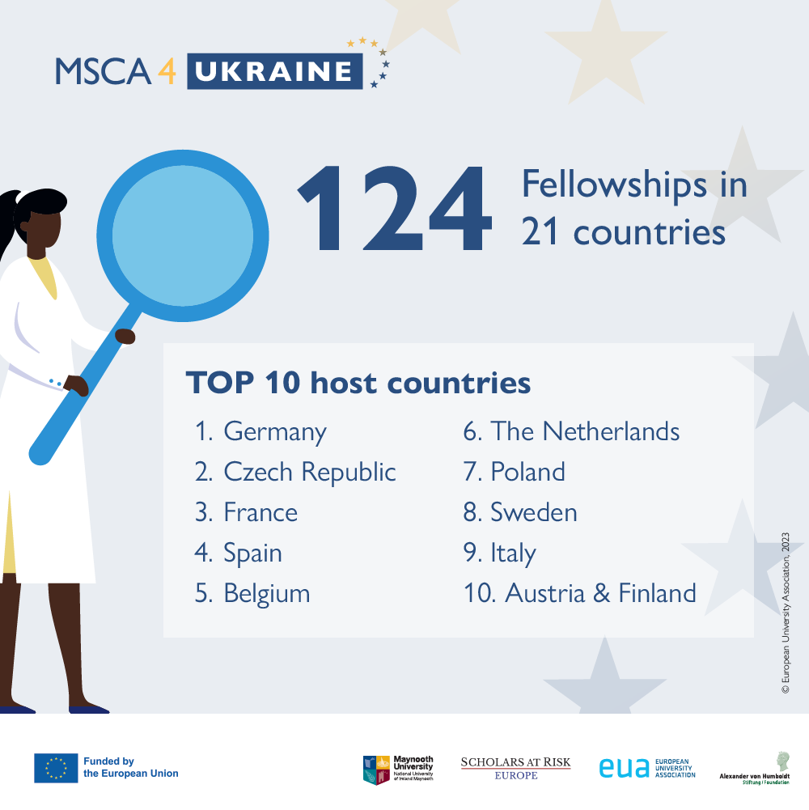
MSCA4Ukraine (Horizon Europe 2022-2026)
Provides support to 124 displaced researchers from Ukraine through dedicated fellowships to enable and to facilitate their reintegration into Ukraine if conditions for safe return are met
Fellowships awarded in February 2023
  contribute to sustaining the Ukrainian academic and research sector in the face of the Russian Federation’s invasion
  help to combat permanent brain drain
  facilitate the continued functioning of the sector in collaboration and exchange with the international research community
  AUTh applied for two researchers in 2022 and for three in the second call (one month ago)

Slide 19


Supporting At-risk researchers with Fellowships in Europe
Pilot fellowship scheme
Establish, test and validate procedures for
  Selection of at-risk researchers
  Matching researchers with host institutions in the EU
Duration: 3 years (2024-27)
Funded by the European Union
Budget: 12M €
Webpage: https://saferesearchers.eu

Slide 20
Will offer:
60 fully-funded fellowships (up to 24 months) for doctoral and postdoctoral researchers of any non-EU nationality
  The SAFE fellowships will be awarded following 2 tracks:
  – At-risk researchers currently outside the EU
  – At-risk researchers already within the EU
Call for Applications: November 2024
Applications can only be submitted by potential host institutions in the EU
Online application platform open: 18 November 2024 to 20 January 2025
The

Slide 21
Future Actions in AUTh
https://www.maynoothuniversity.ie/sar-europe/events/inspireurope-outreach-workshop-thessaloniki-greece-september-30th-2020
Organisation of 3rd Inspireurope+ Outreach Workshop “Supporting Researchers at Risk in SE Europe” and Utrecht Network Staff Training on «Responsible Internationalization and Institutional Support for At-risk Scholars Access to Higher Education, Training And Employment» Thessaloniki 10-14 March 2025
LEARNING

Slide 22


Aim
Staff Training on Responsible Internationalization and Institutional Support for At-risk Scholars Access
to Higher Education, Training And Employment
To reflect on Responsible Internationalisation and the establishment of institutional/national level support for Scholars.
To improve the capacity of the UN universities to provide quality support services and access to continuation of research/academic career to at-risk scholars
Main topics
Challenges that Universities face on forming strategy for Internationalisation
Challenges that scholars at risk face on their way to continue/restart their work in a European institution
The appropriate response of the Institutions; ways to increase the institutional capacity and preparedness.
Workshops
Presentation/mapping of RIGE activities & events at UN member institutions
Responsible Research and Innovation (RRI), Promoting Core Academic Values in International Partnerships/Networks/ European University Alliances
Peer Exchange on Hosting/Supporting/Integrating SARs and Institutions at Risk
Intercultural aspects of hosting
Inspireurope Seminar
Plenary sessions and workshops
Notes:
22

Slide 23
Target group
Staff Training on Responsible Internationalization and Institutional Support for At-risk Scholars Access
to Higher Education, Training And Employment
Selected Faculty of UN member institutions, especially those specialized in the field of Human Rights/ Public Policy Advocacy, Core Academic Values etc.
University Management and Administration: vice presidents/rectors for internationalization/ diversity & inclusion/global engagement; internationalization policy/strategy advisors;
heads of international relations/global engagement etc.
Early Career Researchers (late doctoral/early post-doctoral researchers) from UN member institutions
At Risk Scholars (formerly) hosted at/supported by UN member institutions
Participants
25-30 participants
Priority will be given to participants coming from the Utrecht Network Partner Universities
No fees (coffee breaks and lunches included)
Notes:
23

Slide 24
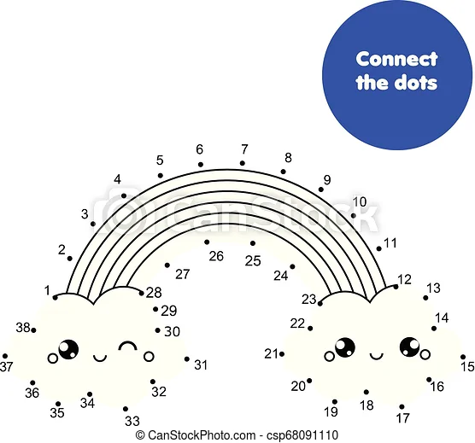
Take home messages!
“Accept the world for what it is” Robert Quinn, Executive Director, Scholars at Risk Network, 23 May Berlin
A bit of money can take you a long way
Connect the dots (the people, the offices) to spread the message, to get the job done
Give them something (recognition, guidance, funds)
Rome wasn’t built in a day (Be patient!)
Don’t lose hope → Ask for help
Don’t Give Up!

Slide 25




Email: inspire_auth@auth.gr
Website: https://scholarsatrisk.ionio.gr/en/greece/ ​

