Slide 1
Polytechnic Institute of Bragança
International Relations Officer
(Thessaloniki, May 2016)

Slide 2
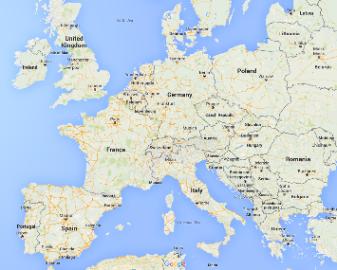
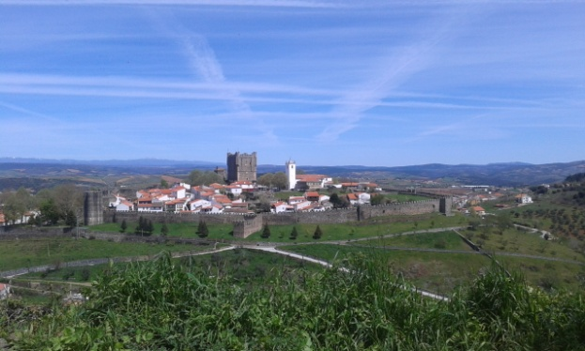
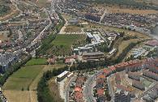
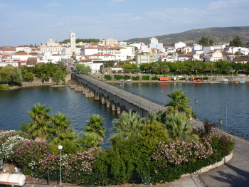
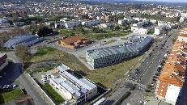
The Polytechnic Institute of Bragança (IPB)
(Campus in Bragança and in Mirandela)
5 schools:
School of Agriculture (ESA)
School of Education (ESE)
School of Health (ESSa)
School of Technology and Management (ESTiG)
School of Public Management, Communication and Tourism (EsACT, Mirandela)
Notes:
Average Cost of Life in Bragança for a Student:
Complete meal at the canteen = 2,30 €
(lunch or dinner)
Accommodation in apartments for foreign students with access to the Internet:
- single room = 125 € + bills
- sharing a doble room = 85 € + bills

Slide 3
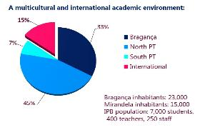
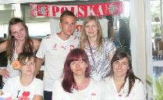
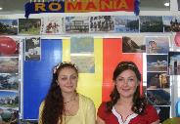
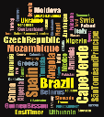
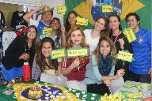
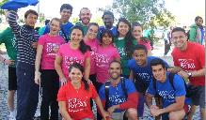
International Relations Office
(central IRO for 5 schools)
IPB in the international context:
900 outgoing and incoming students exchange/year
200 lecturers and administrative staff of outgoing and incoming exchange/year
Projects and Activities:
Erasmus+ Mobility (studies and placements) incoming/outgoing
Erasmus+ ICM program (studies)
Bilateral Cooperation with HEI non-EU countries (Africa, Asia and American countries) for studies, internships and research
International regular students
Erasmus Week
International Conferences and events
Notes:
Degrees taught entirely in English:
Bachelor level:
Chemical and Biological Engineering
Informatics Engineering
International Business Management Master level: Biotechnological Engineering
Chemical Engineering
Information Systems
Management
Management of Forest Resources

Slide 4
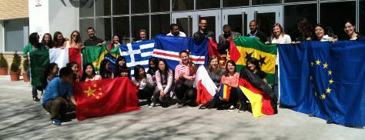
Inês Rodrigues - International Relations Officer
Main tasks:
Manage the Outgoing and Incoming Erasmus Placement (centralized for the 5 schools)
Co-Coordination of the NOW Portugal Erasmus Consortium
Support to all International events organization (Erasmus Week, Intensive Programs, Conferences, others)
Support to all International projects/programs
Notes:
Mais informações:
http://www.ipb.pt/gri e http://www.nowportugal.pt/index.php/pt/estudantes

Slide 5
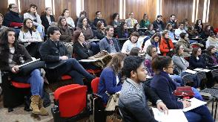
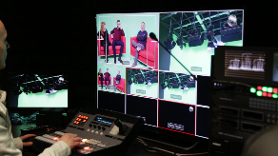
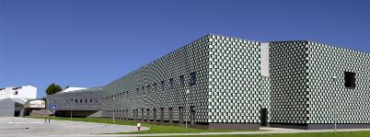
Inês Barbedo – Dep. Informatics and Mathematics
Academic Coordinator
School of Public Management, Communication and Tourism
In collaboration with central IRO:
provide information about the possible actions within ERASMUS+;
analyze applications and designate outgoing students and staff for mobility programs;
help (incoming and outgoing) students with academic procedures and the Learning Agreements;
suggest and review new partnerships considering the capacities and strategic areas of the school.
Notes:
Mais informações:
http://www.ipb.pt/gri e http://www.nowportugal.pt/index.php/pt/estudantes

