Slide 1
PRESENTATION OF ESEPF Higher School of Education of Paula Frassinetti
ERASMUS STAFF
ELISABETE MELO

Slide 2
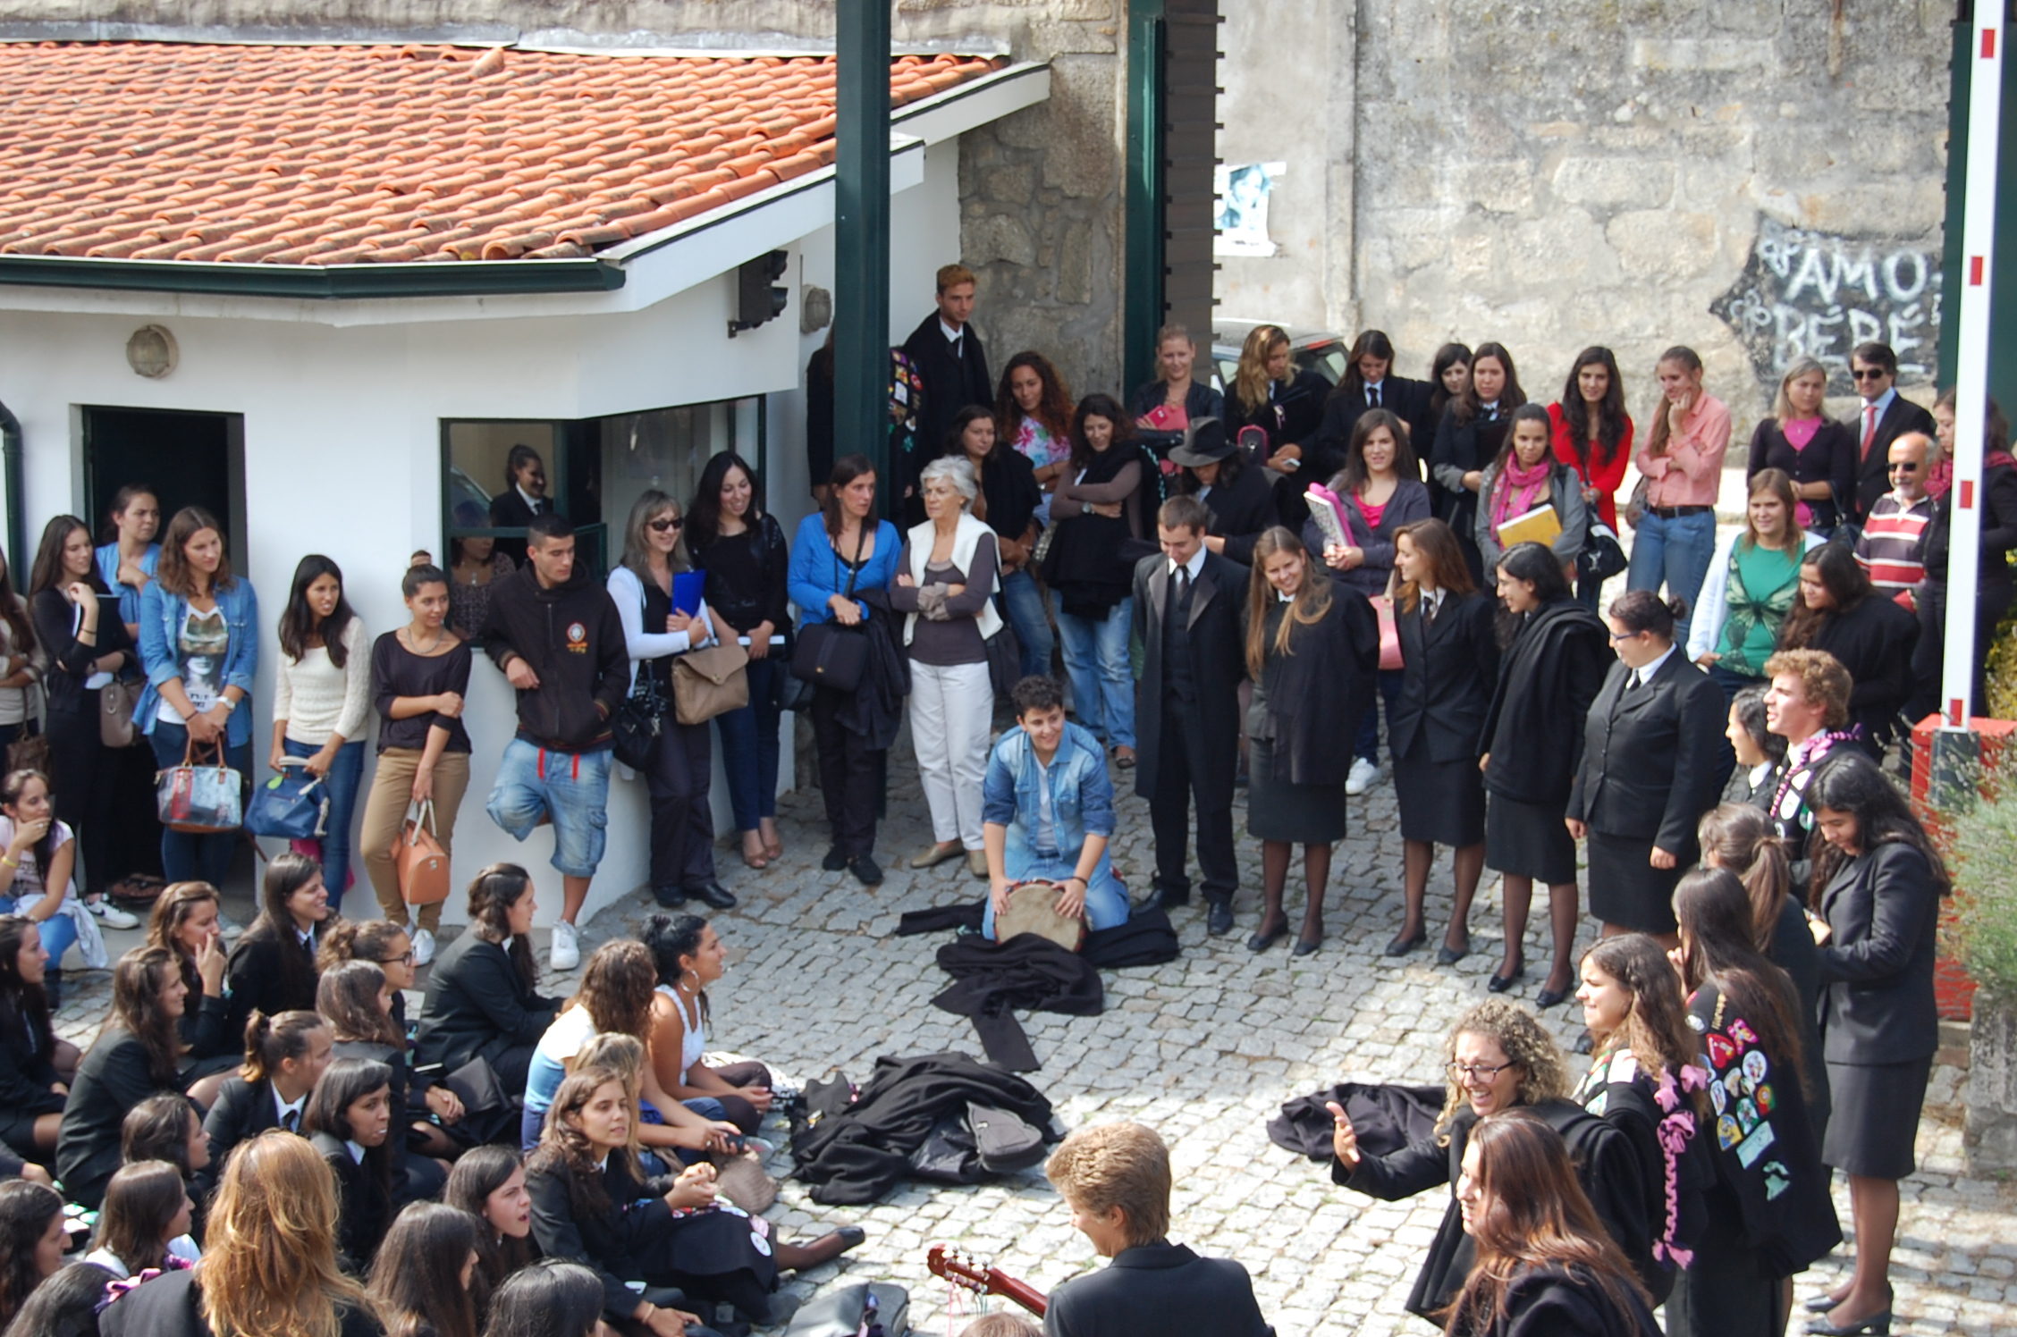
Higher School of Education of Paula Frassinetti (ESEPF)
Formed in October 22, 1963, Higher School of Education of Paula Frassinetti has already trained thousands of education professionals (teachers, social educators, and other educational agents) through bachelor, masters, post- graduate and ongoing training. The institution is known for its quality teachers that add human proximity to academic excellence. As a higher education institution, it favors the pedagogic practices in professional context and it has protocols with more than eighty (80) institutions (Schools, IPSS, Municipalities and others) in the Greater Porto area. In its activity, it implicates teachers and students in projects and international networks of scientific investigation and socio-educational intervention.
The international level is a constitutive part of the ESEPF's dimension, for it integrates the educational network of the Congregation of the Sisters of Saint Dorothy, which runs educational centers in Europe, Africa and North and South America. There are, in total, 50 educational centers,
with more then 4 500 teachers and almost 7 000
collaborators for around 48 000 students.
Besides the ESEPF, two other higher education institutions
are also part of this educational network, both operating
in Brazil - the Frassinetti Faculty of Recife and the Saint
Dorothy Philosophy Faculty, in Nova Friburgo.

Slide 3
Finance Department
The finance department is divided into three areas:
Financial and Accounting Services
Treatment of all financial affairs of the school and the entire accounting process
Human Resources
Treatment individual process involving the contracting process processing monthly pay until the employee
terminates the contract
Administrative Services
Managing of receipts and payments. Management and investing financial resource. Managing approved funds for different projects

Slide 4
Professional duties
Financial and Accounting Services
Ensure the accounting entries, closing and delivery of Audit Reports for approval;
Monitoring of billing file and organization of accounting issues;
Development, in conjunction with the Directors Board, of the annual budget, which after completion, will be validated by the Directors Board and Entity Founder;
Organization of educational and financial dossiers of Funded Projects;
Reports of funded projects and respective submission
Administrative Services
Management of operations of financial investments or loans;
Responsible for treasury management; (coordination, management and supervision of services related to the receipts, payments and working capital. Includes the supervision of the services and functions of 2 collaborators); Current Account management of students in collaboration with an Administrative collaborator.
Ensure the effective organization of Administrative and Financial Services;
Orders management to Suppliers with regard to payments;
Human Resources
Recruitment process of new employees and teachers, as the Directors Board indicates;
Make contracts with new employees and teachers, making the necessary communications to social security;
Control the attendance of employees;
Monthly processing of salaries of staff and teachers;
Creation of different annual reports in order to give different answers to different official bodies;
Acquisition of Goods and Services - responsible for organizing services and monitoring implementation
Infrastructures - responsible for organizing services and monitoring implementation
Health and Safety Services - responsible for organizing services and monitoring implementation
Evaluation and Quality Office – Office member
Other activities related to school - responsible for the organization of Services and monitoring the implementation whenever necessary

