Slide 1
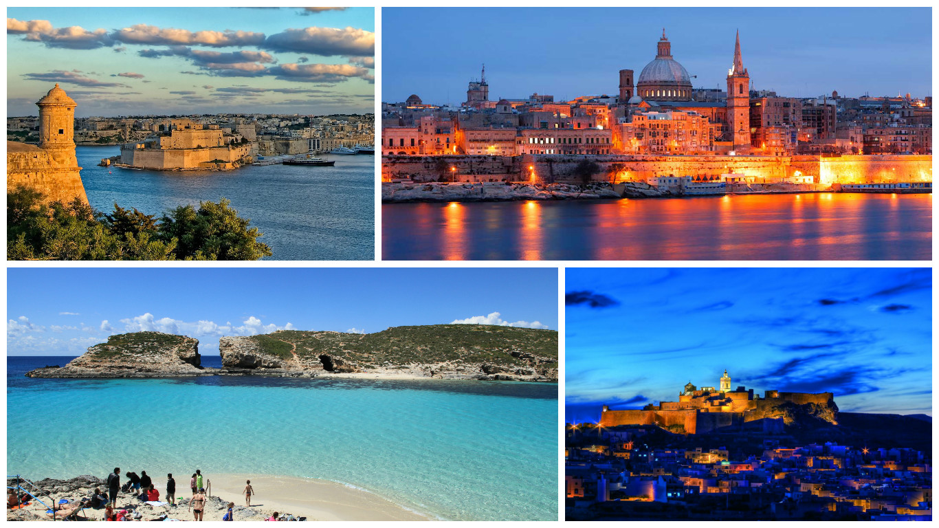

Slide 2
University of Malta
Founded in November 1592
Public University
11,500 students of which 10% are international from 92 different countries
Courses at undergraduate, post-graduate and doctoral level (modular system, ECTS)
Foundation Studies Course
English as the medium of instruction
Taught and Research Master Level Programmes & Joint and Dual Degree Programmes

Slide 3
The International & EU Office
Point of contact for all international students and outbound exchange students
15 members of staff
Erasmus+ with Programme Countries & Partner Countries, Project Support, Gulf Area, International Programmes, Visa, Residence Permit, Orientation and integration, Personal and psycho-social support
Provide support at all times

Slide 4
Area of Work
Erasmus+ with Partner Countries
Project Support

