Slide 1
Department of European Educational Programmes
Aristotle University of Thessaloniki
and
the Erasmus+ programme
© 2023 Department of European Educational Programmes, Aristotle University of Thessaloniki

Slide 2
AUTh at a glance

Slide 3
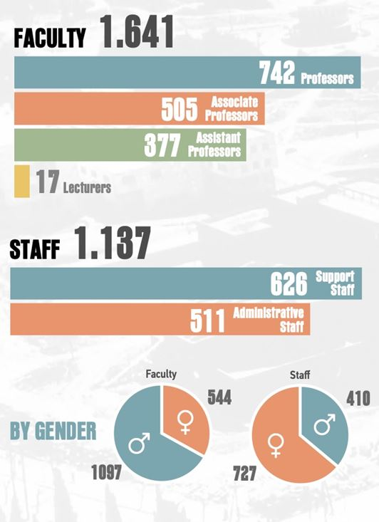
AUTh at a glance

Slide 4
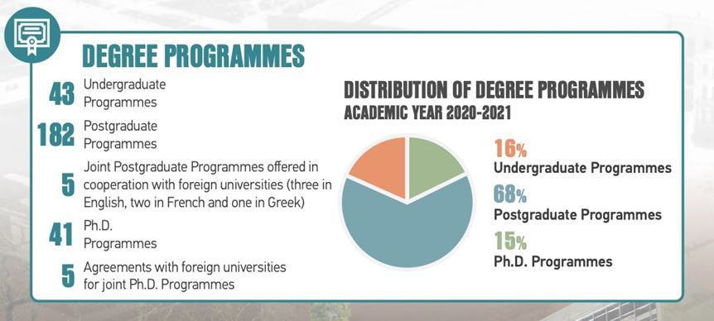
AUTh at a glance
7
7

Slide 5
Postgraduate & Ph.D. Programmes in foreign languages
ENGLISH
FRENCH
Hydrocarbon Exploration and Exploitation
Digital Media, Communication and Journalism
Data & Web Science
English & American Studies
Logistics and Supply Chain Management
Dental and Craniofacial Bioengineering & Applied Biomaterials
Paediatric Dentistry
Human Reproduction
Medical Research Methodology
Film & Television Studies
Theoretical and Applied Linguistics
European Literary Cultures / CLE University of Bologna, University of Upper Alsace, University of Strasbourg International
GERMAN
Language and Culture in the German-speaking area

Slide 6
AUTH: The digital university of Greece
In-house development of pioneering software
myAuth
Quality Assurance Unit
Moebius
ResCom
Personalized digital services for students and professors
Management of incoming & outgoing Erasmus students
Monitoring teaching and research output
Management of research funds

Slide 7
Erasmus+ mobilities in AUTh

Slide 8
Department of European Educational Programmes
Responsibilities at a glance:
Erasmus+ KA131
Erasmus + International KA171
Erasmus+ KA2 projects
Staff Training Weeks
Networks (EUF, Utrecht Network)

Slide 9
Department of European Educational Programmes
1,457
Bilateral
Agreements
19,100
Outgoing
Students
4,950
Outgoing
Staff Members
84
Erasmus+
International
Partner Universities
13,920
Incoming
Students
Example
of good practices
550 Erasmus+ partner institutions

Slide 10
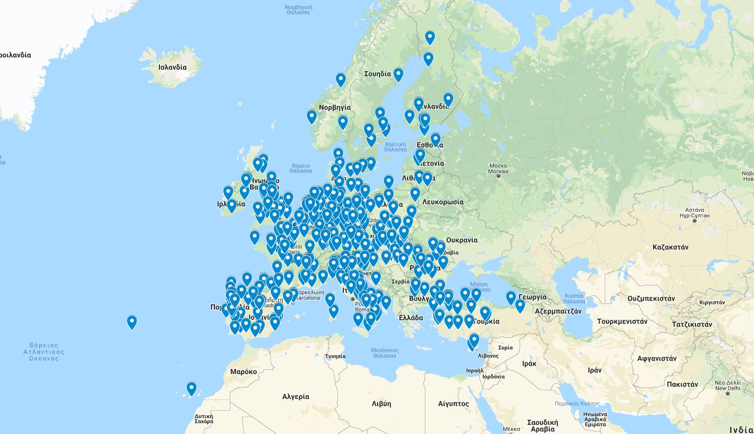
Erasmus+ KA131
1457 bilateral agreements covering all subject areas and all programme countries

Slide 11
Erasmus+ KA131

Slide 12
Erasmus+ KA131

Slide 13
Erasmus+ KA131

Slide 14
Erasmus+ KA131

Slide 15
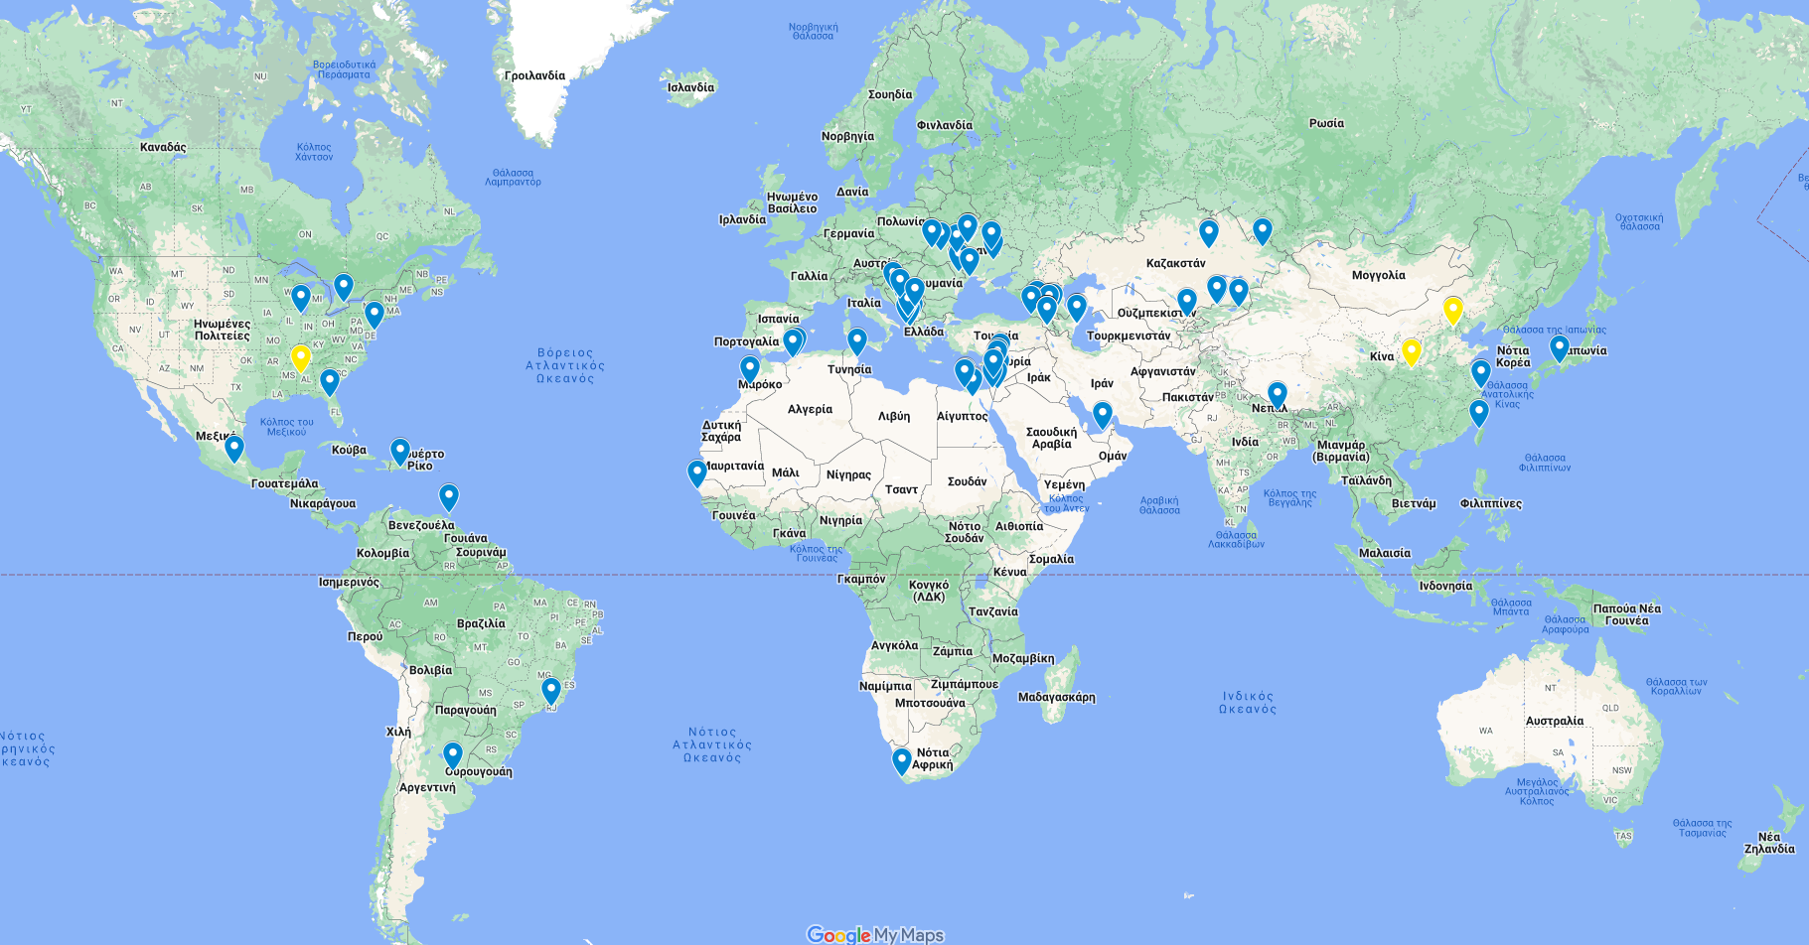
Erasmus+ KA171

Slide 16
Erasmus+ KA171
2015-17
74 Universities
2016-18
27 Countries
72 Universities
2017-19
26 Countries
90 Universities
243 staff & student mobilities
228 staff & student mobilities
29 Countries
156 staff & student mobilities
2018-20
11 countries
48 Universities
85 staff & student mobilities
2019-21
24 countries
94 Universities
112 staff & student mobilities
2020-2022
31 countries
94 universities
220 staff & students mobilities
2022-2024
34 countries
107 universities
159 staff & students mobilities
2023-2026
35 countries
84 universities
139 staff & students mobilities

Slide 17
DEEP Staff Training Weeks
1 annual edition
Special editions on focal thematic areas

Slide 18
DEEP Events
Orientation Weeks
Europe Day Celebration – Erasmus Day Event
Christmas or New Year Events
Dissemination Events for Students and Staff

Slide 19
Networks’ membership

Slide 20
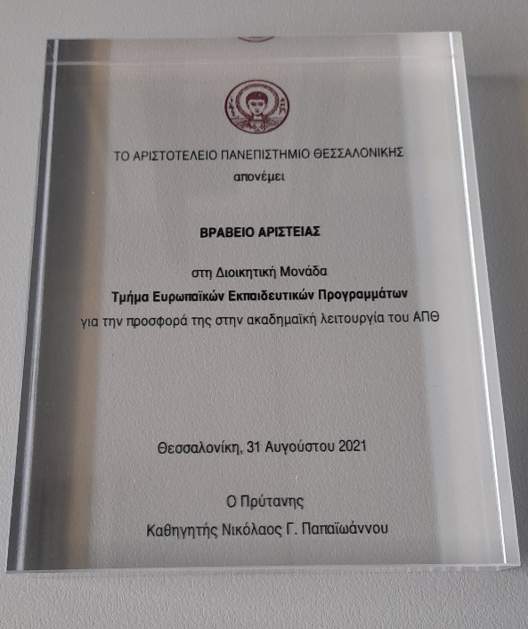
Acknowledgement
AUTh Award of Excellence 2021
Acknowledged as an Institution of Good Practice by the Greek Erasmus+ National Agency
Adoption of AUTh good practices by the Greek Erasmus+ National Agency and Greek HEIs

Slide 21
Management of mobilities and quality assurance

Slide 22
A few useful figures…
550 partner universities
900
outgoing students
700 incoming students
1400 bilateral agreements
200 staff mobilities
1 central Erasmus office
Notes:
22

Slide 23
Management structure
Vice Rector
for Academic and Student Affairs
(Internationalization strategy)
Department
of European Educational Programmes
(Administrative aspects of mobilities)
Erasmus+/ECTS Coordinators
(per School)
(Academic aspects of mobilities)
Committee
of European and Educational Programmes
(Supervision and guidance)

Slide 24
Mobility phases
Mobility period
Selection
Bilateral agreement
Notes:
Bilateral agreements: Set the basis for quality mobilities
Specify language requirements
Contacts
Selection by sending institution: allocation of students to different places according to spceific academic criteria
Mobility period: Monitoring of study programme during mobility and quality feedback upon completion

Slide 25
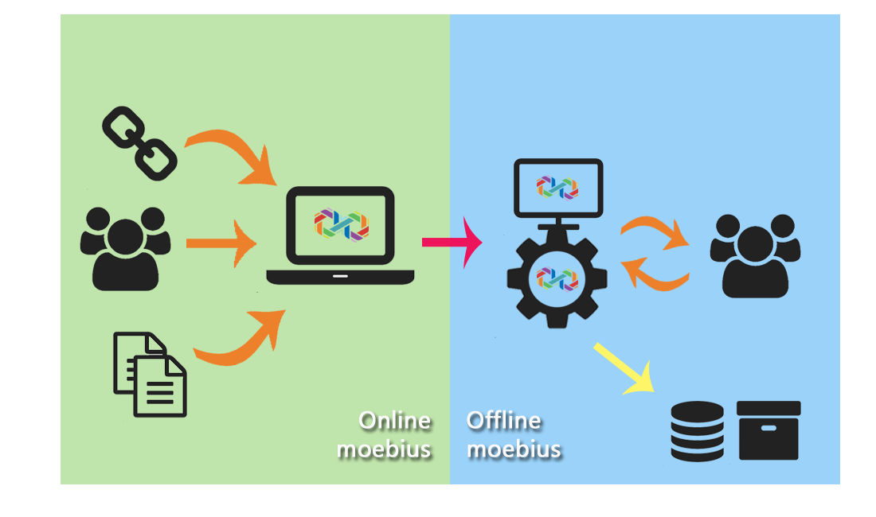
Moebius: AUTh mobility management software
Notes:
25

Slide 26
AUTH selection procedure
Ministry of Education directives for transparency, impartiality, consistency, full documentation and equal treatment of all applicants
Phase 1: common selection criteria prioritized by each School and detailed justification of results
Phase 2: a single layout for selection results justification
Phase 3: introduction of a point system

Slide 27
Monitoring of academic performance
Define successful academic performance
Exams
Threshold regarding awarded ECTS credits
Financial penalty for those not compliant with quality standards

Slide 28
DEEP and Erasmus+ projects

Slide 29
Main responsibilities:
Dissemination of Erasmus+ funding opportunities
Consulting and support on project proposal preparation
Networking and facilitation of collaborations
Participation/contribution in Erasmus+ projects in the field of students’ and staff mobilities
Coordination of Erasmus+ projects

Slide 30
AUTh’s contribution in the European Student Card Initiative (Digitalization of the Erasmus+ programme)
Member of the EWP+ consortium (ongoing)
Coordinator of the European Digital Student Services Infrastructure/EDSSI (concluded)
Consortium member of the EDSSI L2 project (concluded)
Technical leader in the OLA 3.0 project (concluded)
Consortium member of the Erasmus+ Mobile App project (concluded)
Consortium member of the MyAcademicID project (concluded)

Slide 31
Aristotle University of Thessaloniki is WP Leader in the creation of an inter-university campus
implementation of innovative procedures of admissions, evaluation and academic monitoring (gamification)
design of technical solutions both for teaching methods (Virtual Campus Learning Platform) and administrative support (Virtual University Registrar System)
Notes:
EDSSI
EPICUR – έργο υποδομής

Slide 32
DEEP’s involvement in projects
Coordinator of the Assessing Courses of the Online Learning Agreement/AsCOLA project (Erasmus+ KA2/ongoing)
Business analysis and events’ organization for EWP+ consortium (Erasmus+/ongoing)
Coordinator of the European Digital Student Services Infrastructure/EDSSI (CEF/concluded)
Project partner of Making Mobility the Norm/NORM project (Erasmus+ KA2/concluded)

Slide 33
Department of European Educational Programmes
Thessaloniki, Greece
E-mail: eurep-projects@auth.gr
Web: https://eurep.auth.gr

