Slide 1
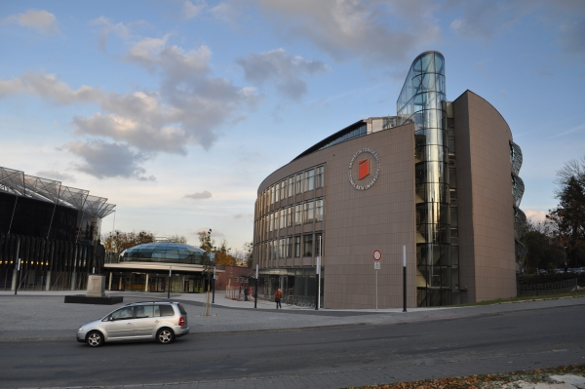
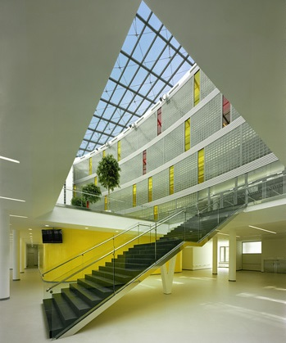
2001 establisment of TBU in Zlín (1969 FT).
Modern university.
10,500 students.
6 faculties: FT, FAME, FMC, FAI, FHS, FLCM.
Bachelor's, Master's, PhD programmes.
www.utb.cz
Notes:
Faculty of Technology, Faculty of Management and Economics, Faculty of Multimedia Communications, Faculty of Applied Informatics, Faculty of Humanities, Faculty of Logistics and Crisis Management.

Slide 2
Studies:
Chemistry
Environmental Protection Engineering
Polymer Engineering
Physics and Materials Engineering
Food Technology
Cosmetics Technology
Production Engineering
Summer Schools:
Environmental-Friendly Technologies for Solid Waste Treatment
Polymer Processing and Functionalization
www.summerschools.utb.cz
www.utb.cz/ft

Slide 3
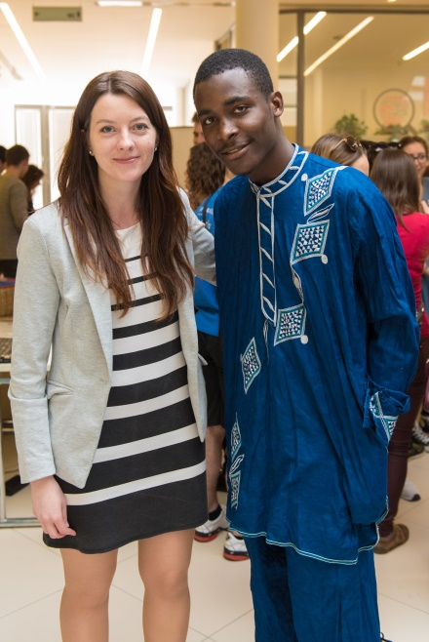
Miroslava Miličková Officer for International Relations
Incoming / Outgoing students for studies and internships.
Erasmus+, Ceepus, Freemover exchanges.
International partnerships and cooperation (bilateral agreements).
Promotion of study abroad opportunities.
Staff mobilities.

