Slide 2
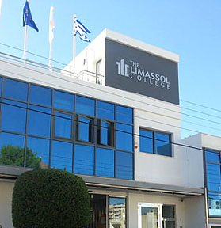
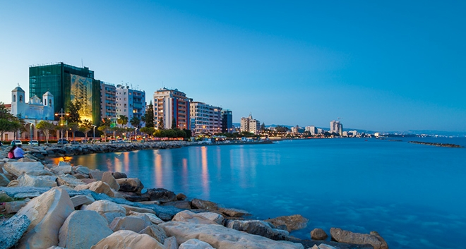
TLC College
TLC is a private institution of Higher Education.
It is situated in Limassol, Cyprus

Slide 3
Programs of Study
TLC offers:
Aesthetics (2 years, Diploma)
Aesthetics and Cosmetology (4 years, BSc)
Dietetics and Nutrition (4 years, BSc)
Clinical Dietetics (4 years, MSc)
Nutrition and Dietetics (4 years, MSc)
Technology of Information and Communication in Education (MSc)

Slide 4
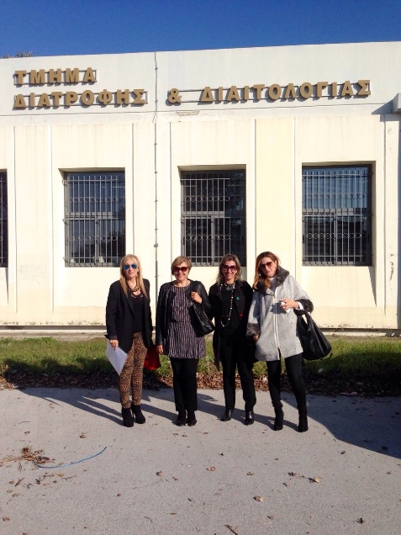
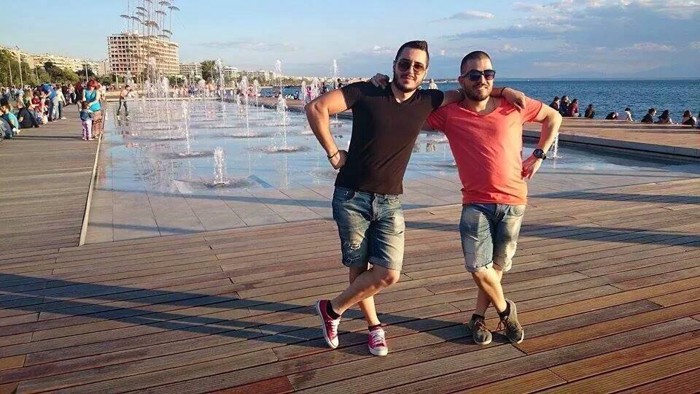
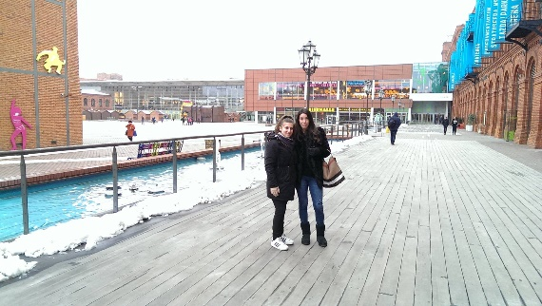
Strategy
A major aim is to develop Interinstitutional Agreements with neighbouring countries such as Israel, Lebanon, Jordan with whom we share common characteristics and we intend to play a bridging role between the HEI of the E.U. and the Mediterranean countries in the fields of research (e.g. promotion of Mediterranean Diet) and mobility.

