Slide 1
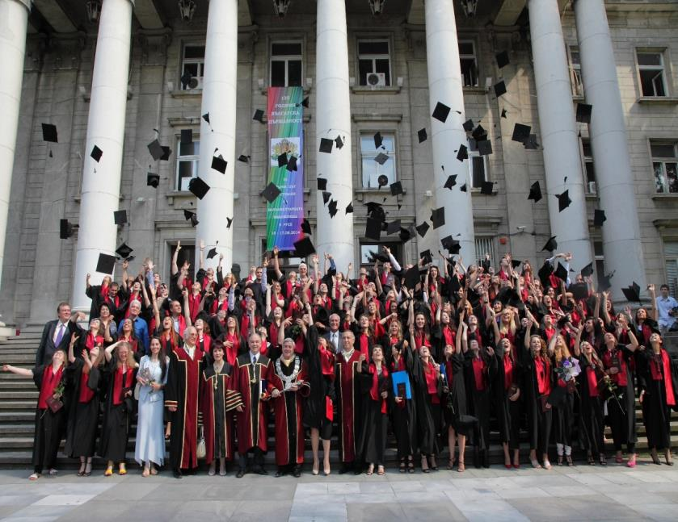
University of ruse „angel kanchev“
70th ANNIVERSARY
1945-2015

Slide 2
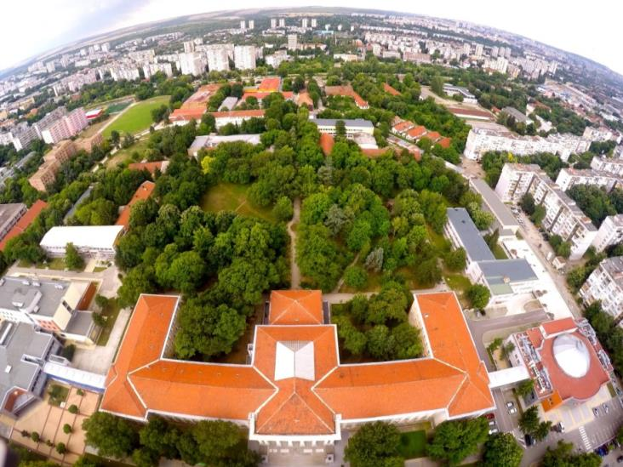
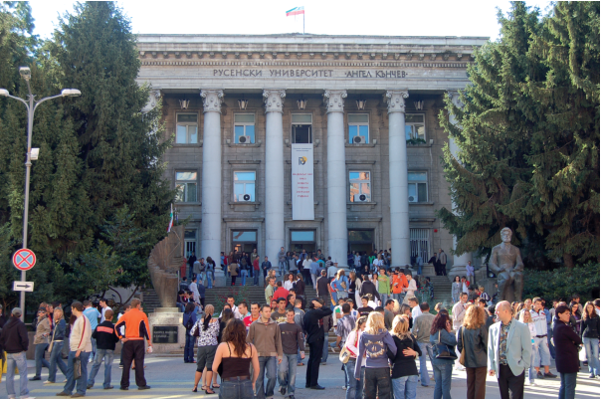
IN THE PAST
TODAY

Slide 3
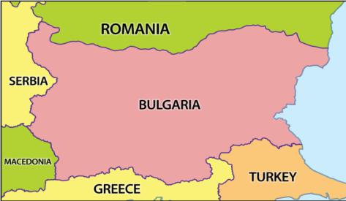
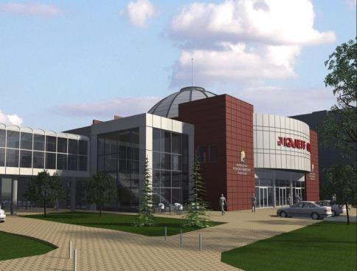
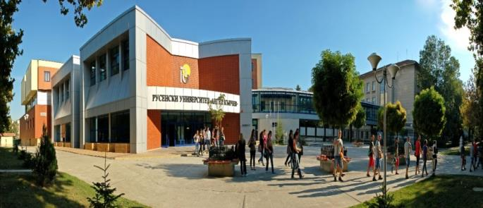
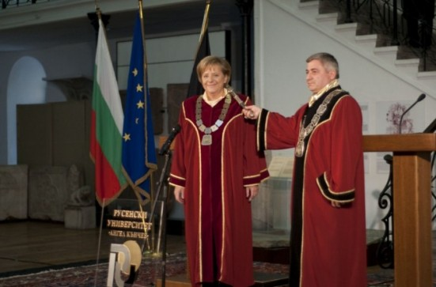
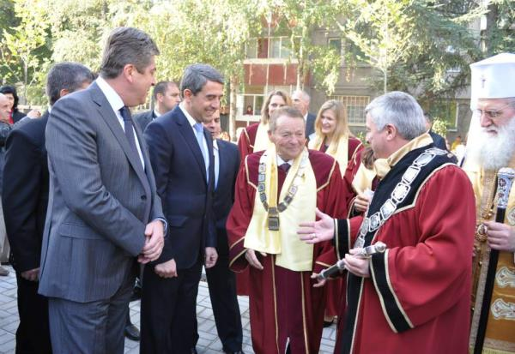

Slide 4
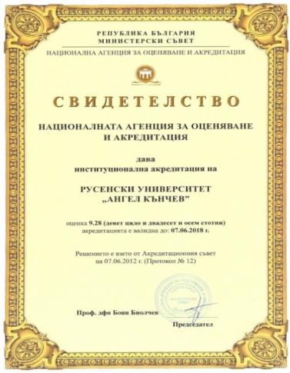
PROFILE OF THE UNIVERSITY OF RUSE
In 2012 the University of Ruse was granted institutional accreditation for the third time by the National Agency for Evaluation and Accreditation with the Council of Ministers of the Republic of Bulgaria with a grade of 9,28, where 10 is the maximum.
State higher school;
One of the 10 largest universities in Bulgaria;
Trains over 8 000 students in 50 Bachelor and 90 Master degree programmes in 23 professional fields;
Trains PhD students in 44 PhD degree programmes;
About 400 international students and PhD students annually;

Slide 5
PROFILE OF THE UNIVERSITY OF RUSE
Faculty of Mechanical and Manufacturing Engineering
Faculty of Business and Management
Faculty of Natural Sciences and Education
Faculty of Public Health and Healthcare
Agrarian and Industrial Faculty
Faculty of Law
Faculty of Transport
Faculty of Electrical Engineering, Electronics and Automation
Razgrad Branch
Silistra Branch
8 FACULTIES
2 Branches

Slide 6
INTERNATIONAL STUDENTS
PROFILE OF THE UNIVERSITY OF RUSE

Slide 7
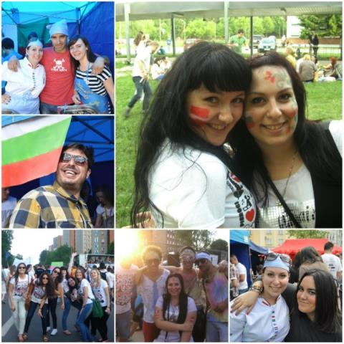
PROFILE OF THE UNIVERSITY OF RUSE
Leading position in Bulgaria in implementing projects with EU funding: 7th Frame Programme, Intelligent Energy for Europe, COST, Cooperation in the Black Sea Basin, Cooperation in innovations and research with Central and Eastern Europe, Programme for Trans-border Cooperation Bulgaria-Romania 2007-2013, numerous projects under OP „Human Resources Development“, etc.
Active international activities:
- Signed 72 frame agreements for cooperation with universities and research institutions from Europe, the USA, Russia, Japan, etc. Signed over 280 Erasmus agreements with universities from 28 countries;

Slide 8
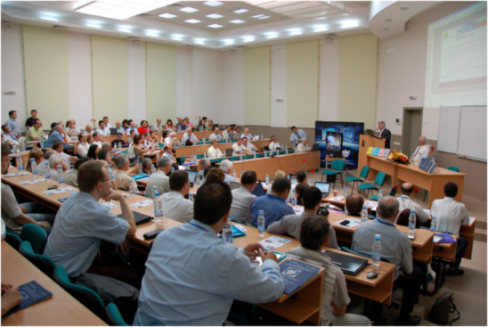
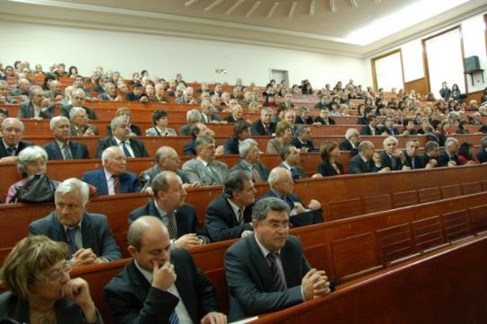
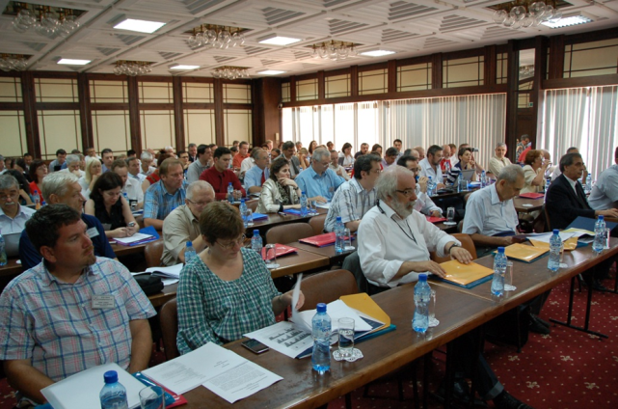
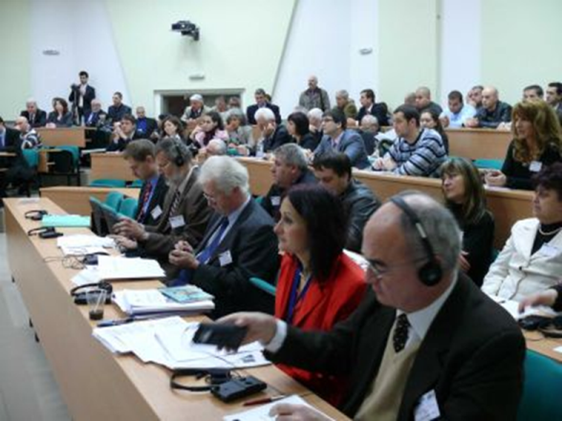
OVER 20 INTERNATIONAL AND NATIONAL CONFERENCES AND WORKSHOPS ARE HELD ANNUALLY, INCLUDING THE PARTICIPATION OF EMPLOYERS

Slide 9
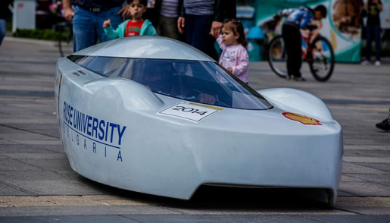
INNOVATIONS

Slide 10
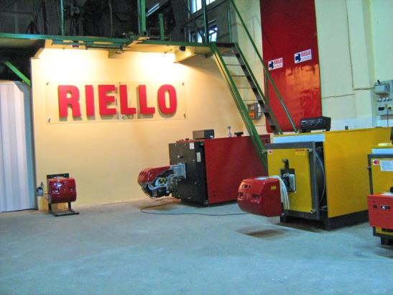
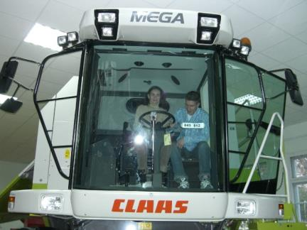
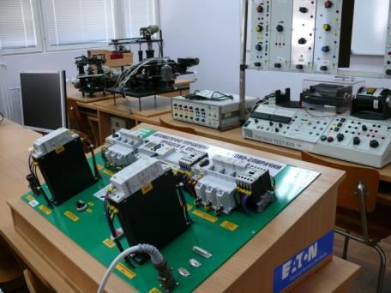
Laboratories worth over 3 mln eur, built by partner companies

Slide 11
KANEFF Centre
In 2013 a congress centre was built- KANEFF Centre,
half of the funding came as a donation by the Bulgarian-born Canadian construction entrepreneur.

Slide 12
THANK YOU
FOR YOUR
KIND ATTENTION!
Antoaneta Dobreva
Academic Erasmus coordinator
adobreva@uni-ruse.bg
Mob: 00359 887 746 311
Vasko Dobrev
Dean of Transport Faculty
vdobrev@uni-ruse.bg

