Slide 1
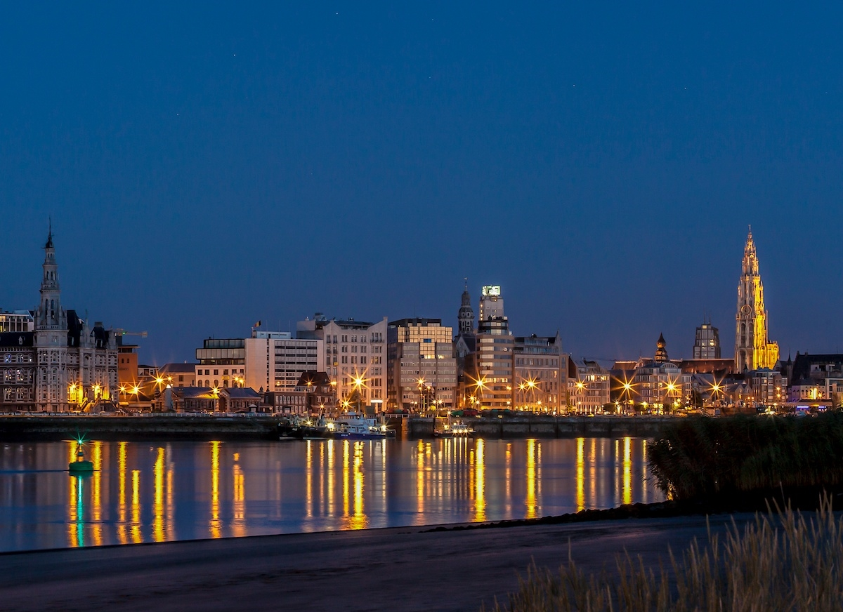


Slide 2
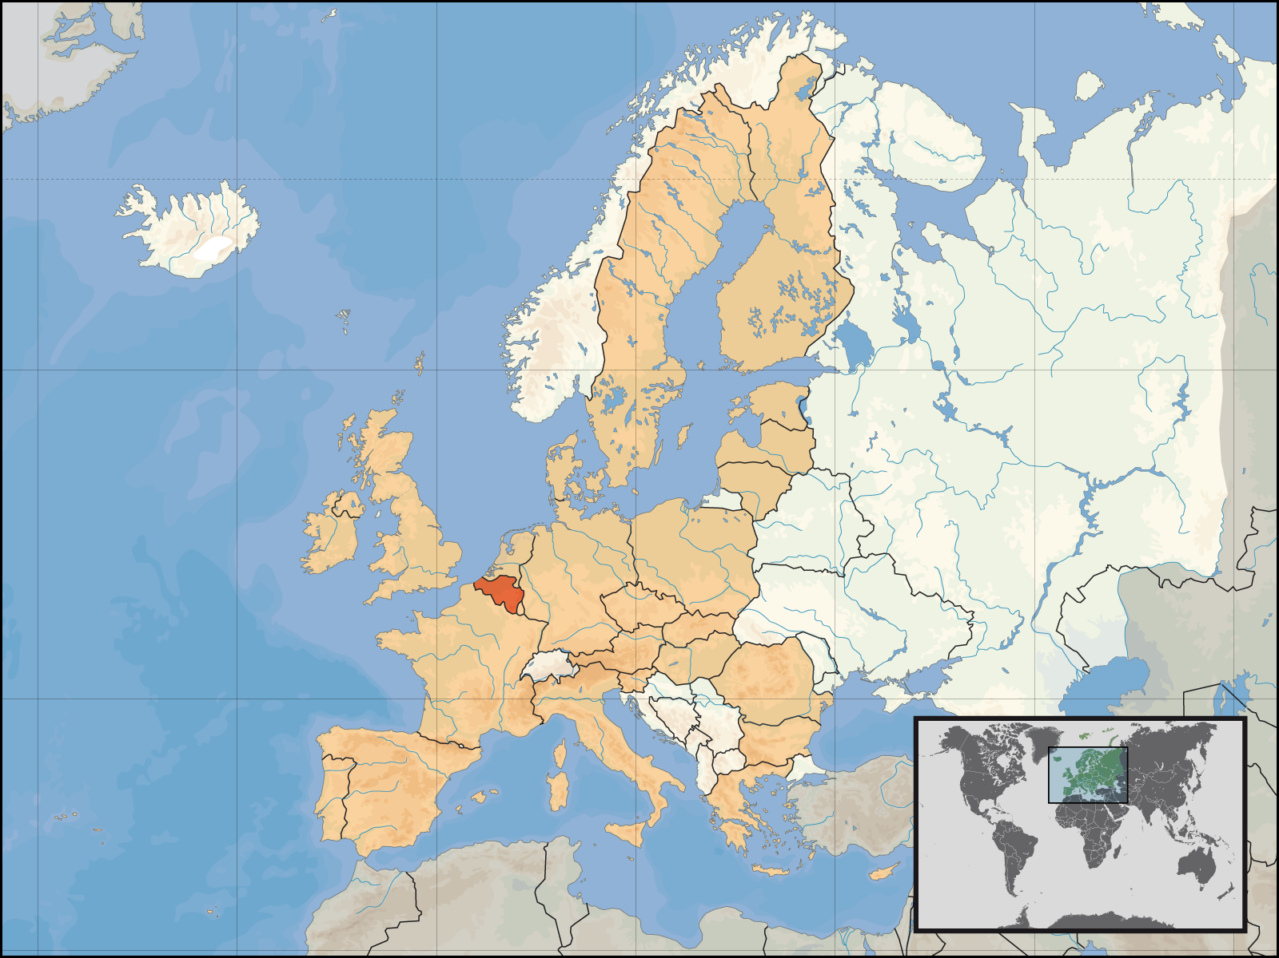

Slide 3
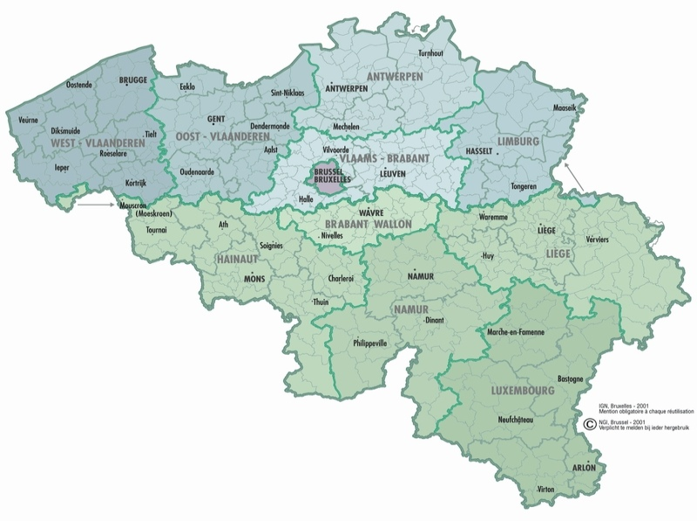

Slide 4
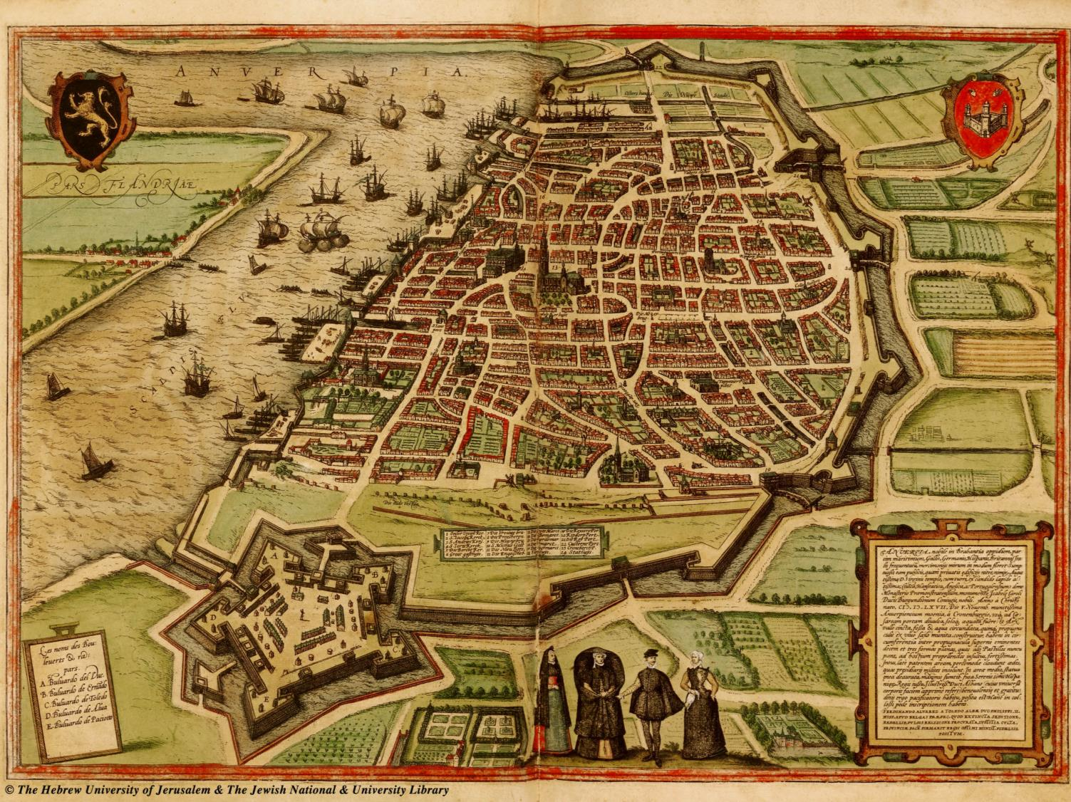

Slide 5
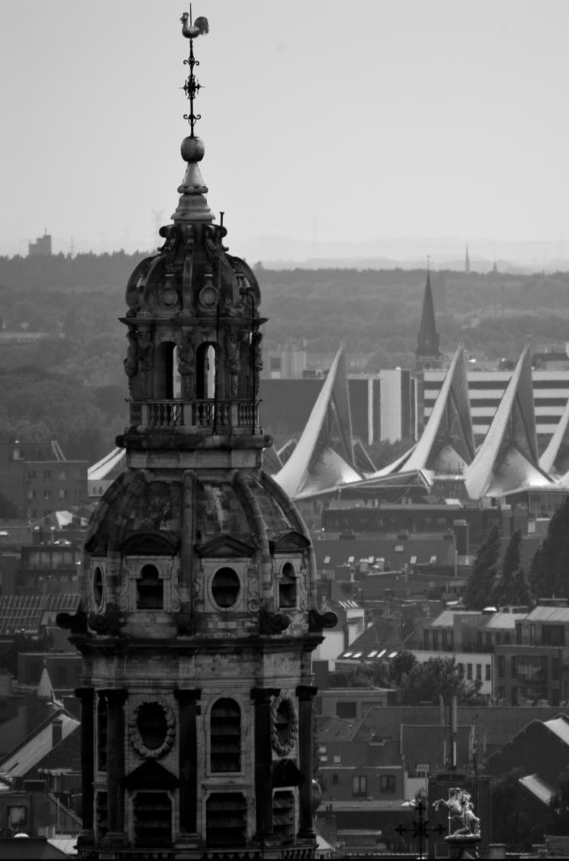
Antwerp metropolis
  511 716 inhabitants
  172 different nationalities
  44 000 students
  1 136 restaurants and cafés
  25 museums
  50 000 trees

Slide 6
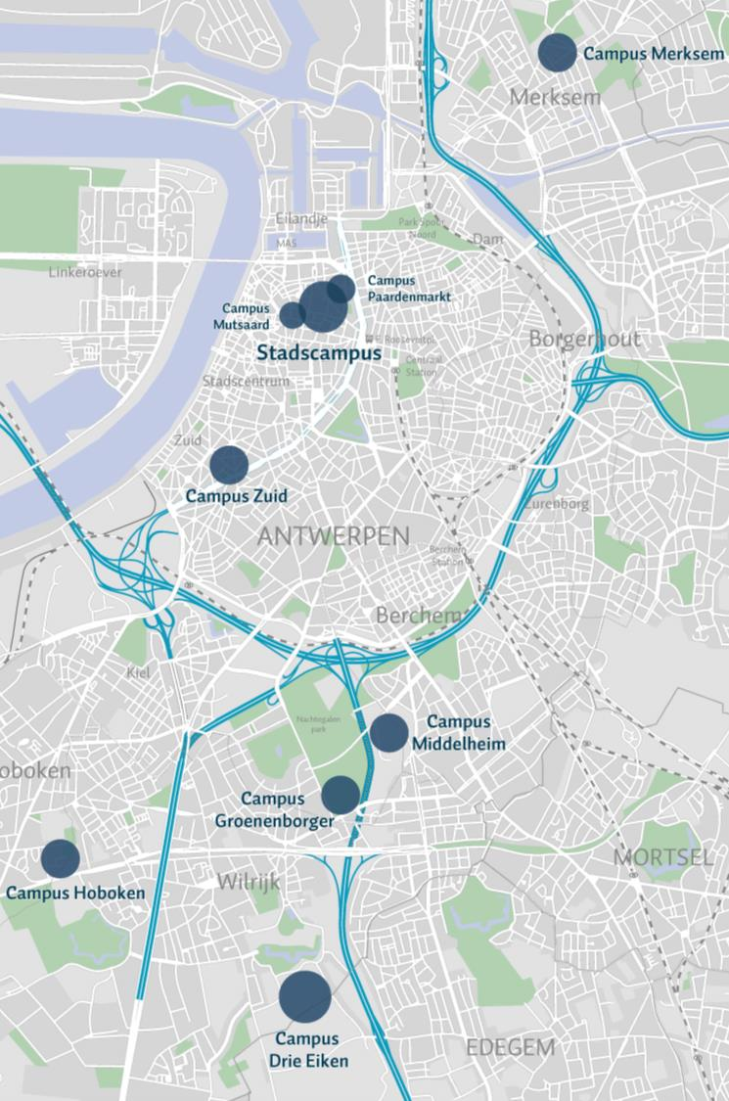
Antwerp Student City
44.000 students in higher education (University, University Colleges and Academy)
2nd largest student city of Flanders
University of Antwerp
  Currently nine campuses
  Near future: some major relocations
  From nine to six campuses
Notes:
Van 9 naar 6 campussen
Industrieel ingenieurs van Campus Hoboken en Campus Paardenmarkt verhuizen in 2016 naar Campus Groenenborger
Revalidatiewetenschappen en kinesitherapie verhuizen van Campus Merksem naar Campus Drie Eiken
Toegepaste Taalkunde (Vertalers Tolken) verhuizen naar Stadscampus

Slide 7
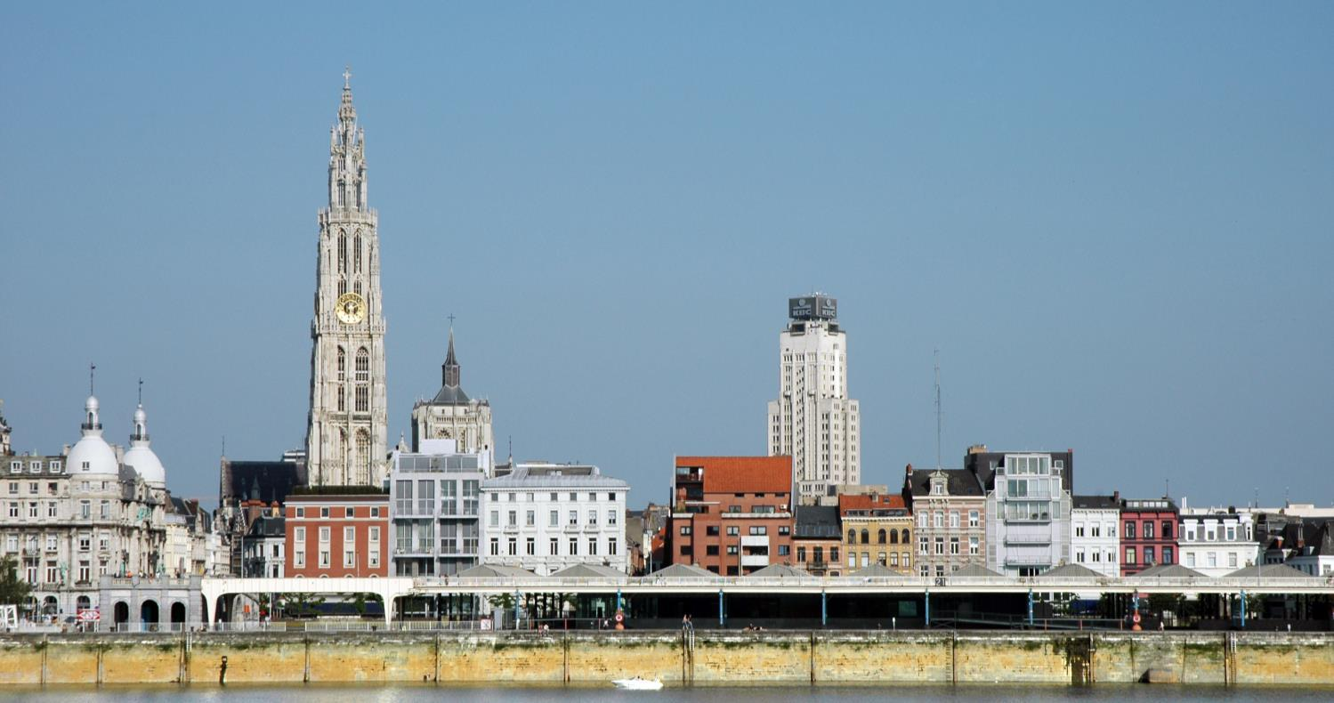
Reasons to opt for Antwerp

Slide 8
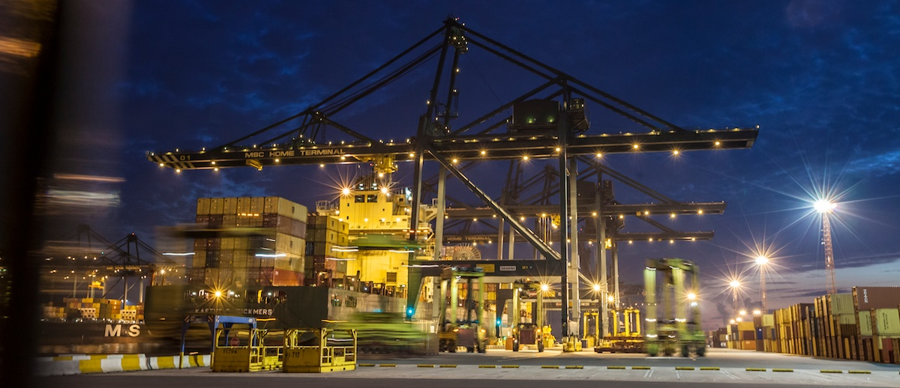
Antwerp’s port: Centre of Trade

Slide 9
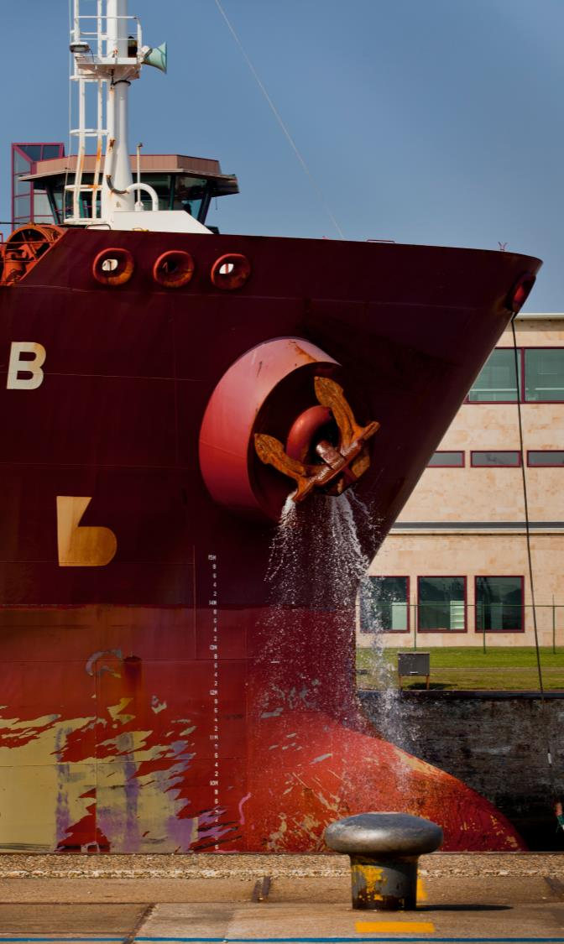
The port of Antwerp
Second largest port in
Europe
16th worldwide
12 million container
units handled annually
247 million euros
turnover every year

Slide 10
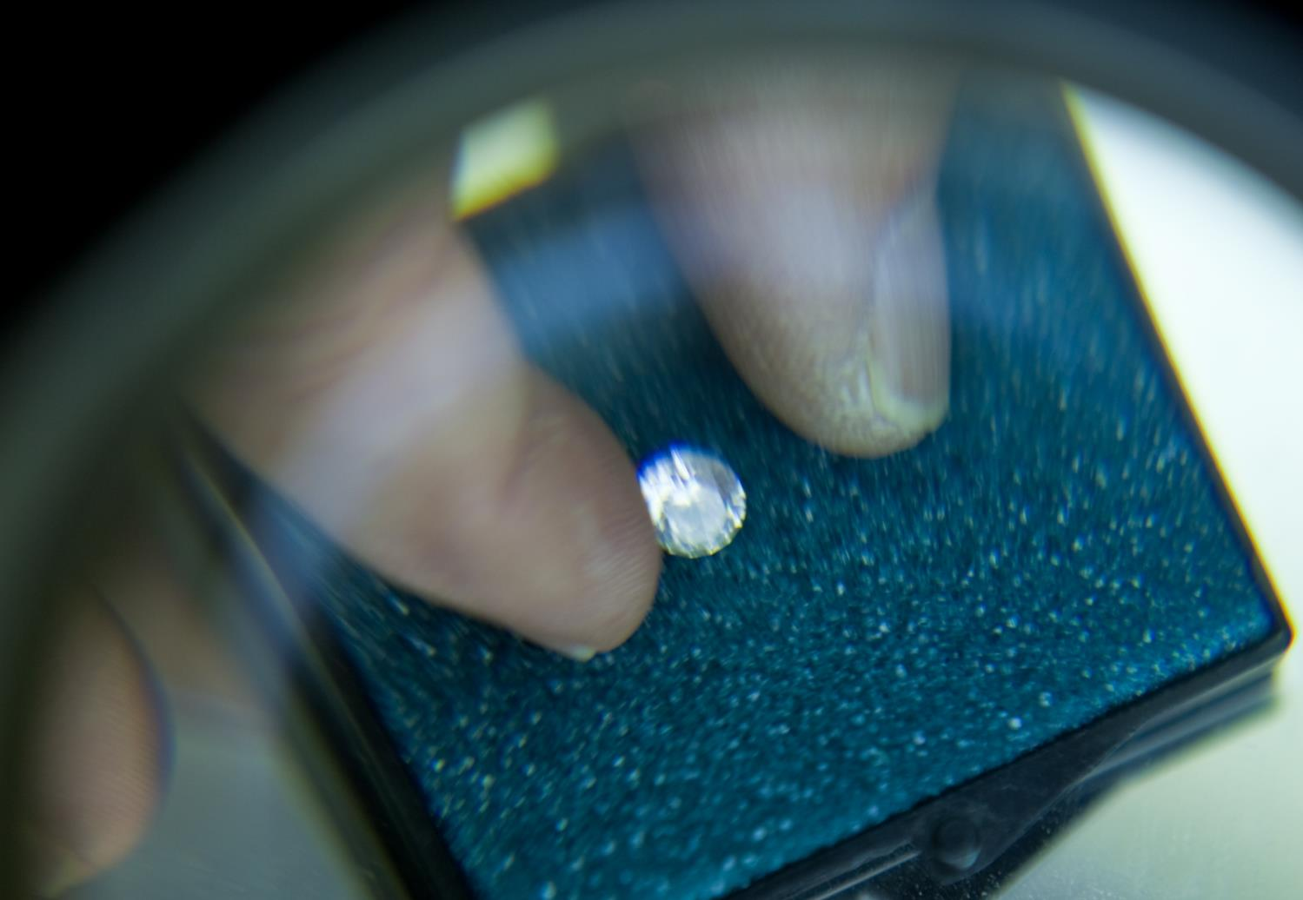
Diamond Sector Antwerp

Slide 11
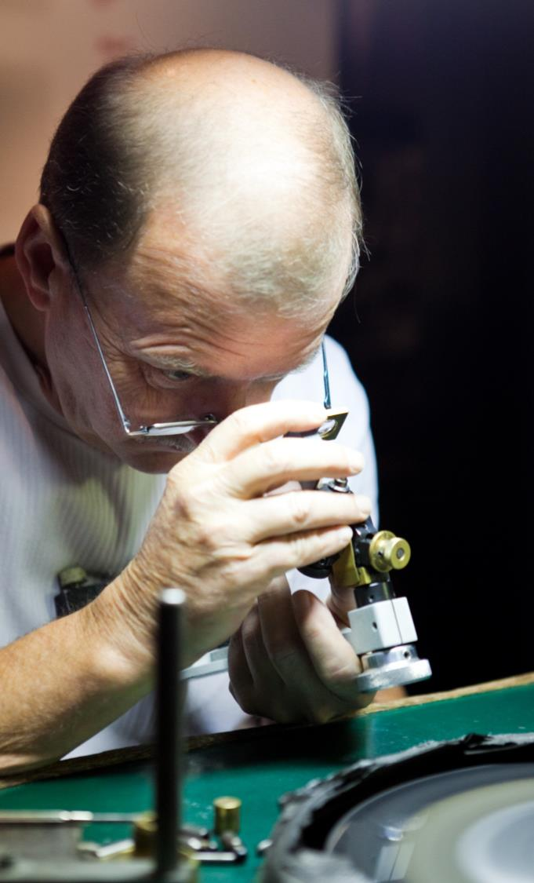
Diamond sector Antwerp
80% of world trade in rough diamonds and 50% in cut diamonds takes place in Antwerp.
2060 diamond companies
34 000 direct & indirect jobs
Turnover 51.9 billion dollars (2012)

Slide 12
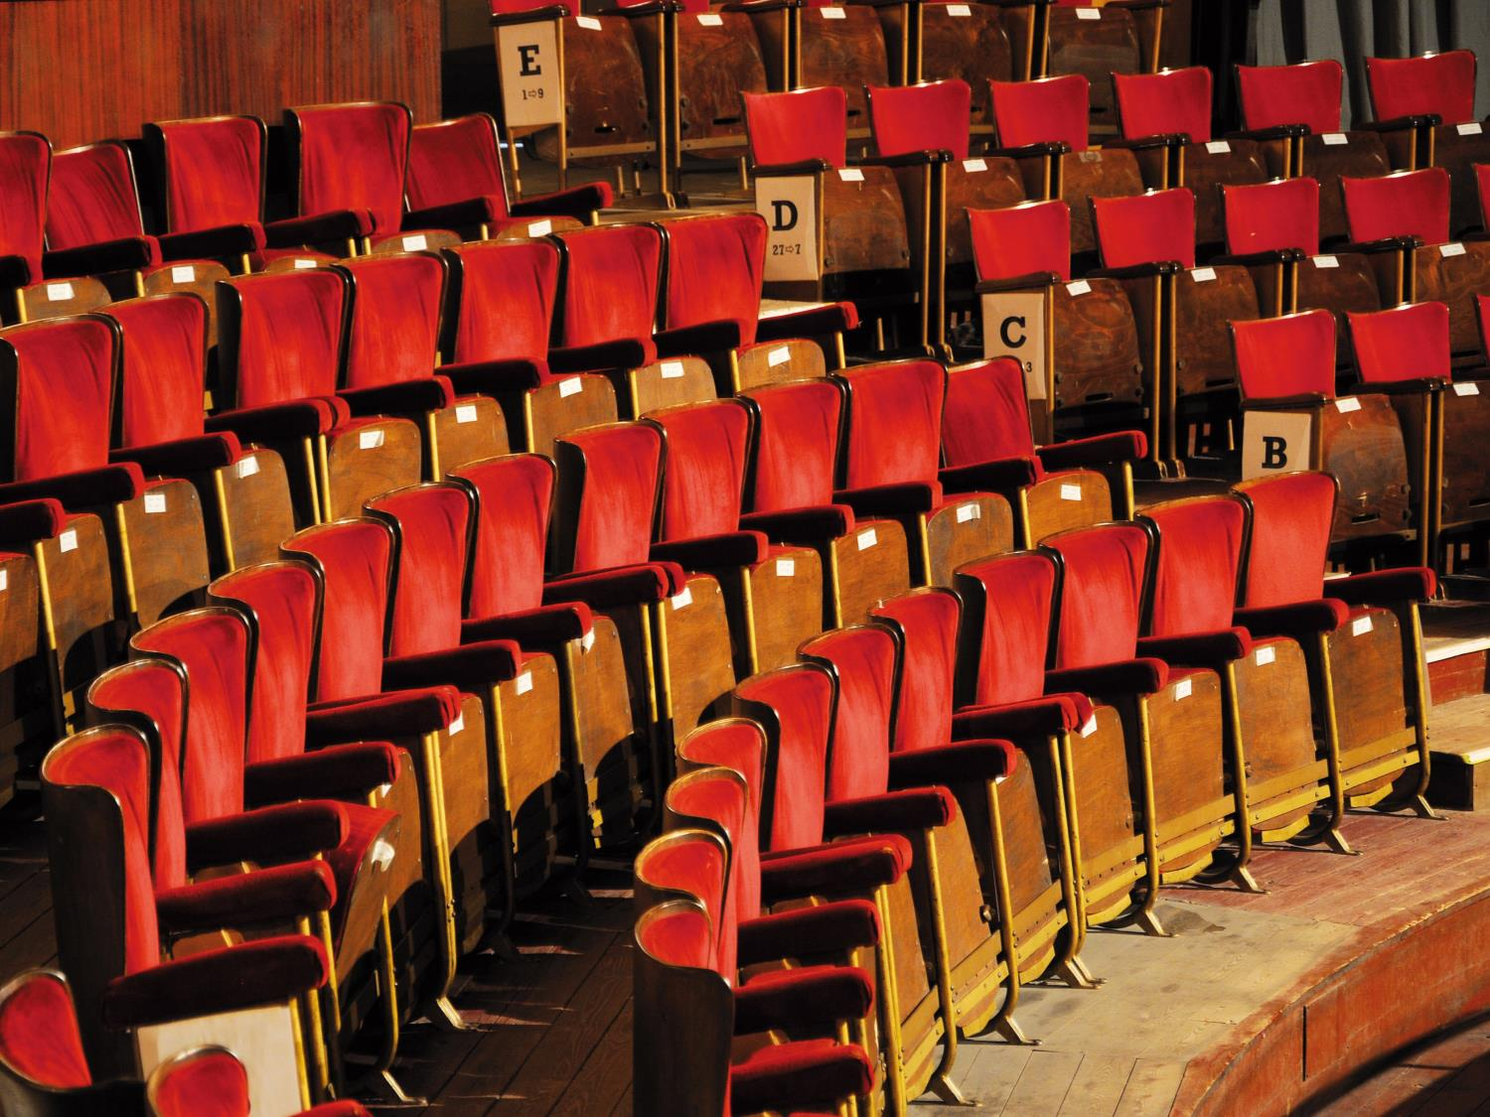
Sparkling cultural life

Slide 13
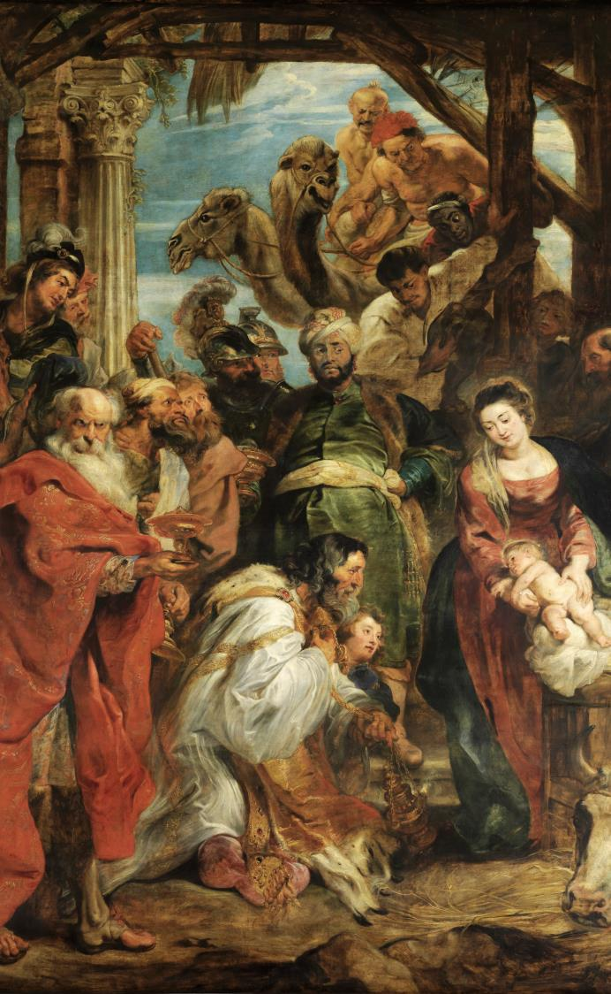
Culture in Antwerp
25 museums
800 000 objects of art
30 theatres
Local and international
performances
Famous festivals like
Tomorrowland,
Laundry Day and Summer of Antwerp

Slide 14
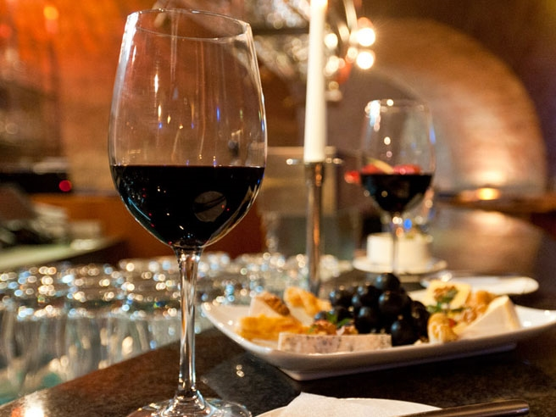
Exquisite wining and dining

Slide 15
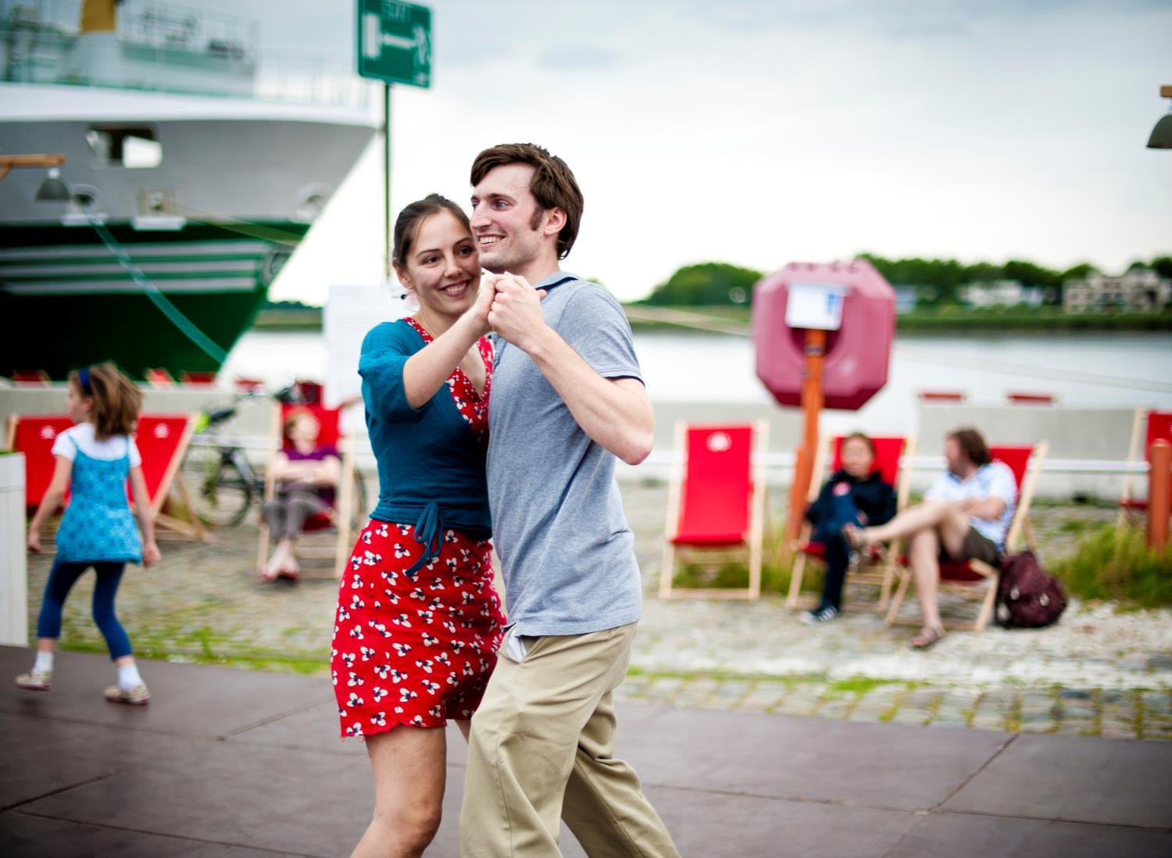
Various sports activities

Slide 16
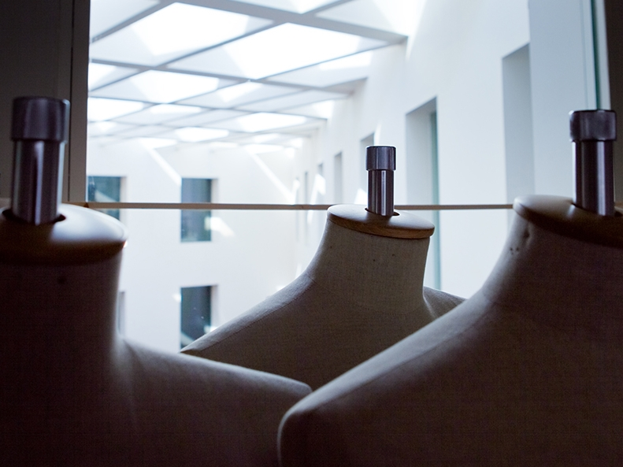
The catwalk of Europe

Slide 17
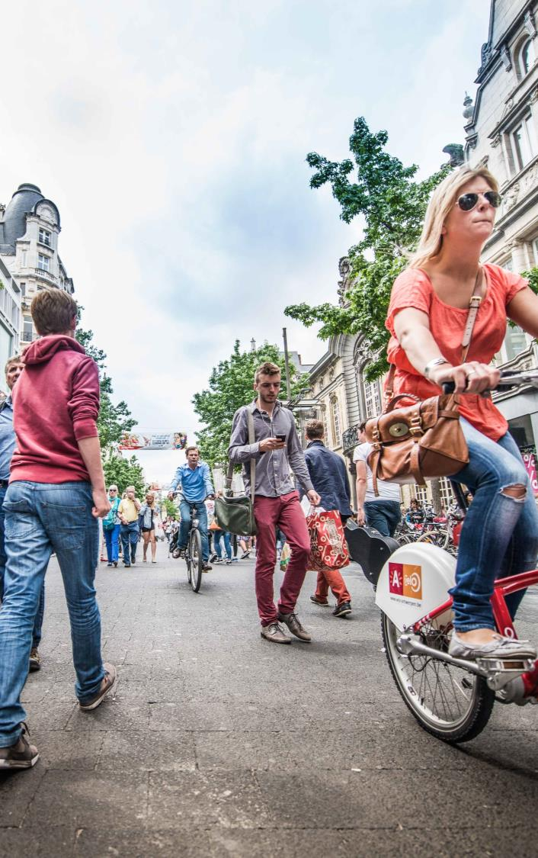
City of Fashion
Fashion, Design & Shopping
Royal Academy of Fine Arts
Fashion Museum
Famous fashion designers:
    Dries van Noten
    Ann Demeulemeester
    Dirk Bikkembergs
    A.F. Vandevorst

Slide 18

Green city and surrounding areas

Slide 19
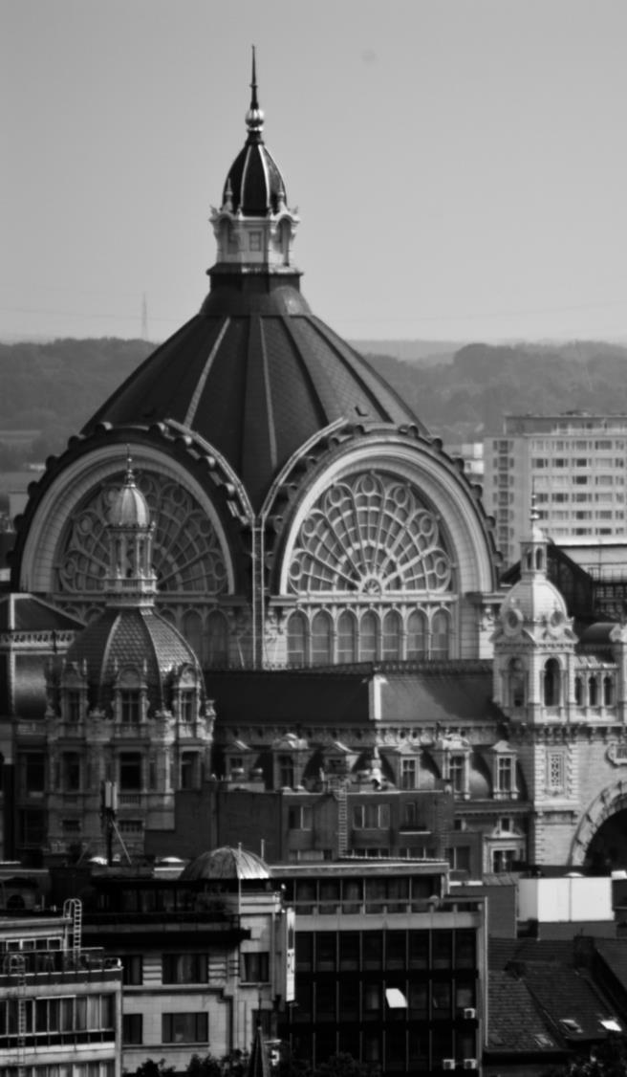
Antwerp metropolis easily accessible
Bike
Bicycle rental system
Bus and tram
Extensive network
Train
Antwerp Central Station is one of the most beautiful train stations in the world
Easily accessible from cities in Belgium, The Netherlands, Germany and France
Stop for Thalys
Airport Deurne

Slide 20
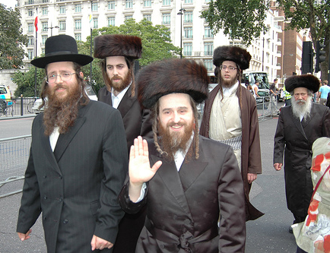
Antwerp metropolis in pocket size
Surprisingly multicultural
More different registered nationalities than in NYC
Places of worship of more than 140 different ‘religions’
Cheap compared to the rest of Europe
You can even survive with English only

Slide 21
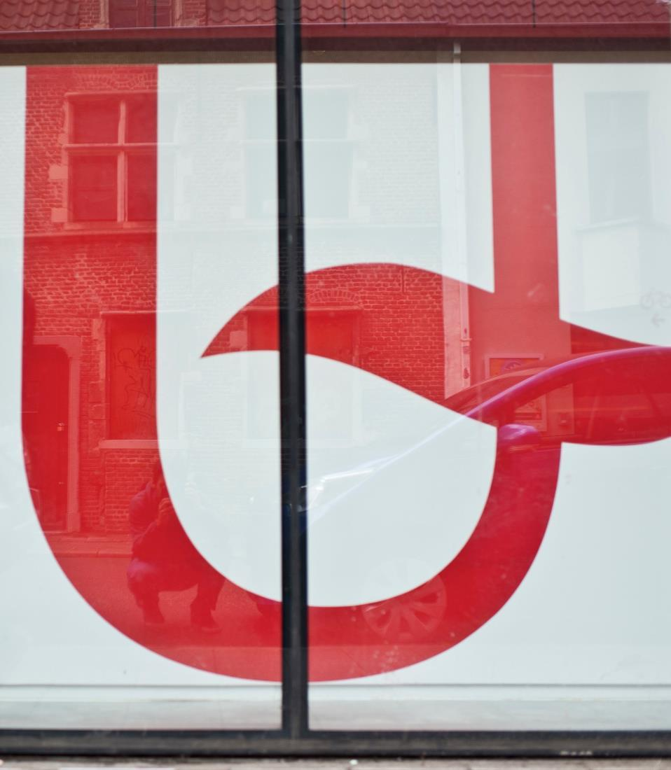

University of Antwerp

Slide 22
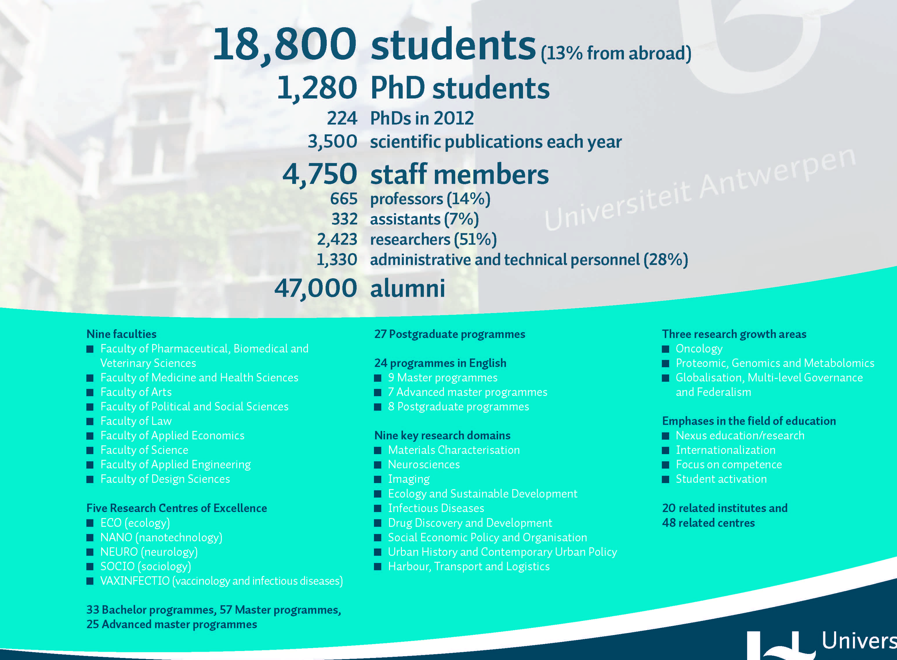

Slide 23
9 faculties
Applied Engineering Sciences
Design Sciences
Pharmaceutical, Biomedical and Veterinary Sciences
Arts and Philosophy
Law
Political and Social Sciences
Applied Economic Sciences
Medicine and Health Sciences
Science

Slide 24

Top 50 Universities under 50, 2014:
10th place worldwide

Slide 25
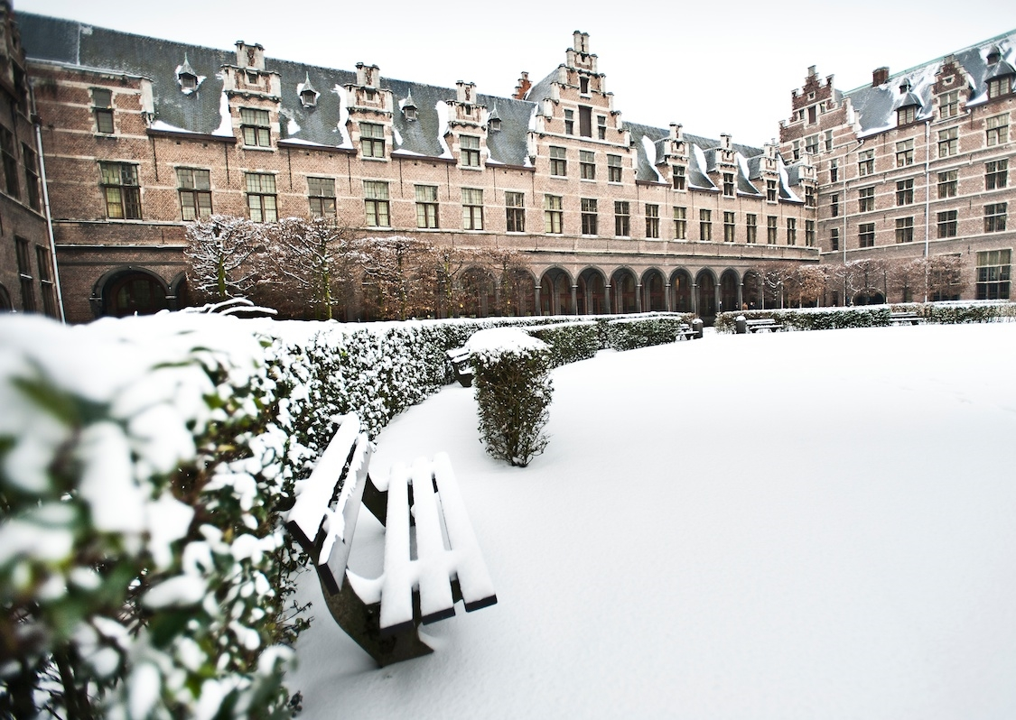
Faculty of Law City Campus

Slide 26
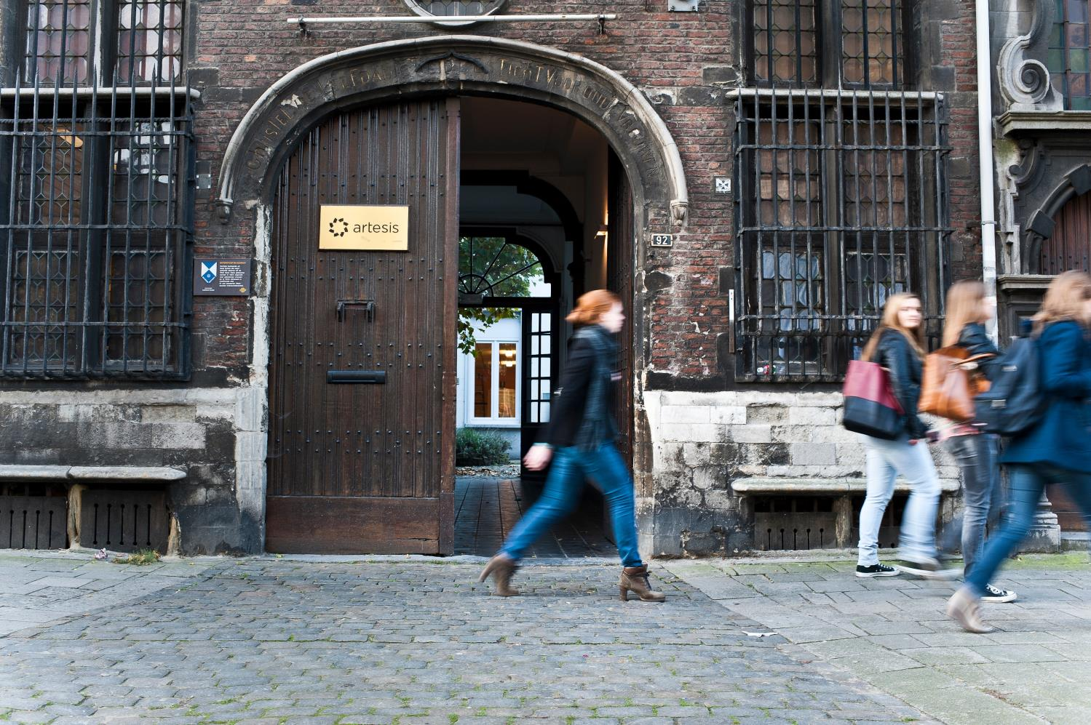
City Campus

Slide 27
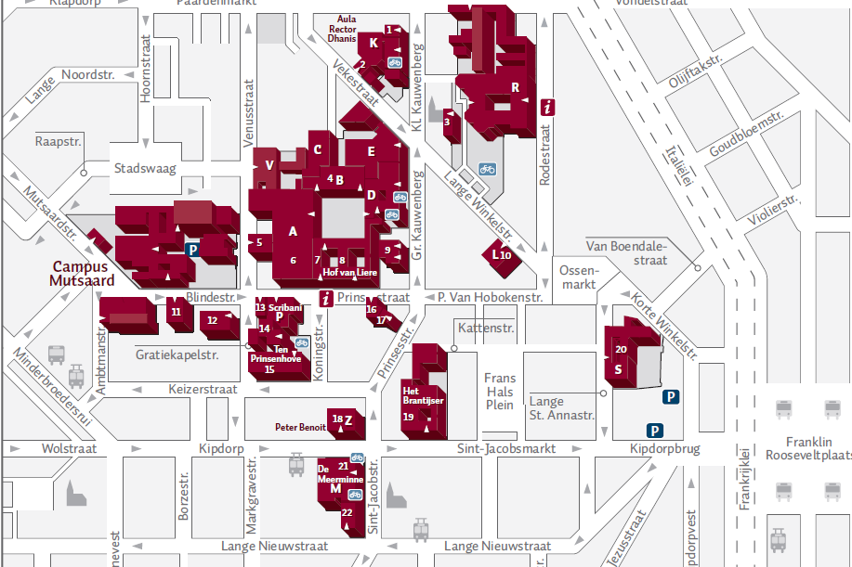

Slide 28
Faculty of Law
Programmes
  Bachelor of Laws (3 yrs) +/- 400 first year students
  Master of Laws (2 yrs) (in Dutch) +/- 190 graduates per year
  From 2016-2017: Master of Laws (2yrs) in English
  Master in Safety Sciences (2 yrs)
  Advanced Master in Tax Law (1 yr)
  Advanced Master in Corporate Law (1 yr)
  Doctoral programme in law
  www.uantwerp.be/rechten

Slide 29
Faculty of Law
approximately 85 incoming exchange students per year
  mostly EU (Erasmus Socrates exchange)
  also bilateral exchanges (Australia, Brazil, China, India, Puerto Rico, South Africa, United States)
From 2016-2017 incoming exchange students take courses from the Master of Laws
  Students taking 30 ECTS in a semester or 60 ECTS in a year receive the certificate ‘International and European Legal Studies Programme’

Slide 30
% of master students that was ‘mobile’ during studies

Slide 34
Faculty of Law
NETWORKS
Partners for student exchange
CIEL programme
Networks: Academia Network and Nanterre network
Memoranda of Understanding

Slide 35
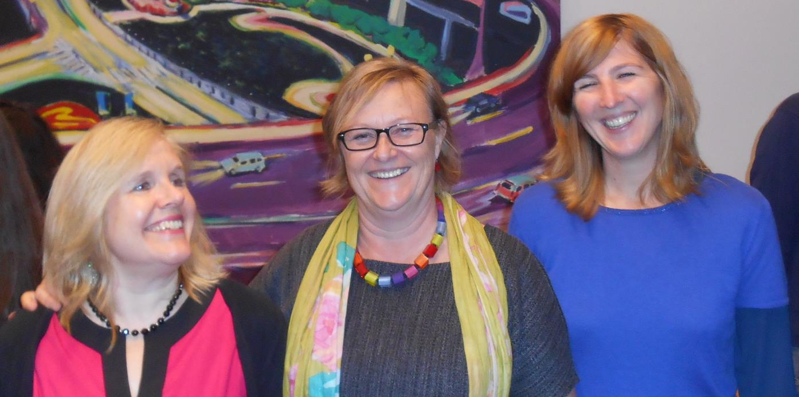
Our faculty’s International Office: Terry - Mieke - Nele

Slide 36
