Slide 1
Enhancing the quality framework of student mobility
The AsCOLA project and tool
Speaker(s) Name(s)

Slide 2
The vision
Close the data gap on quality of HE internationalisation
Enhance students' academic experience
Allow HEIs to assess and monitor institutional performance

Slide 3
The expertise

Slide 4
The main results
Evaluation methodology for courses offered to Erasmus+ students
Online course evaluation tool
Training sessions and materials
Connected to the Online Learning Agreeement (OLA)
Supporting HEIs in using the tool effectively

Slide 5
The online course evaluation tool – why is it important?
For students
Ensures their voices are heard
Encourages informed decisions on prospective courses to be taken abroad
For Universities
Provides a streamlined way to collect feedback from this specific target group
Increases the quality of the mobility experience
Promotes improvement of their services
Aligns their course offer for mobility students with high-quality standards

Slide 6
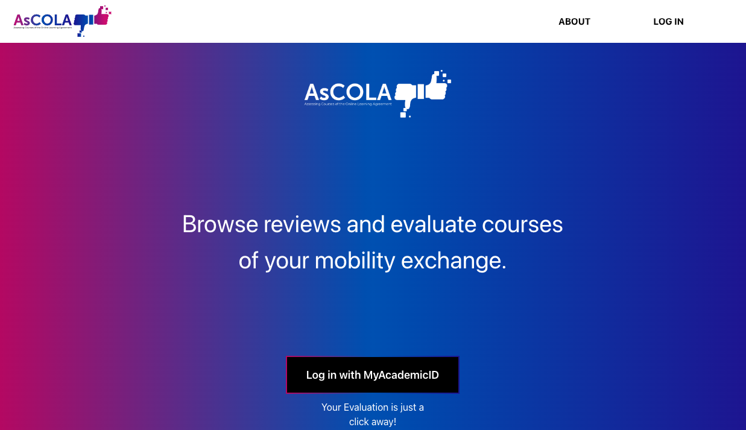
Praesent vel blandit purus
Praesent non lectus eu ipsum varius aliquam.
Aenean interdum lectus quis tellus porttitor, id fringilla ipsum hendrerit.
Praesent eget sem in ligula efficitur tincidunt id a lectus.

Slide 7
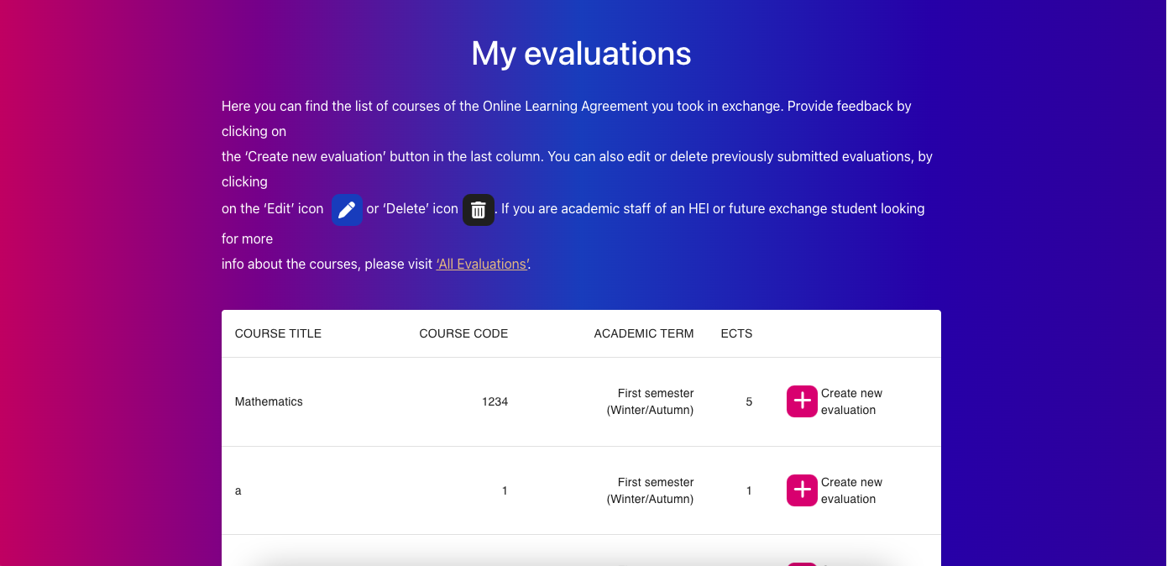
Praesent vel blandit purus
Praesent non lectus eu ipsum varius aliquam.
Aenean interdum lectus quis tellus porttitor, id fringilla ipsum hendrerit.
Praesent eget sem in ligula efficitur tincidunt id a lectus.

Slide 8
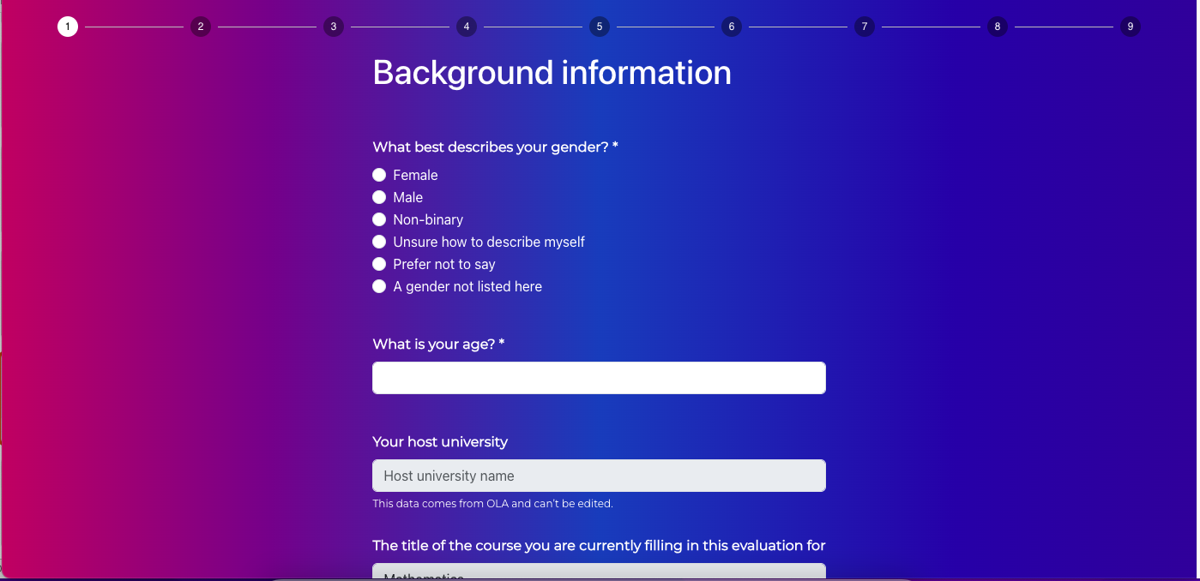
Praesent vel blandit purus
Praesent non lectus eu ipsum varius aliquam.
Aenean interdum lectus quis tellus porttitor, id fringilla ipsum hendrerit.
Praesent eget sem in ligula efficitur tincidunt id a lectus.

Slide 9
Thank you for your attention!
project.uni-foundation.eu/ascola

