Slide 1
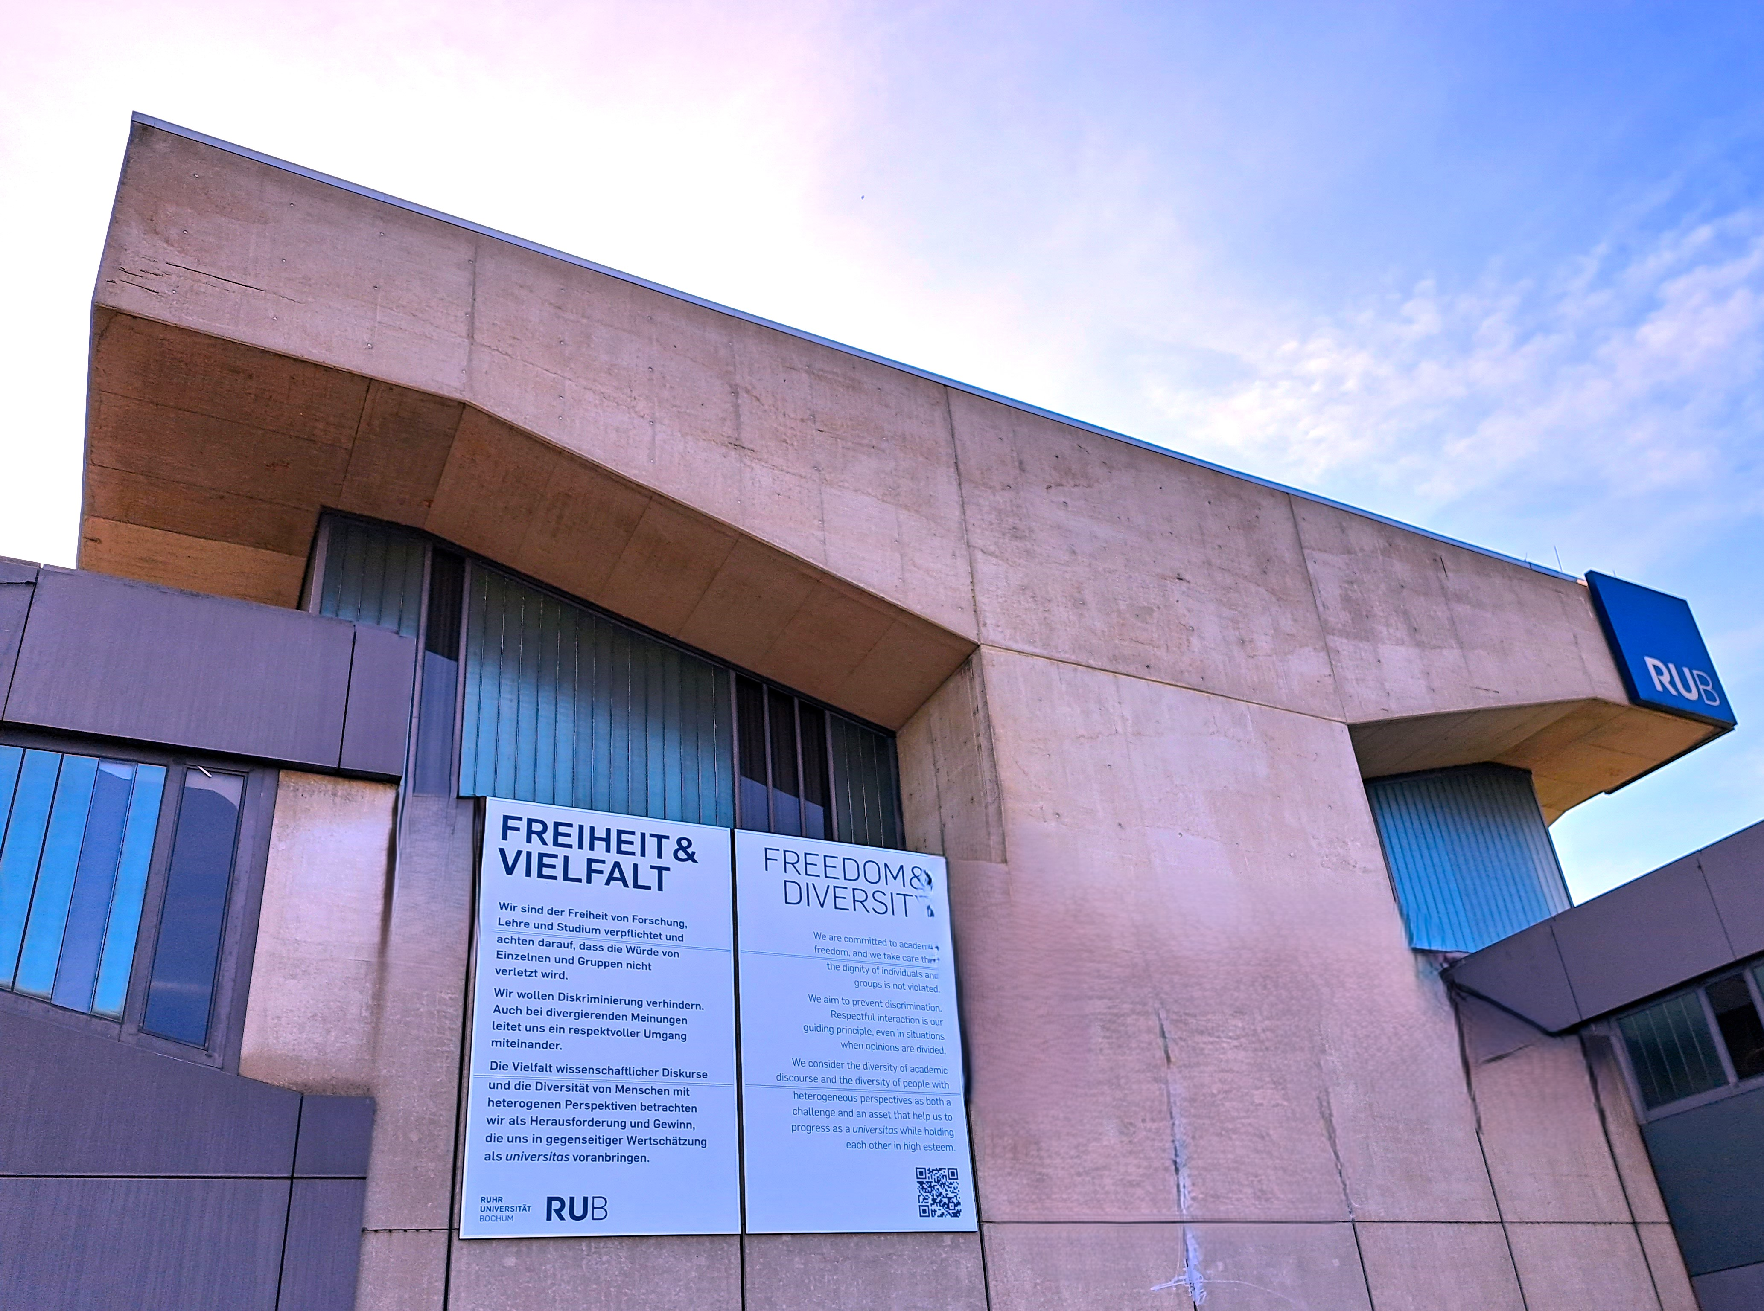
Promoting Academic Freedom and Supporting At-Risk Scholars at Ruhr University Bochum: From Local to INternational

Slide 2
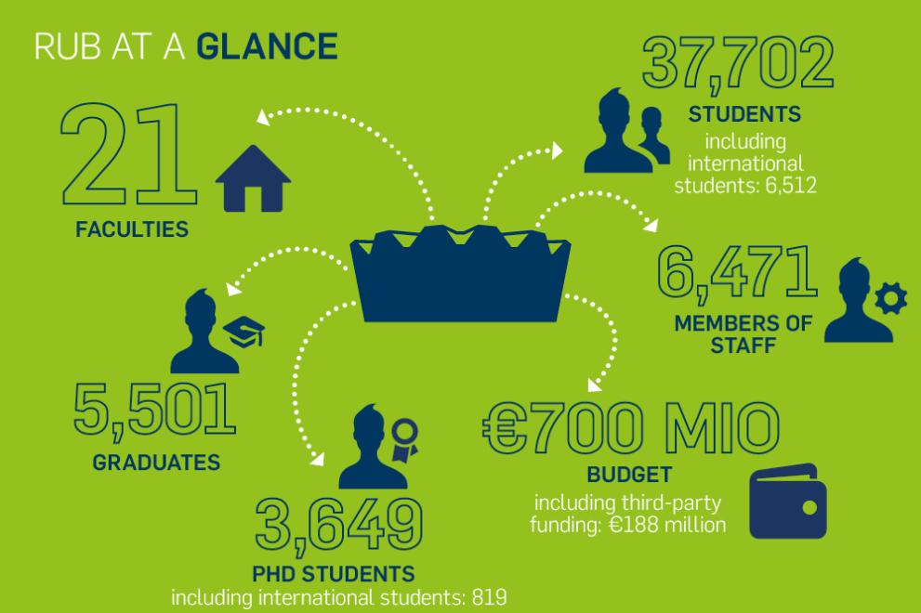
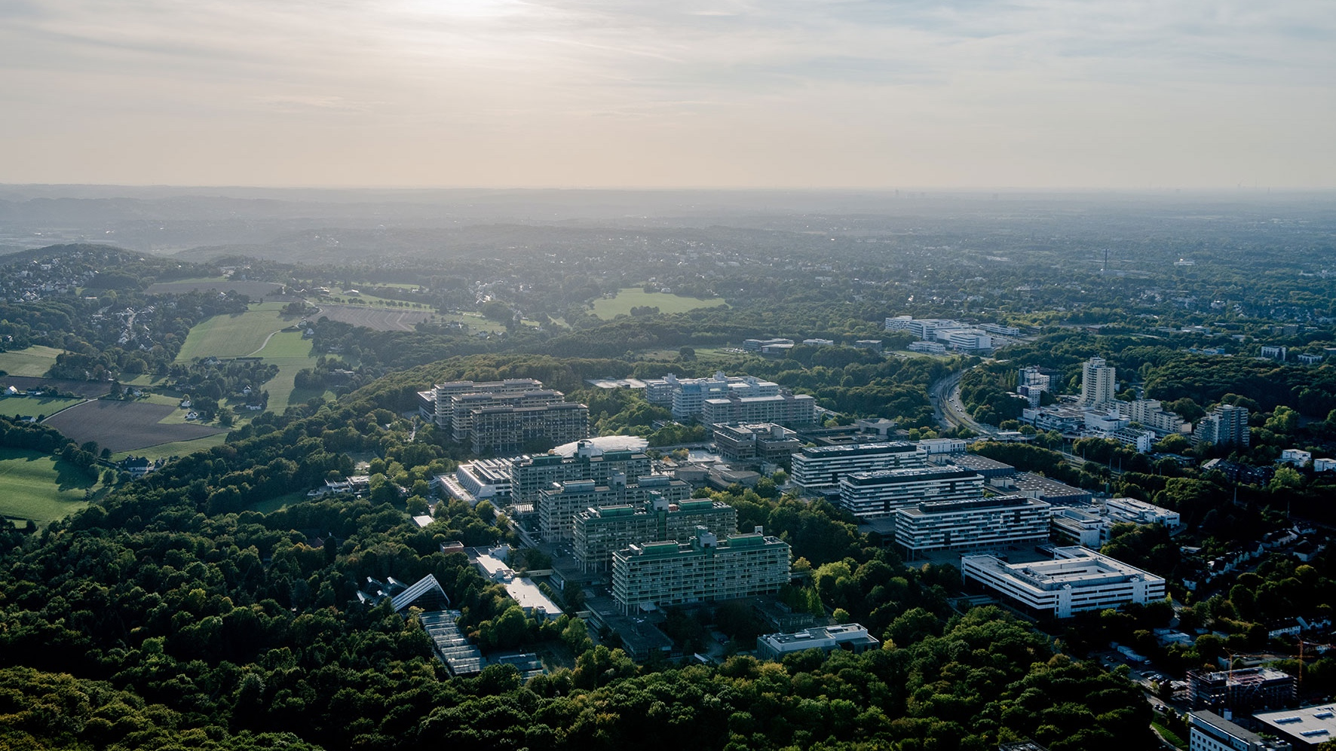
RUHR UNIVERSITY BOCHUM AT A GLANCE
    BUILT TO CHANGE. SINCE 1965
BUILT TO TRANSFORM SOCIETY
    Diversity
    Sustainability
    Internationalisation
    Digital Transformation

Slide 3

TOWARDS A WHOLE-INSTITUTION APPROACH
ACADEMIC FREEDOM-ACADEMIC SOLIDARITY- ACADEMIC RESPONSBILITY
Embedded in Vision & Mission
Strategic Alignment
Cross-Cutting Theme (Principles to Implement Academic Freedom as a Right)
International Office as Central Institutional Coordinator/Hub
Creating Knowledge Networks: From Local to International
Notes:
INSTITUTIONAL HUB: International Office
STRATEGIC ALIGNMENT: Internationalisation, Diversity, Sustainability, Digitalisation
CROSS-CUTTING THEME: Codices, Services, Research, Teaching and Learning, Knowledge Transfer, Public Policy and Human Rights Advocacy, Networking
MULTIPLE STAKEHOLDERS: University Leadership, Faculty, Students, Administration, University Networks, Schools, City/Citizens/Civil Society, Funding/Science Organisations

Slide 4




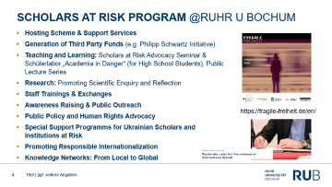
SCHOLARS AT RISK PROGRAM @RUHR U BOCHUM
    Hosting Scheme & Support Services
    Generation of Third Party Funds (e.g. Philipp Schwartz Initiative)
    Teaching and Learning: Scholars at Risk Advocacy Seminar & Schülerlabor „Academia in Danger“ (for High School Students), Public Lecture Series
    Research: Promoting Scientific Enquiry and Reflection
    Staff Trainings & Exchanges
    Awareness Raising & Public Outreach
    Public Policy and Human Rights Advocacy
    Special Support Programms for Ukrainian Scholars and Institutions at Risk
    Promoting Responsible Internationalization
    Knowledge Networks: From Local to Global
https://fragile-freiheit.de/en/

Slide 5
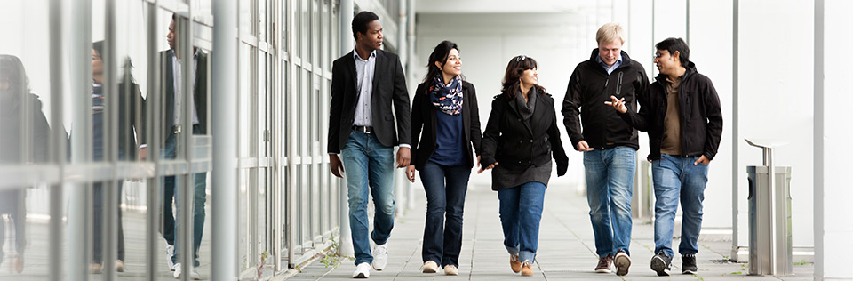

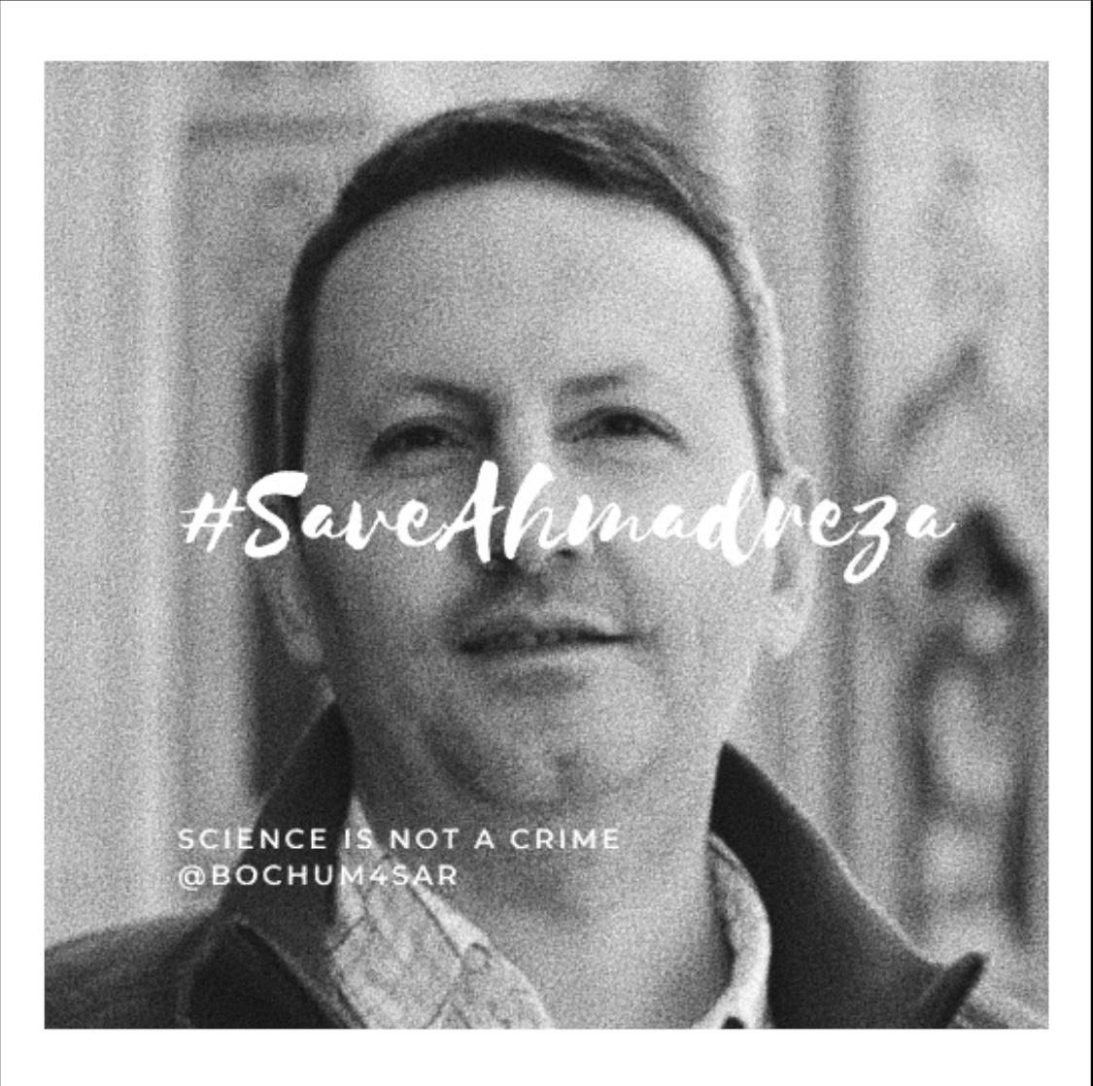
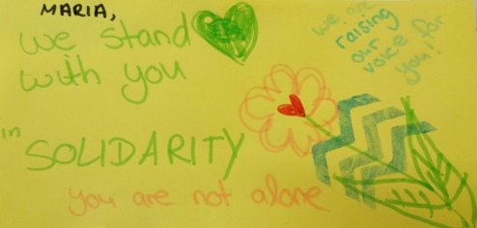
RUHR U BOCHUM SUPPORT FOR SCHOLARS AT RISK: FACTS & FIGURES
When it all started @RUB in the 1960s: Hosting & Fellowships for Researchers from Afghanistan, Afghanistan Institute & Program
Fellowships for RAR since 2016: 60
Philipp Schwartz Fellowships (Avh)
Walter Benjamin Fellowships (DFG)
Scholar Rescue Fund Fellowships
Hilde Domin Fellowships (DAAD)
Other Sources

Slide 6

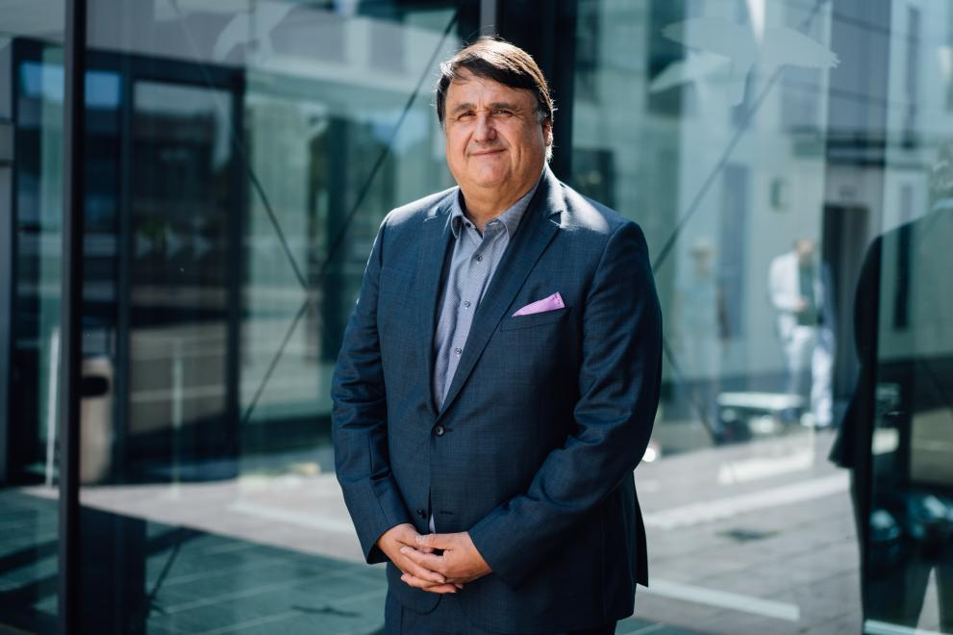
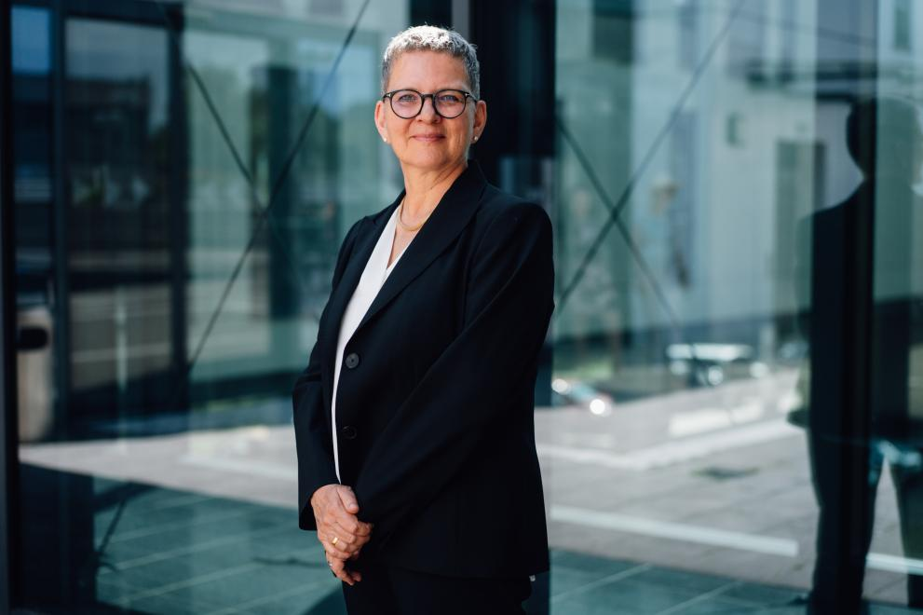
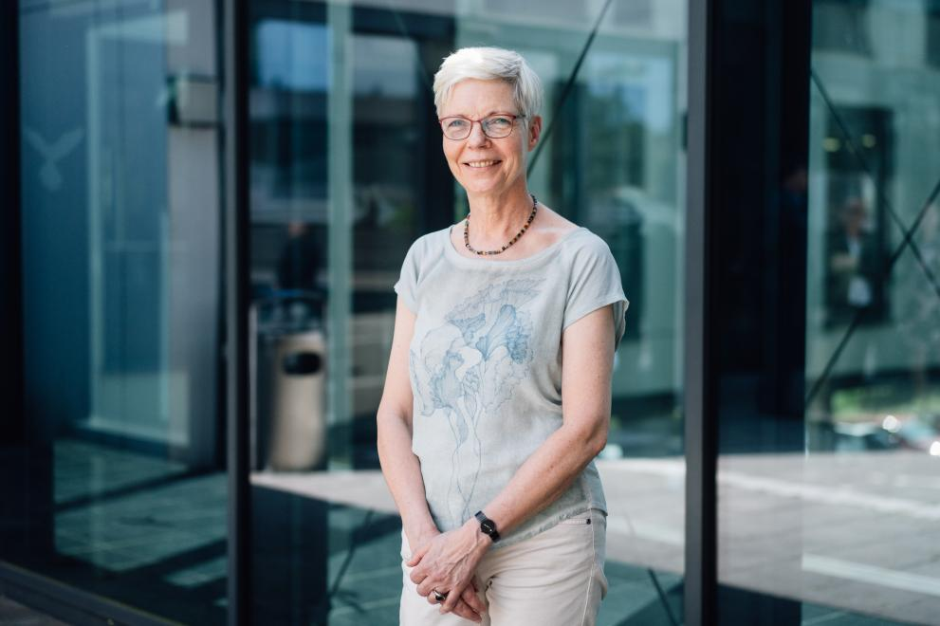




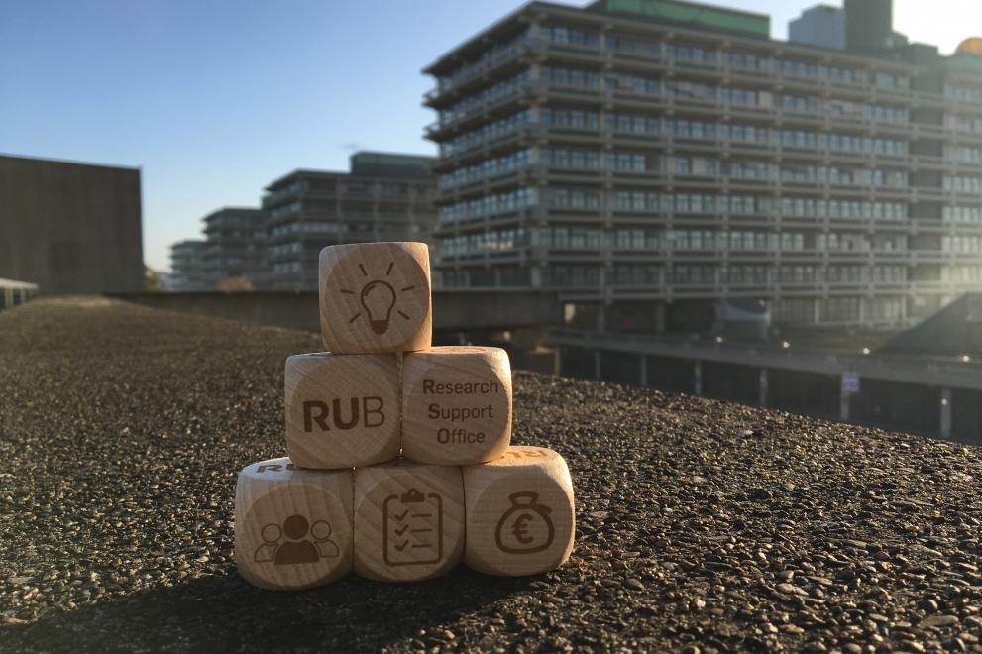




LOCAL NETWORKS: UNIVERSITY WITHOUT BORDERS
    Tailor-made programs, services and fellowships for at-risk, refugee and forcely displaced researchers and students
    Fellowships (e.g. Philipp Schwartz Initiative, DFG Walter Benjamin, DAAD Hilde Domin)
    Welcome Services: Information, Orientation & Advice (visa, registration, family services, housing support, IT.Services)
    Research Support Services
    Transfer and Start Up Support Services
    Social and Interdisciplinary Networking Events
    Psychological/Trauma Counselling
    Professional Development & Training Programs
    Academic Mentoring & Coaching
    Antidiscrimination Office, Ombudsperson
    Integration into (International) Collaborations & Networks
Rectorate
International Office

Slide 7
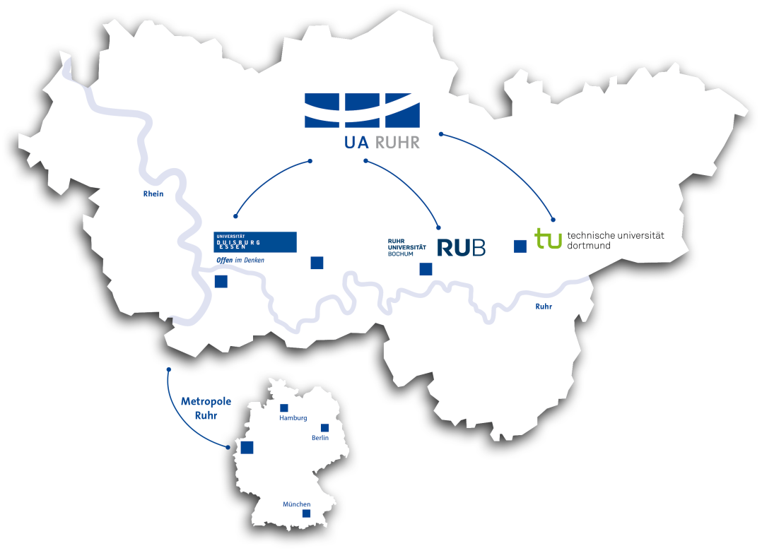
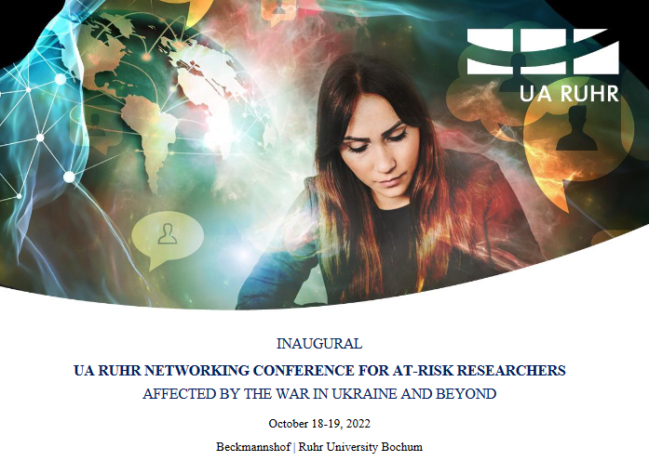



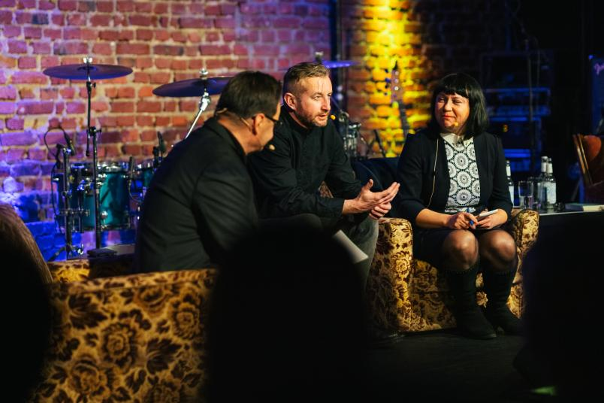
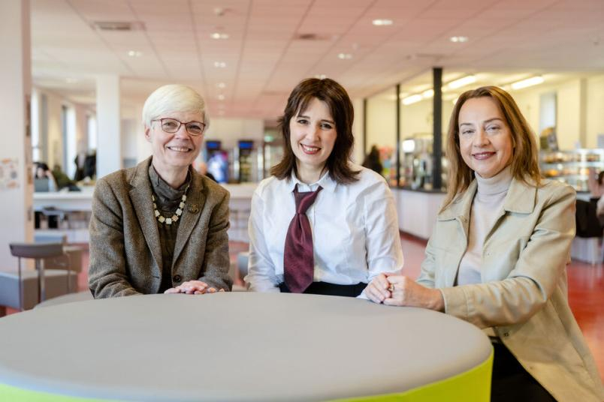

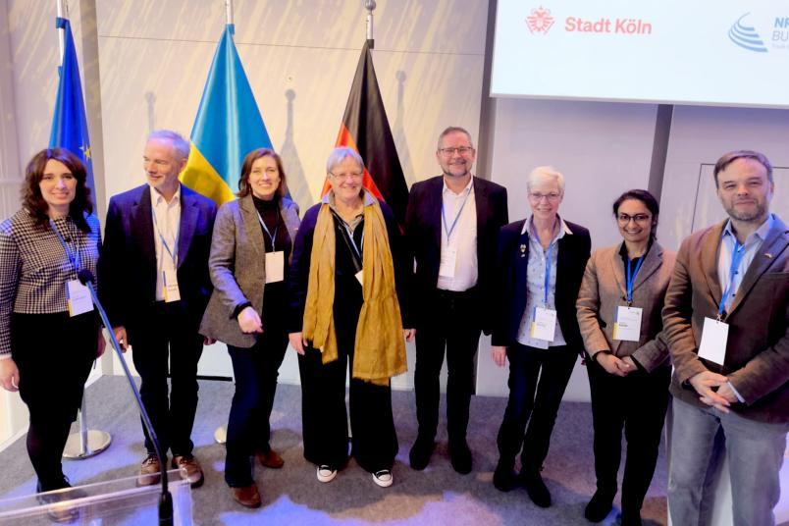
REGIONAL NETWORKS: UNIVERSITY ALLIANCE RUHR
Fedor Stepun Fellowships
DAAD Digital Laboratories for Students at Risk
Benefit Concert & Poetry for Ukrainian Partner Institutions by Serhij Zhadan
DniPro NRW
Exhibition „Pictures from Bachmut“ (V. Ivleva)
Faculty and Institutional Partnerships with Ukrainian Universities & Mobility Schemes

Slide 8


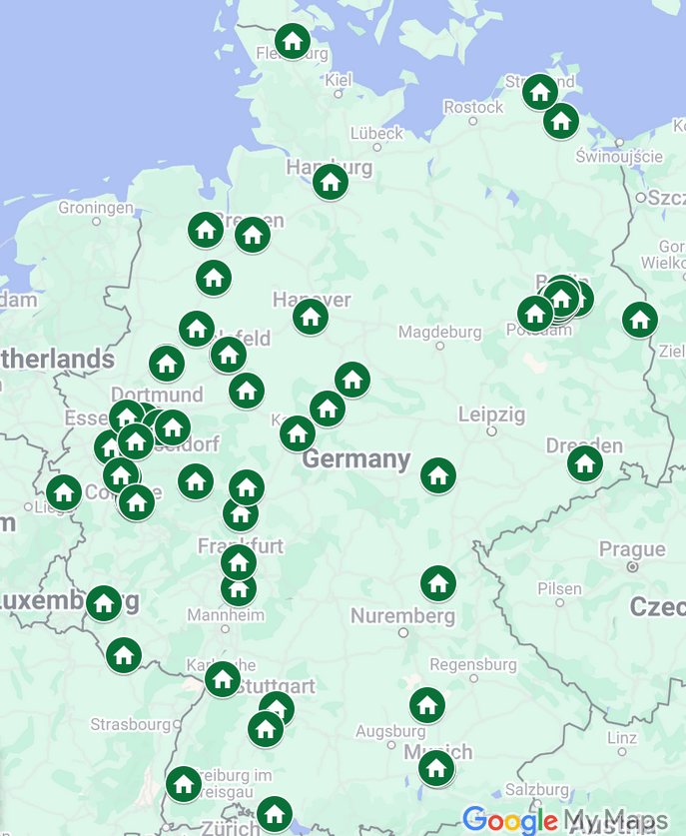
NATIONAL NETWORKS:
Founding Member since 2016
Member of Steering Committee (2016-19, 2022-2025)
    Annual Philipp Schwartz Stakeholder Forum
    SAR Global Congress (Berlin)
Founding Member of Regional Group North-Rhine Westfalia
    Regular Peer Support/Coaching
    Public Lecture Series 2022/23
    Joint Professional & Career Development Program for RARs/PSI Fellows (for careers inside and outside academia)

Slide 9

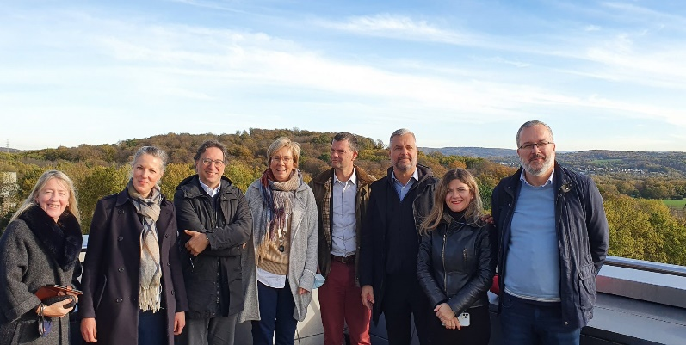






EUROPEAN NETWORKS:
Responsible Internationalization and Global Engagement:
Promoting Academic Freedom and Responsibility in International Higher Education and Research
Peer Exchange and Coaching
UN RIGE Survey & Mapping & Virtual Map
UN RIGE Repository
UN RIGE Public Lectures
UN RIGE Staff Training „Responsible Internationalization & Institutional Support to At-Risk Scholars“ @ AUTH
UN RIGE Summer School „Advocacy for Academic Freedom and Human Rights - internationalization in a fragmented world” @ Utrecht U (August 2025!)
https://utrecht-network.org/task-forces/rige/

Slide 10





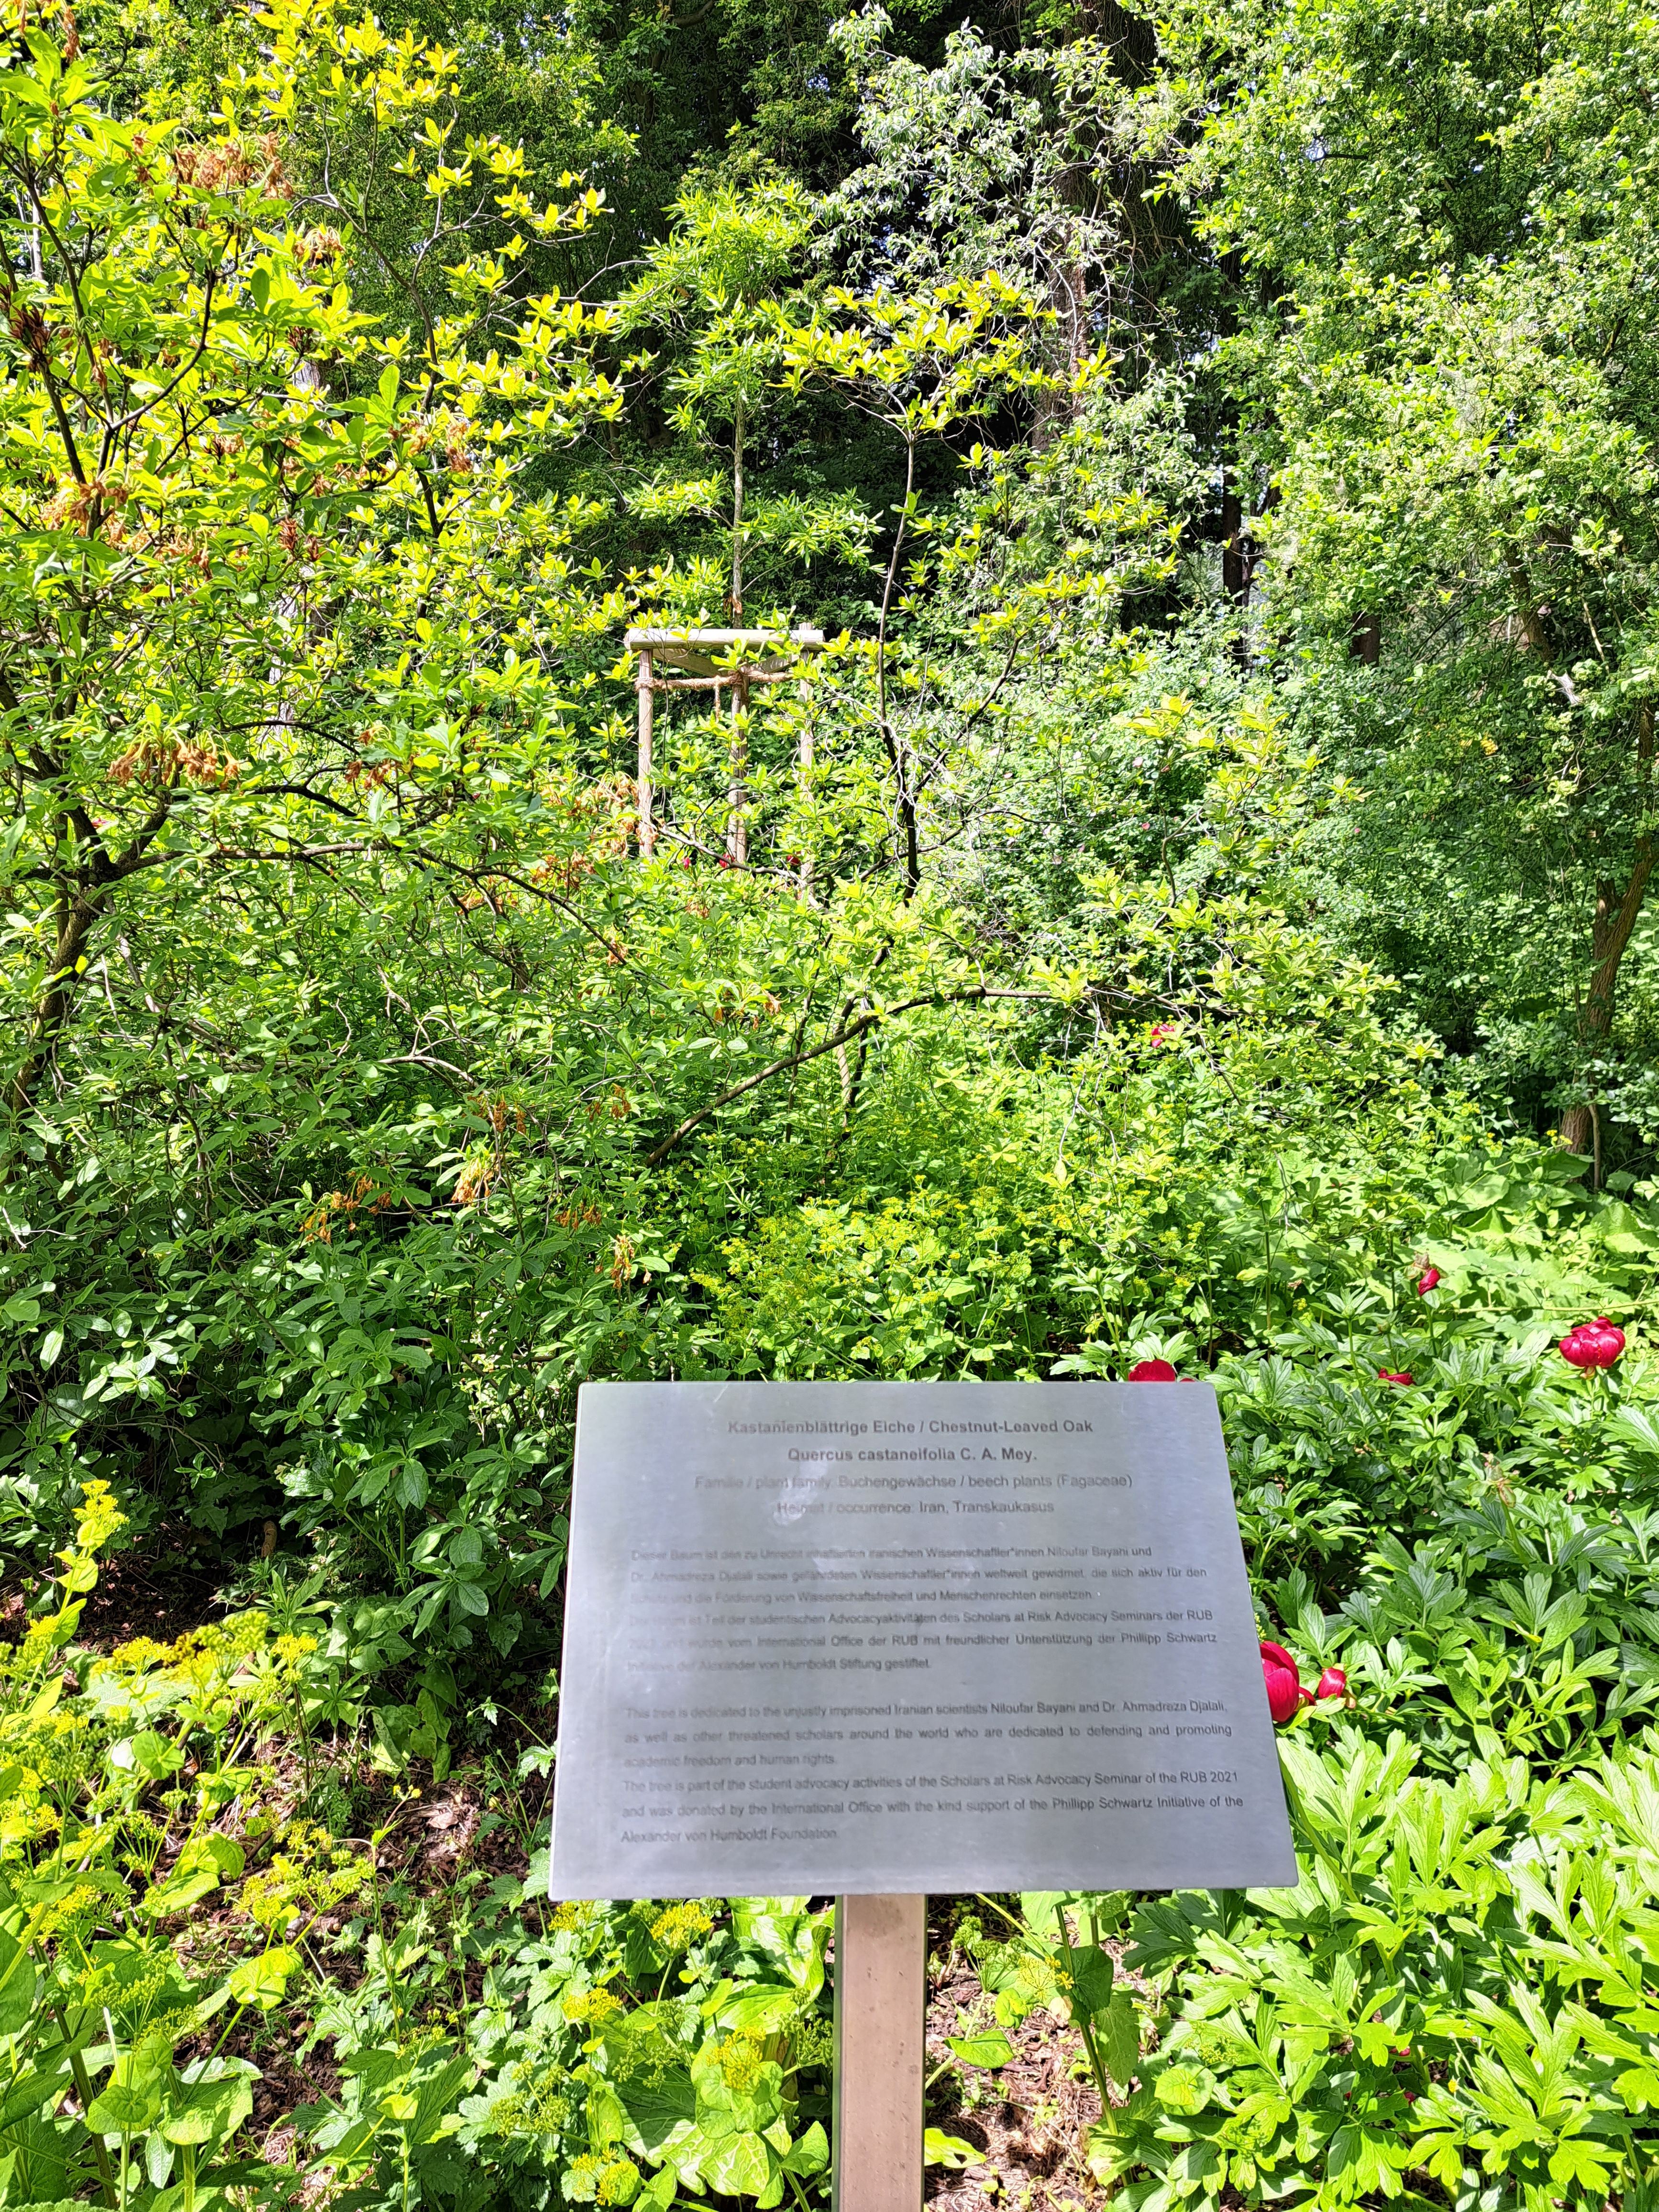

INTERNATIONAL NETWORKS
Threat Assessments, Matching Services
Scholars at Risk Advocacy Seminar
SAR Student Advocacy Days
Weekly Scholars´ Online Forum
Co-Led Online Seminars
Scholar Lectures Series
Annual Scholars´Conference
Publishing and Professional Support
Human Rights Advocacy
Academic Freedom as a Driver of Development? Regional Perspectives on the Roles of Academia

Slide 11









CREATING KNOWLEDGE NETWORKS: FROM LOCAL TO INTERNATIONAL
    EXPANDING & BROADENING SUPPORT FOR AND WITH AT RISK SCHOLARS
    GENERATING KNOWLEDGE TOGETHER
    KNOWLEDGE DIPLOMACY
    BUNDLING OF RESOURCES
    AMPLIFYING VOICES IN PUBLIC POLICY AND HUMAN RIGHTS ADVOCACY
    SHARING OF BEST PRACTICES

Slide 12
THANK YOU VERY MUCH!
Contact Iris Vernekohl | iris.vernekohl@rub.de

