Slide 1








EU Project SAFE – Background & status quo
Inspireurope+ Regional Outreach Workshop, 13.03.25
Stefanie Kottowski, Project Manager

Slide 2





Background
Declining academic freedom and multiple ongoing crises, very high demand for protection programmes
National existing initiatives for students and researchers at risk (e.g. Scholars at Risk, Philipp Schwartz Initiative, Hilde Domin Programme)
European initiatives advocating for European approach (Inspireurope & Inspireurope+), MSCA4Ukraine

Slide 3


Supporting at-risk researchers with fellowships in Europe (SAFE)
Donor: European Commission - European Research Executive Agency (REA)
Objective: To develop and test a suitable structure to select and fund researchers (PhD / Post-Doc)at risk at EU higher education and research institutions
Target groups:
  At risk researchers inside the EU
  At risk researchers in third countries
Consortium: DAAD, Campus France, Collège de France/PAUSE, UNIMED + associated partners
Budget: 12 Mio. EUR; up to 60 fellowships
Implementation Period: 36 months as of September 2024
Matchmaking: Open from mid-October – mid-December
Application by host institutions: Open from 18. November 2024 – 20. January 2025
https://saferesearchers.eu/

Slide 4
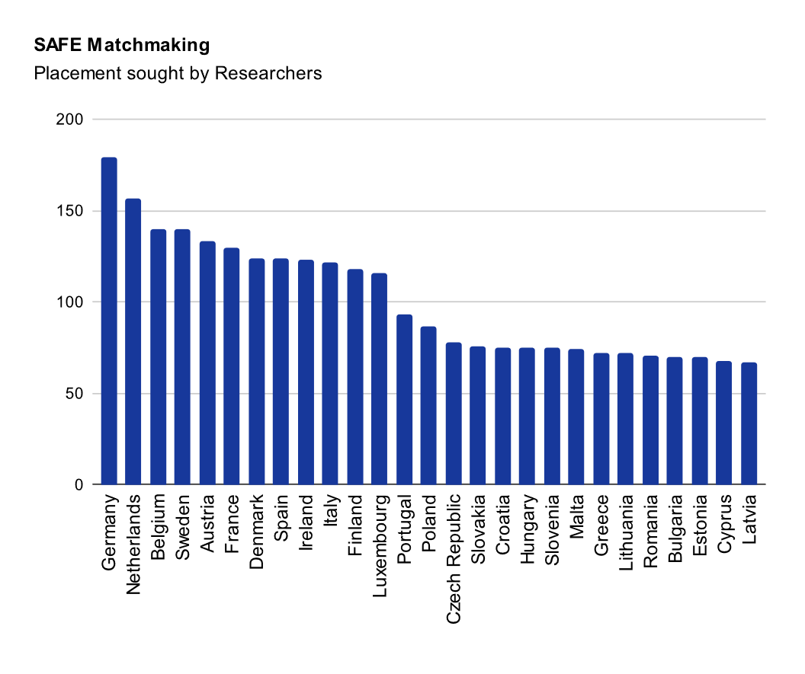
Status Quo
WP 4 – Matchmaking
61 Expressions of interest host institutions
226 Expressions of interest from researchers
  54 PhD, 172 post-docs
  136 track 1 (outside the EU), 90 track 2 (inside the EU)
53 succesful matches

Slide 5
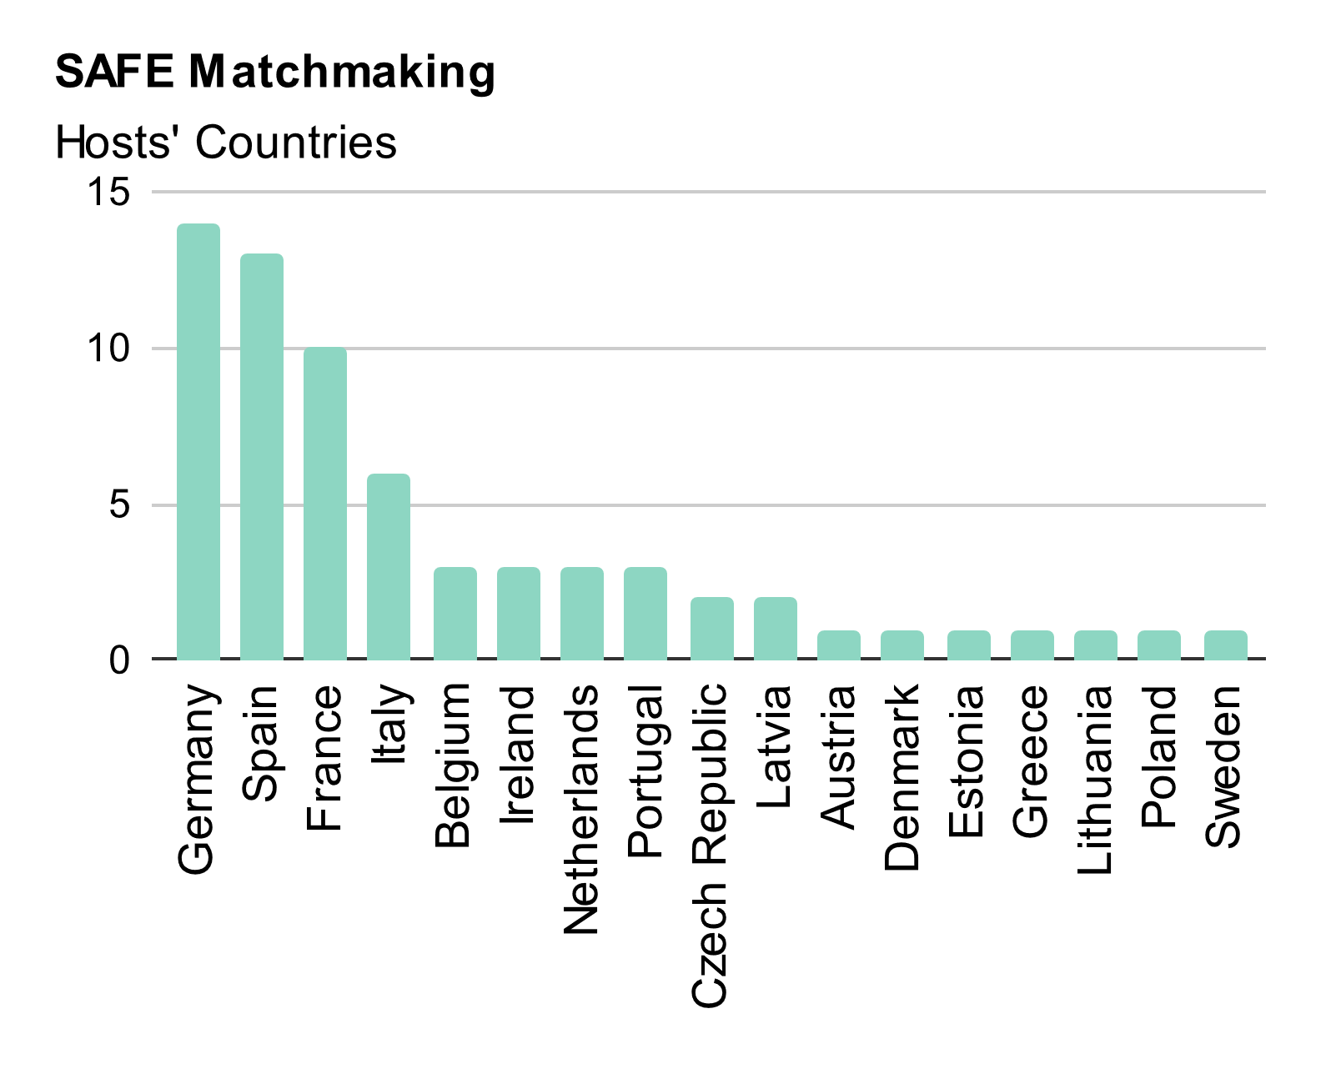
Status Quo
WP 4 – Matchmaking
Good response from host institutions willing to support at-risk researchers (61)
Successful connections between researchers and institutions
The process helped strengthen partnerships for future initiatives (beyond SAFE)
Notes:
Managing a short matchmaking window (2 months)
Ensuring researchers met eligibility criteria
Aligning expectations between researchers and host institutions
Handling a high volume of inquiries efficiently
Tracking the outcomes of matches

Slide 6


Status quo
WP 3 – Application & Selection
359 applications received
  283 applications are for postdocs and 76 for doctoral students.
  191 females, 164 male, 4 non-binary candidates
  88 track 1 (outside the EU), 271 track 2 (inside the EU)

Slide 7
Challenges
Outreach, especially to people outside Europe
Very high demand > managing expectations of the applicants and workload for the team
  One application per host institution
  Matching process before the application
Balancing selection criteria (risk / academic profile)
Long-term perspectives for the funded researchers
Future of the project after 2027

Slide 8

Contacts:
info.safe@daad.de - information on the call for applications
info.safe@uni-med.net - information on the matchmaking service
safe.pause@college-de-france.fr - information on policy recommendations
safe@campusfrance.org - other questions
www.saferesearchers.eu
#saferesearchers

